Slide 1
Non-Exhaust Emissions, Exposures, and Health Risks from Transportation
Rima Habre, ScD
Associate Professor
Division of Environmental Health & Spatial Sciences Institute
University of Southern California
habre@usc.edu
March 30, 2023
The Long and Winding Road: The Evolution of Mobility – Challenges and Opportunities, Vancouver, BC
Notes:
Abstract
Air pollution exposure is the largest environmental risk factor in the global burden of disease, with strong spatial patterning and systemic inequities leading to persistent environmental health disparities. Coupled with climate change and widening gaps in socioeconomic opportunity, these trends are expected to increase over time. While most studies have focused on individual outdoor, regulated criteria air pollutants, humans are exposed to mixtures from various sources with distinct physiochemical properties and toxicity profiles. Furthermore, human mobility, time-activity patterns, and indoor microenvironments contribute significantly to personal exposure and health risk yet are often ignored, introducing exposure measurement error. Advances in geospatial technologies, remote sensing, and personal monitoring have greatly increased our ability to assess highly personalized and source-specific exposures in context, within actual activity spaces, and understand their health effects. This talk will present an overview of these methods and applications from Dr. Habre’s research. The ultimate goal is to advance precision environmental health, design targeted interventions, and reduce health disparities.
Short Bio for Introduction
Dr. Rima Habre is an Associate Professor of Environmental Health and Spatial Sciences at the University of Southern California. Her research aims to understand the effects of co-occurring environmental exposures, air pollution mixtures and social stressors on the health of vulnerable populations across the life course. Dr. Habre co-chairs the Geospatial Working Group in the NIH ECHO Program and is also MPI and Project Lead in the ECHO and MADRES centers at USC, respectively, investigating the effects of neighborhoods, air pollution sources, and mixtures on maternal and child health disparities.

Slide 2
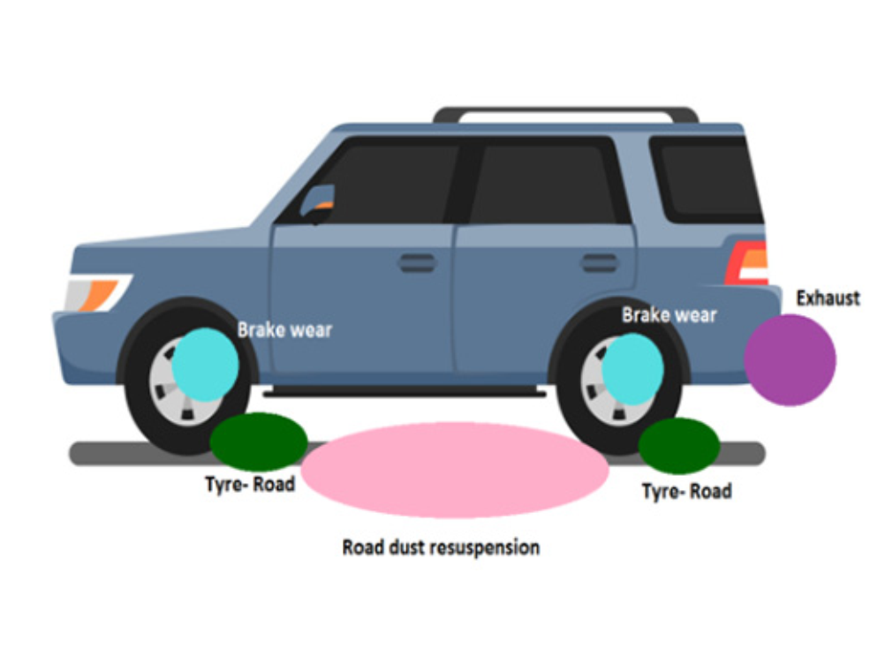
Non-Exhaust Emissions
Pollutants not emitted from combustion engine, but from wear or degradation of vehicle parts and road surfaces
Brake wear, tire wear, catalyst wear, road surface wear, road dust resuspension due to turbulence (usually a mix)
Mainly from friction, erosion, or mechanical abrasion, affected by thermal heat, vehicle weight, weather, driving conditions etc.
Mostly primary, also contribute to secondary particle formation
Emitted into air and dust, transported through ecosystem
Figure from Matthaios et al., STOTEN, 2022
OECD (2020), Non-exhaust Particulate Emissions from Road Transport: An Ignored Environmental Policy Challenge, OECD Publishing, Paris, https://doi.org/10.1787/4a4dc6ca-en.

Slide 3
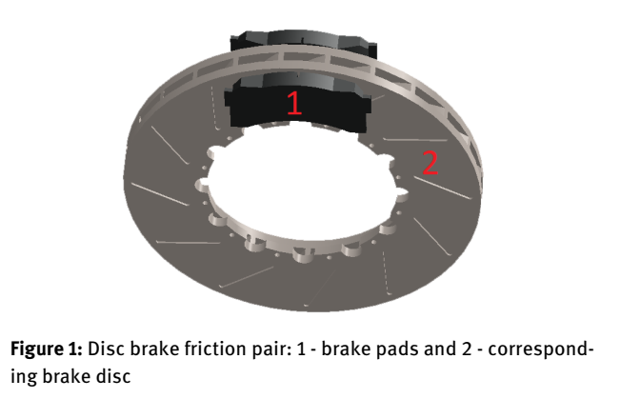
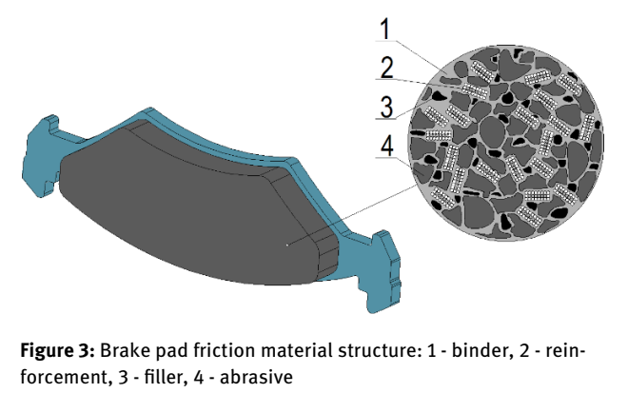
Non-Exhaust Emissions
Unregulated compared to exhaust emissions
Sometimes referred to as “non-tailpipe,” doesn’t quite apply for catalyst wear
Or “Abrasive Vehicular Emissions”
Materials evolving
Brake pads and discs (low-/semi-metallic, non-asbestos organic, ceramics, etc.)
Tires (fibers, natural/synthetic rubber, organics, microplastics, etc.)

Slide 4
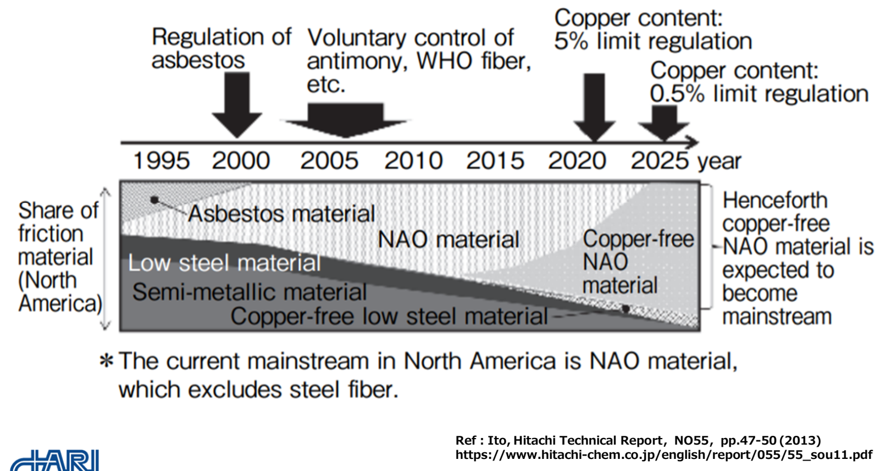
Regulatory Evolution of Brake Pad Composition in North America
Taken from Dr. Hiroyuki Hagino’s talk, HEI 2020 Virtual Workshop on Non-Tailpipe Particulate Matter Emissions and Exposure, retrieved from: https://www.healtheffects.org/sites/default/files/hagino-break-wear-particles-emissions.pdf

Slide 5
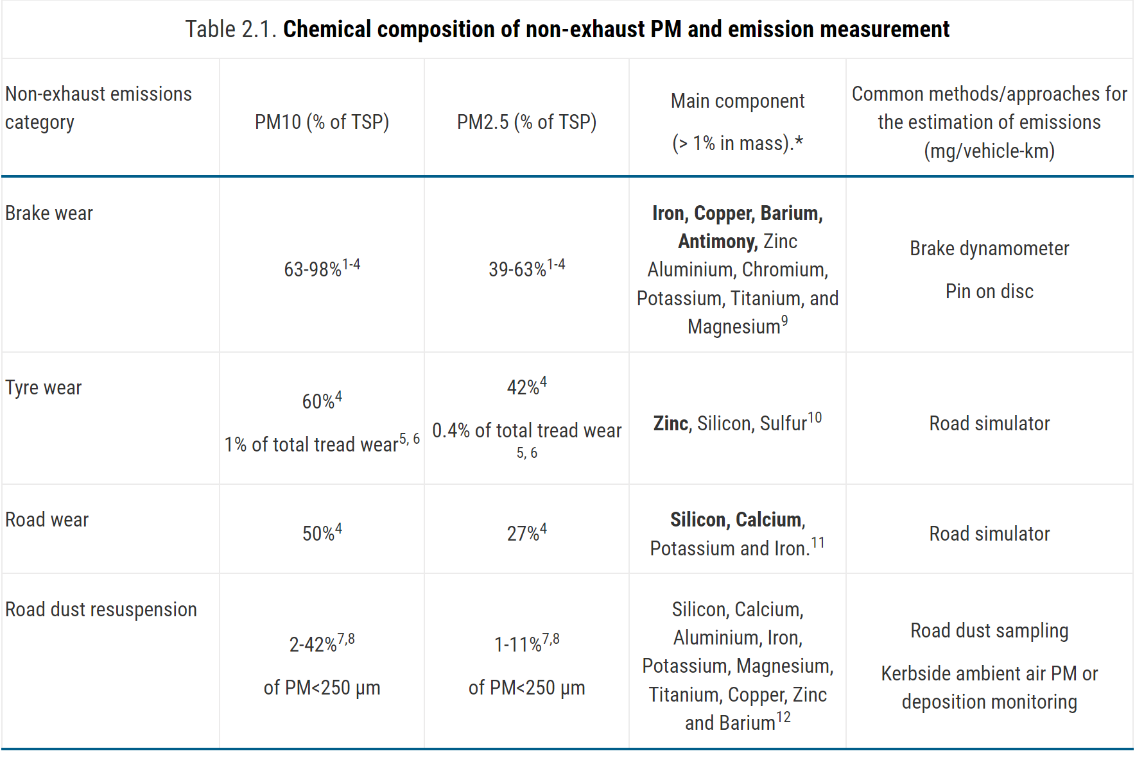
Chemical Composition and Source Tracers
OECD (2020), Non-exhaust Particulate Emissions from Road Transport: An Ignored Environmental Policy Challenge, OECD Publishing, Paris, https://doi.org/10.1787/4a4dc6ca-en.

Slide 6
Chemical Composition and Source Tracers

Slide 7
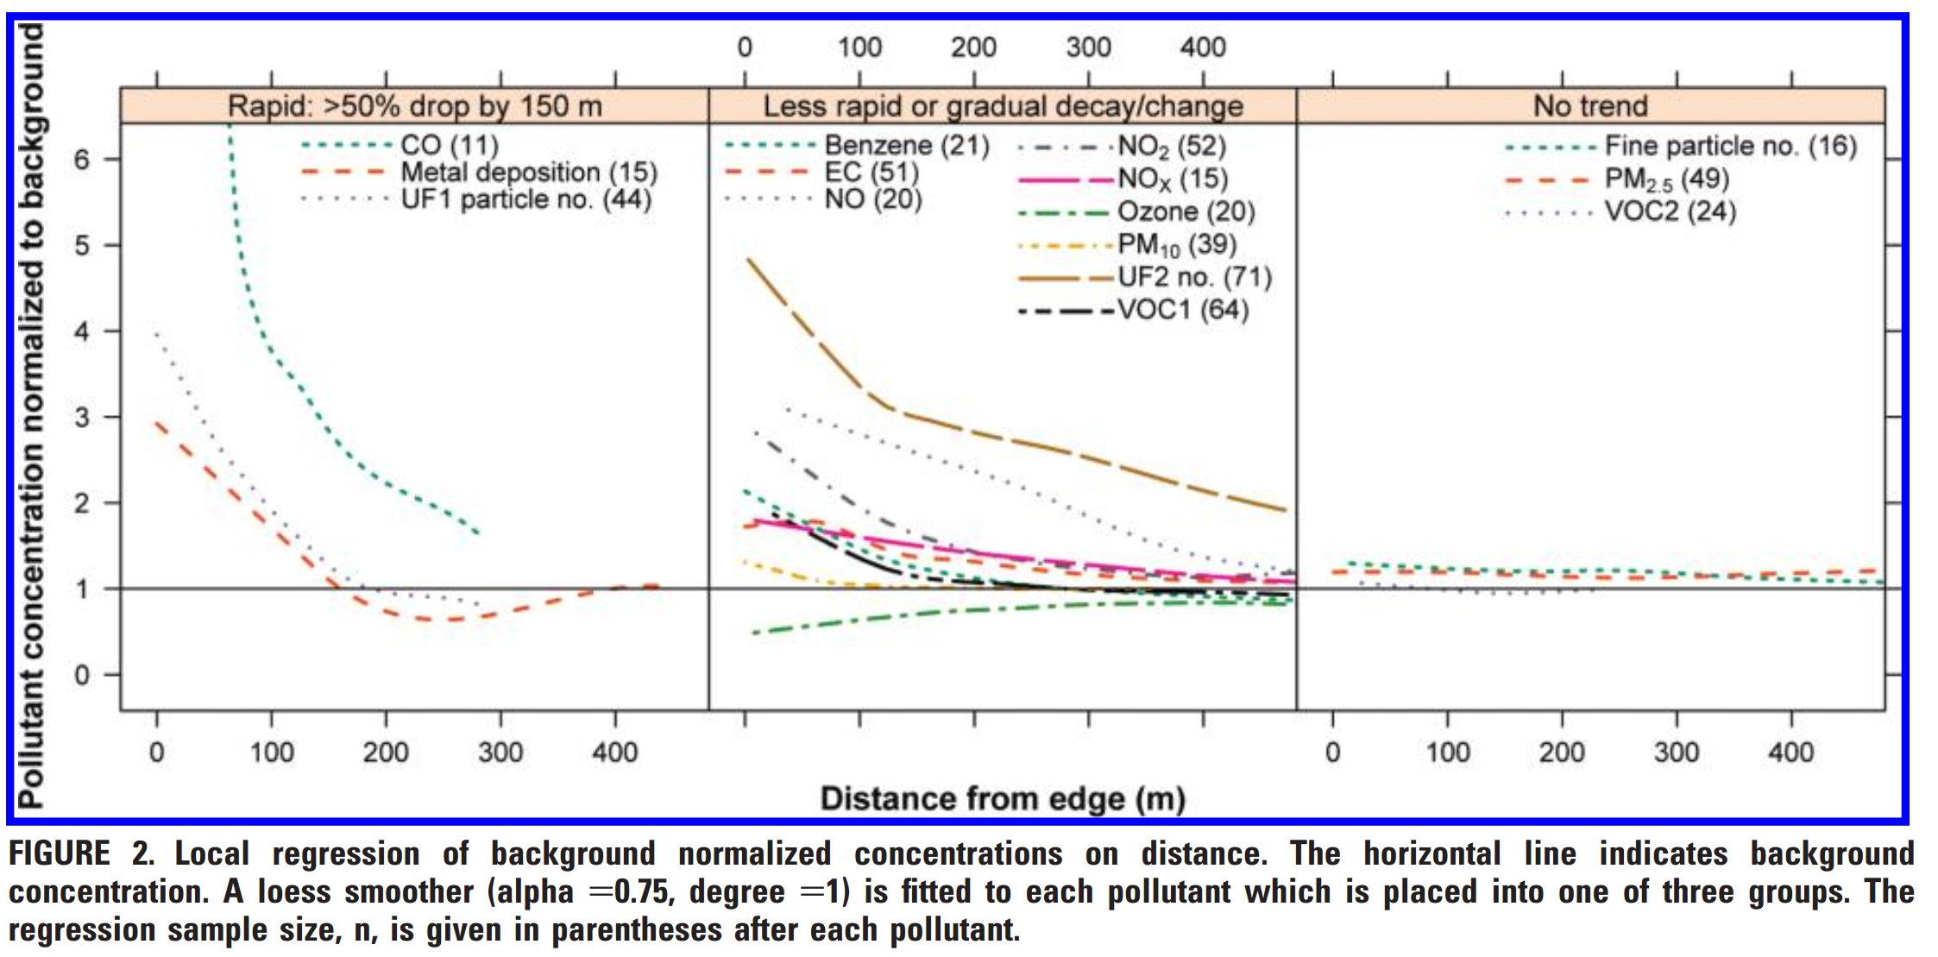
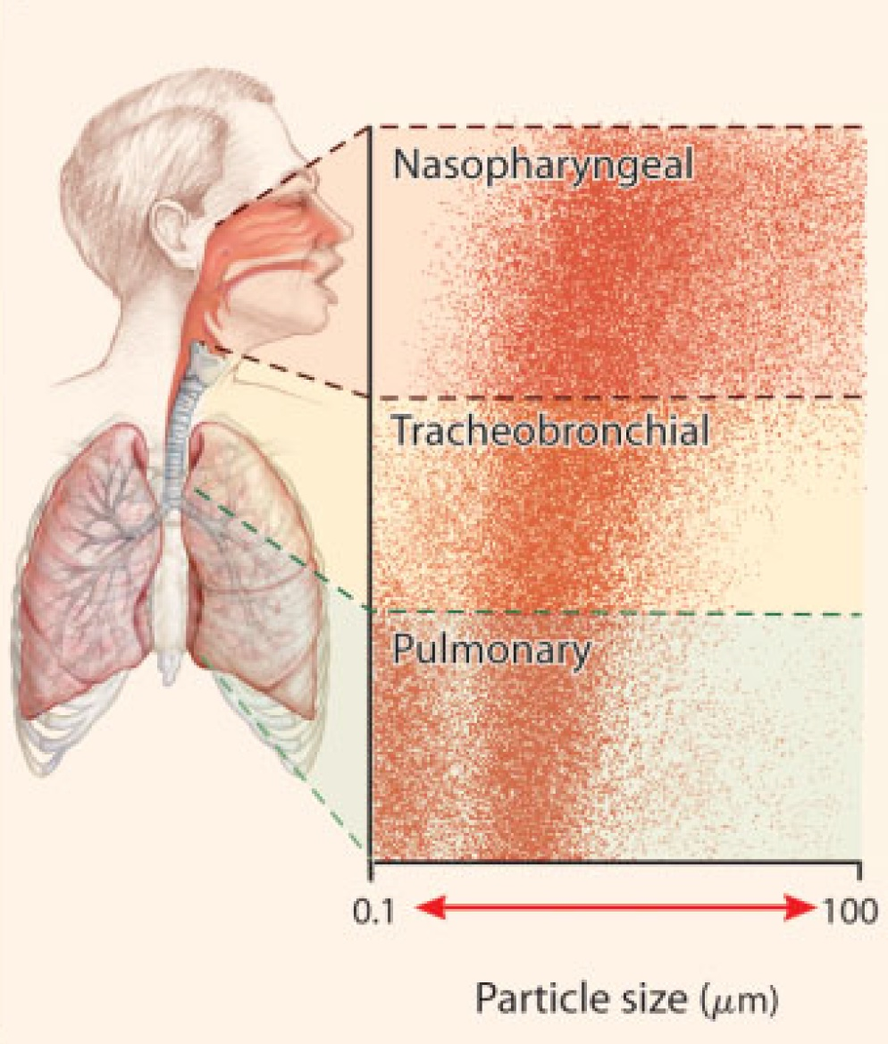
Non-Exhaust PM Size Distribution
Larger size fractions (coarse, PM₁₀)
Recent studies showing smaller size ranges too (UFP to PM_{2.5})
Why does this matter?
Residence time in air, fate and transport, spatial gradients
Inhalation exposure potential
Roy and Milton, 2004

Slide 8
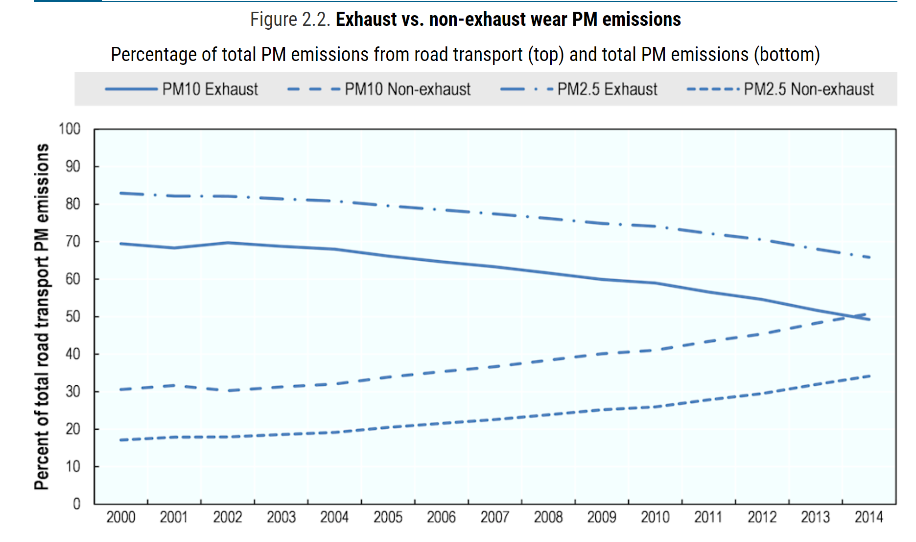
Trends
Studies in US and EU showing decreases in exhaust emissions but increases in non-exhaust emissions
Relative contribution of non-exhaust to total increasing
Newer materials, regenerative braking in hybrids and EVs ↓ brake wear, but cars heavier, VMT ↑
OECD (2020), Non-exhaust Particulate Emissions from Road Transport: An Ignored Environmental Policy Challenge, OECD Publishing, Paris, https://doi.org/10.1787/4a4dc6ca-en.

Slide 9
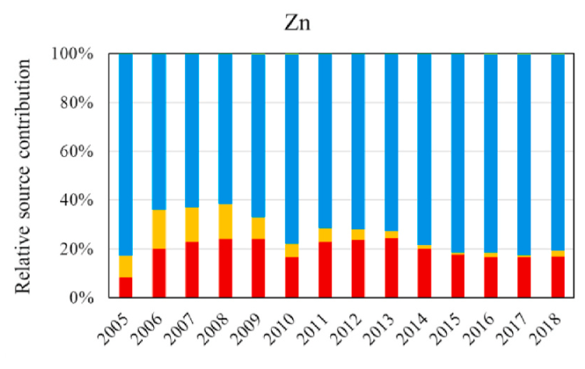
Trends
Relative contribution of tire wear source (blue) to Zn concentrations in Los Angeles, CA, 2005-2018
Farahani et al, Atm Env 2021
Combustion sources overall (incl. vehicular exhaust) ↓ 2005-2018
Road dust resuspension ↑ in LA 2013-2018

Slide 10
How Do We Assess Human Exposure?
Source(s)
Concentrations
Exposure Assessment
Exposure
Dose
Effect
Measurements and/or Models (e.g. LURs, CTMs, source apportionment models, etc.)
Body Boundary
Exhaust and Non-Exhaust Sources (Brake Wear, Tire Wear, etc.)
Overall Mixture and its Components

Slide 11
How Do We Assess Human Exposure?
Source(s)
Concentrations
Exposure Assessment
Exposure
Dose
Effect
Source apportionment models
Body Boundary
Source-oriented models
SOURCES
Receptor-oriented models
RECEPTORS

Slide 12
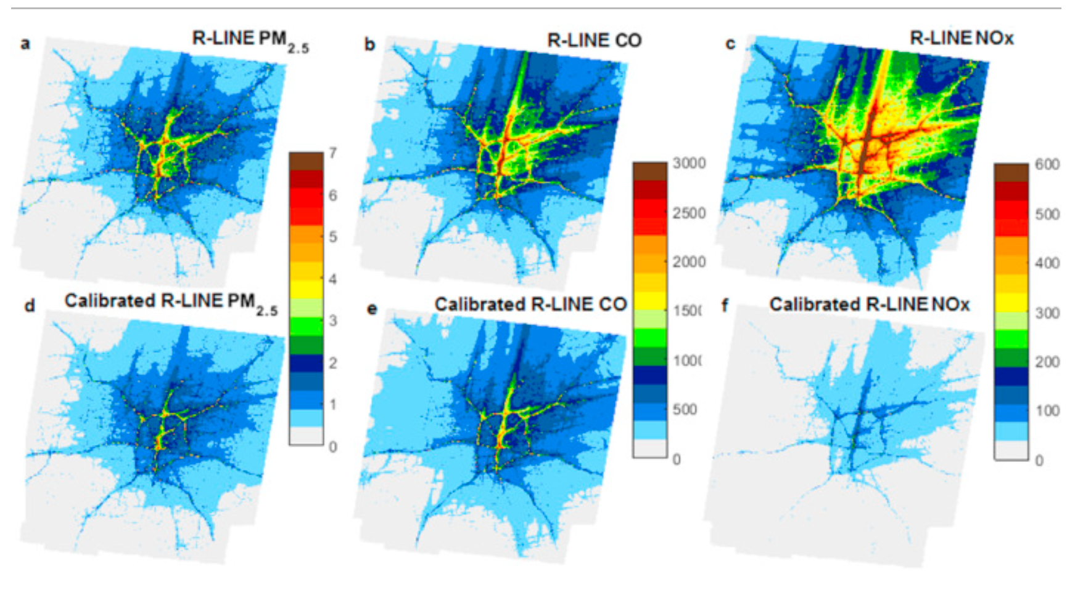
Source-Oriented Models Line source dispersion models
Physical dispersion (no chemistry)
eg, RLINE or CALINE4
Many inputs, highly space/time resolved.. incl. meteorology, emission factors
Challenges for epi
Spatiotemporal patterns for tailpipe and non-tailpipe pollutants generally highly correlated

Slide 13
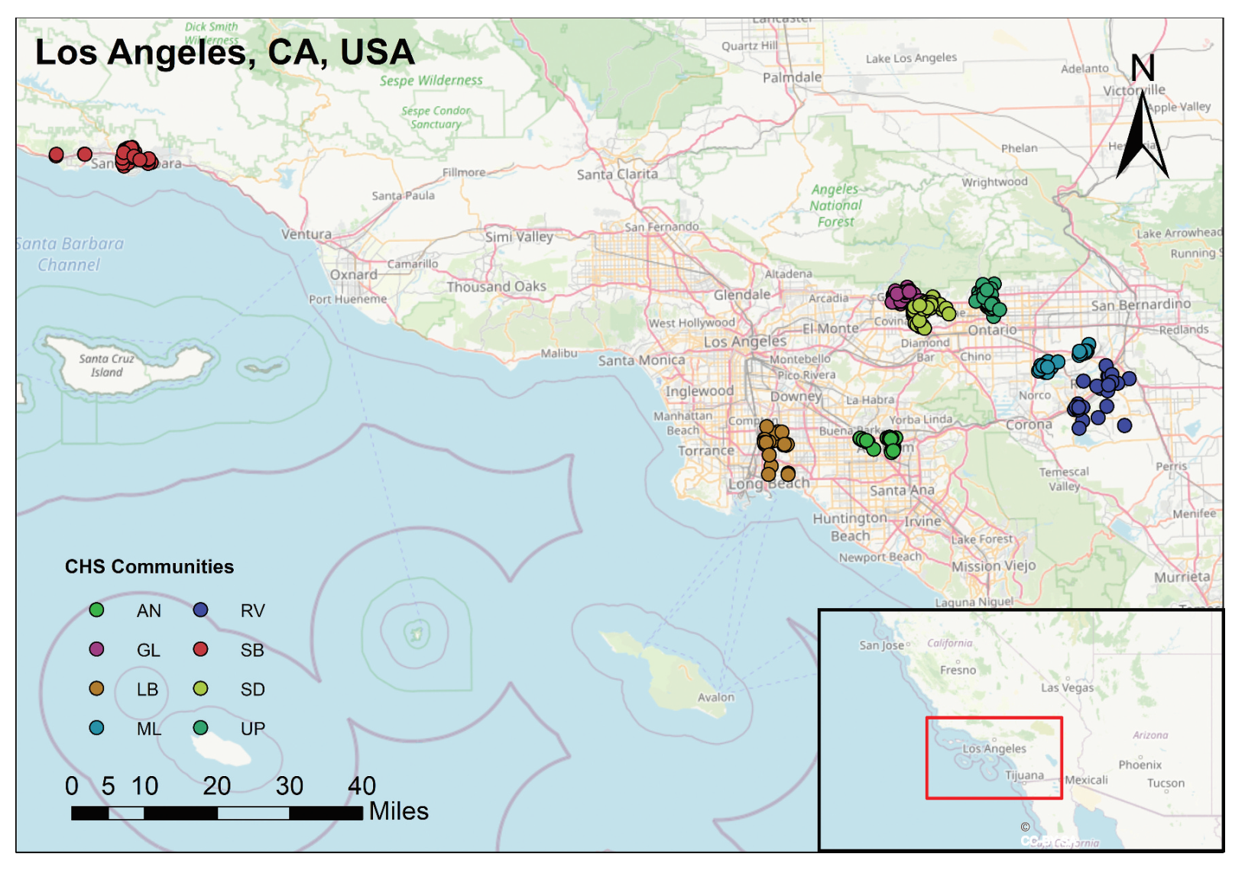
Receptor-Oriented Models Using outdoor community-based measurements
Speciated PM_{0.2}, PM_{2.5}, PM₁₀
8 CHS communities, 2008-9
Tailpipe and non-tailpipe traffic
Tailpipe EC, wsOC, isOC, B
Separate gasoline and diesel sources in PM_{2.5}
Non-tailpipe brake, tire, and catalyst wear signals Ba, Cu, Mo, Sb, Zn, Pt and Pd

Slide 14
Receptor-Oriented Models Using outdoor community-based measurements
Habre et al., JAWMA, 2021

Slide 15
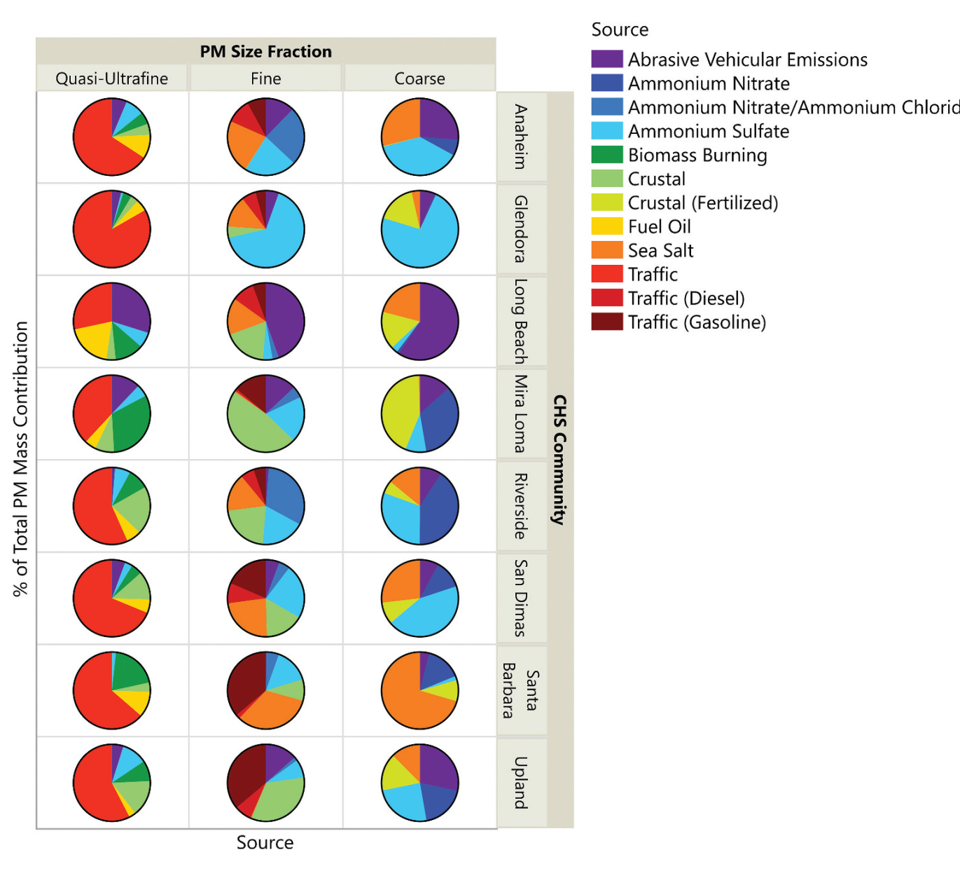
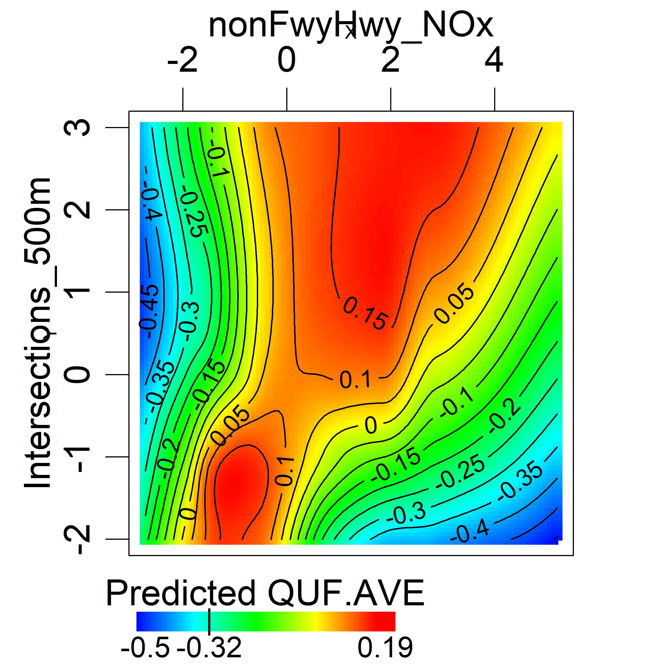
Abrasive Vehicular Emissions in PM_{0.2} (brake, tire, catalyst wear) ↑ when both intersections and non-FwyHwy NOx ↑, outside of LB and ports/trucks area

Slide 16
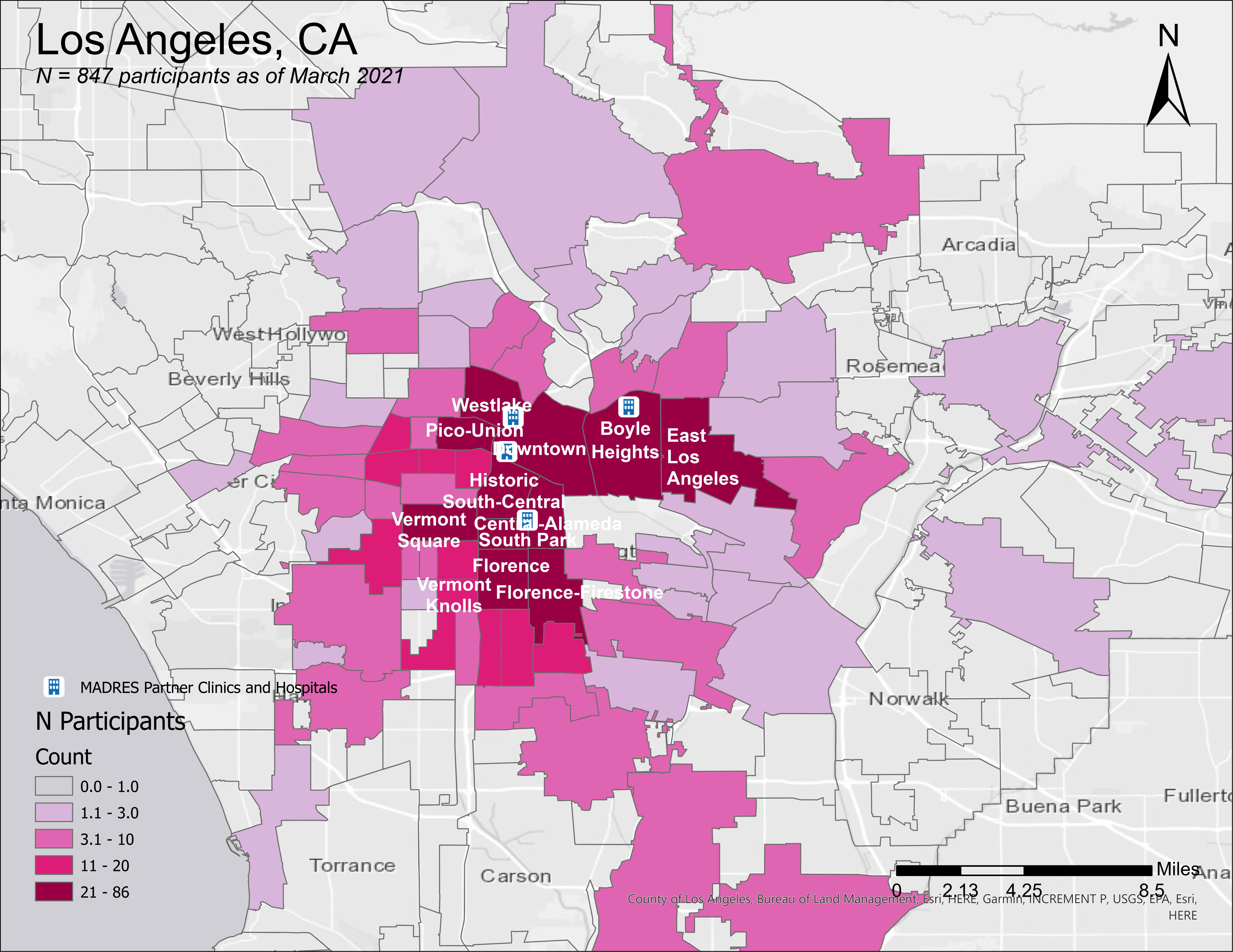
Receptor-Oriented Models Using personal monitoring
Story Map
Website
https://arcg.is/1y8KHn
www.madres.usc.edu

Slide 17
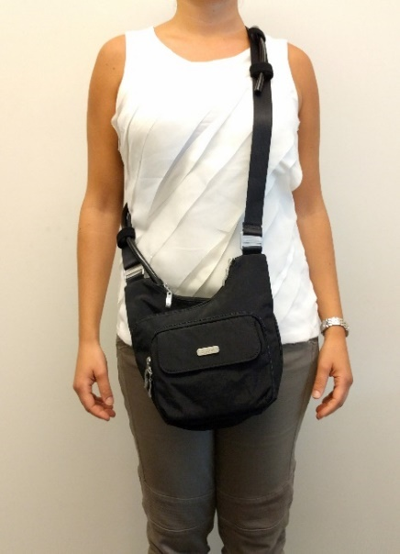
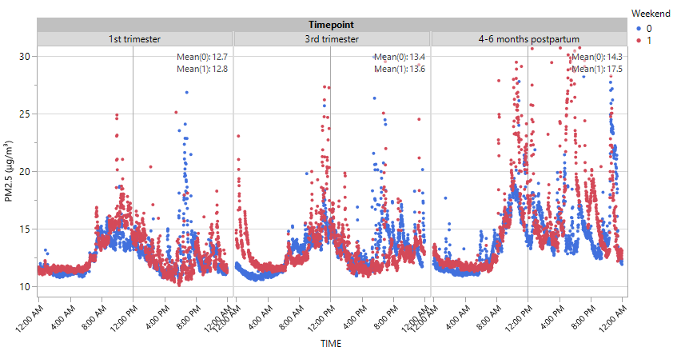
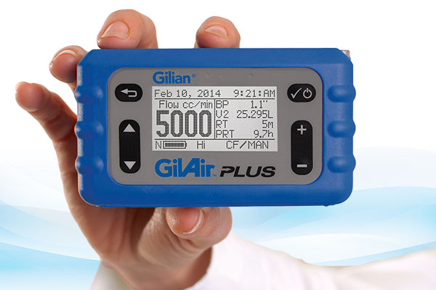
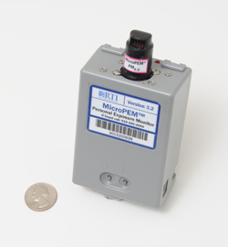
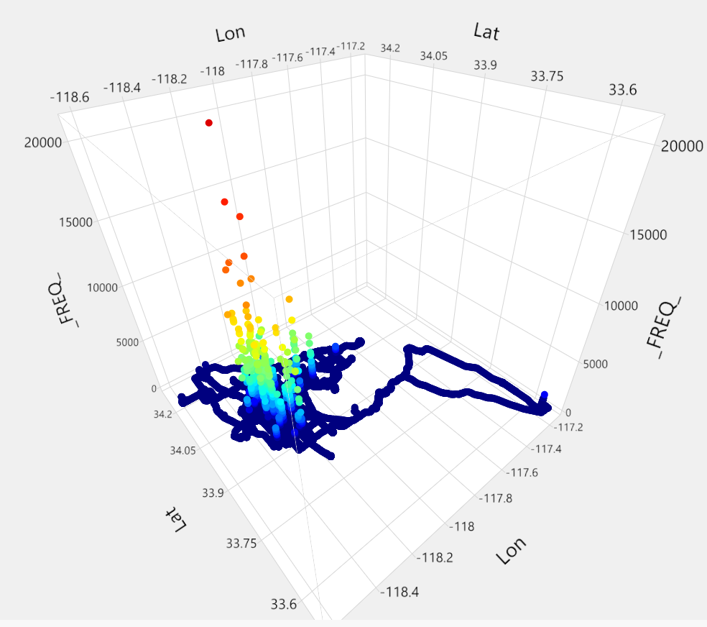
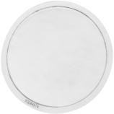
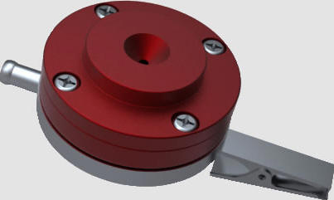
Personal Exposure Monitoring
Continuous and integrated methods, paired with GPS and EMA mobile surveys during pregnancy and early postpartum
RTI microPEM
Sensidyne GilAir Plus pumps
Teflon filters
Harvard PEMs
EMA
GPS and EMA apps

Slide 18
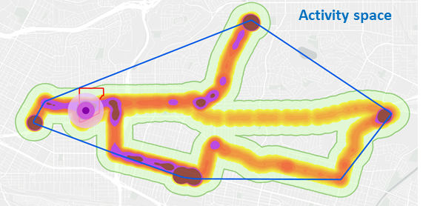
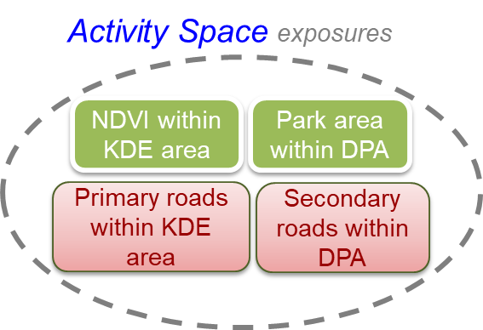
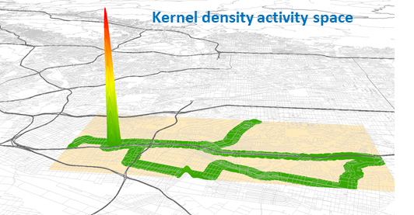
Activity Spaces and Personal PM_{2.5} Exposure
Yan Xu, PhD
Association with Personal PM_{2.5} Exposure
Xu Y et al., The Impact of GPS-derived Activity Spaces on Personal PM_{2.5} Exposures in the MADRES Cohort. Environment Research. 2022.

Slide 19
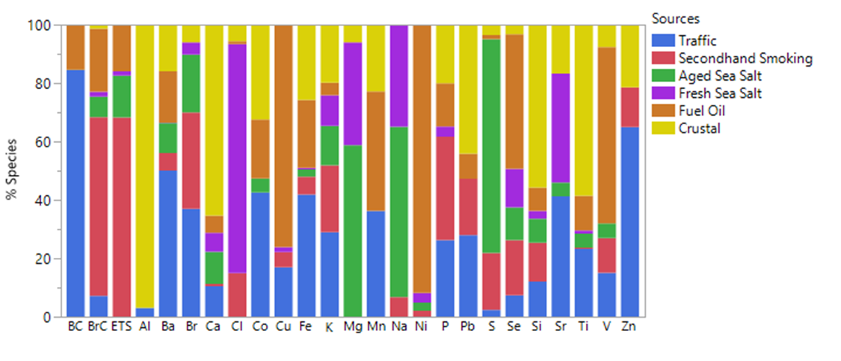
Sources of Personal PM_{2.5} Exposure
Yan Xu, PhD
Sources | Average mass contribution (μg/m³) | Percent Contributions (%)
Secondhand Smoking | 11.7 | 64.2
Crustal | 2.3 | 12.6
Fuel Oil | 2.1 | 11.4
Aged Sea Salt | 0.9 | 4.8
Fresh Sea Salt | 0.8 | 4.5
Traffic | 0.4 | 2.4
Sources identified and characteristic species
Secondhand smoking (BrC, ETS, Br)
Crustal (Al, Ca, Si, Ti)
Fuel Oil (Ni, V)
Aged Sea Salt (Na, Mg, S)
Fresh Sea Salt (Cl, Na, Mg)
Traffic (BC, Ba, Zn)
Xu Y et al., Sources of Personal PM_{2.5} Exposure in the MADRES Pregnancy Cohort. JESEE. In Submission.

Slide 20
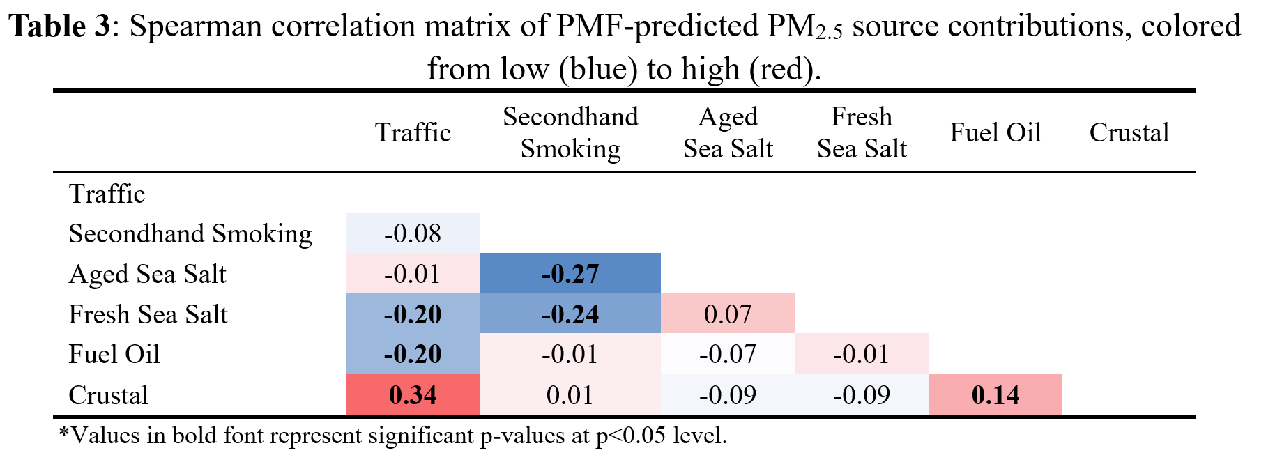
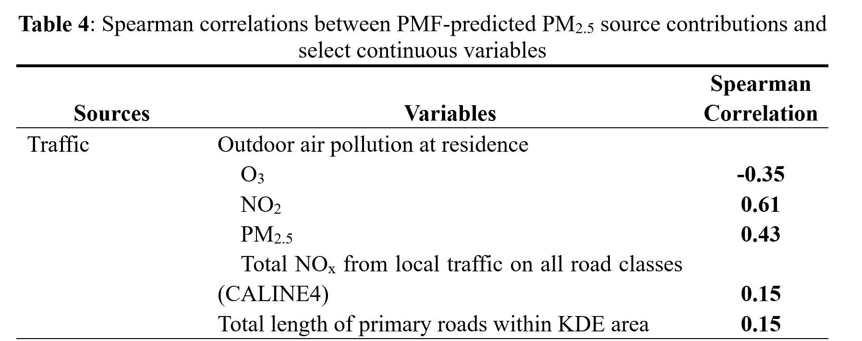
Traffic Source
Yan Xu, PhD
Xu Y et al., Sources of Personal PM_{2.5} Exposure in the MADRES Pregnancy Cohort. JESEE. In Submission.

Slide 21
Health Risks of Non-Exhaust Emissions
Very well-established epidemiological literature on traffic-related air pollution effects on respiratory and cardiovascular health, mortality, etc.
Mostly on exhaust, much less on non-exhaust exposures!
Very high source collinearity > hard to separate exhaust from non-exhaust effects
Toxicology pointing to negative effects
Inflammation, oxidative stress, perturbed immune responses, etc.
Expect what we already know about PM size considerations to apply
High-risk subpopulations
Living or working near major roads (homes, schools, low-income housing)
Commuters and occupational groups (drivers, heavy-duty equipment operators)
Existing health vulnerability (elderly, immunocompromised, pregnancy, infants, etc.)
Disproportionately impacted EJ communities (eg, warehousing, freight, goods movement corridors, etc.)

Slide 22
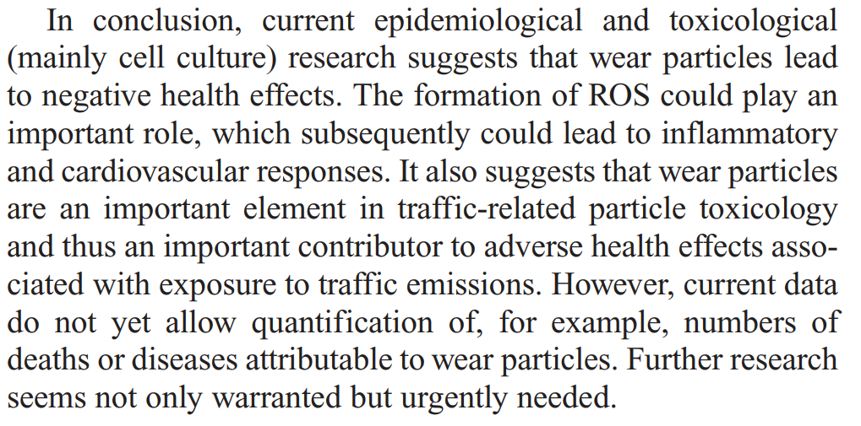
Challenges in Assessing Health Risks

Slide 23
Conclusions
↑ non-exhaust emissions and contributions
Important EJ concerns
Quickly evolving materials, technologies, and fleet
Hybrids/EVs, regenerative braking, LDVs and HDVs
Material science question?
Learning a lot from toxicology studies
Harder to capture real-world conditions
Great improvements in hybrid modeling approaches and well-known (but not always unique) tracers
Source collinearity still a great challenge for epi!
Notes:
Personal exposure to air pollution and other environmental risk factors is highly variable in space and time and depends on human time-activity and mobility patterns, behaviors, indoor and outdoor sources. Especially in large population studies, personal exposure to air pollution is often approximated by static, outdoor residential concentrations predicted with varying degrees of spatiotemporal resolution and accuracy. This talk will demonstrate how advances in personal monitoring and geospatial technologies are allowing researchers to assess highly personalized and spatiotemporally resolved exposures within actual activity spaces to inform precision environmental health. These advances ultimately lead to a better understanding of contextual effects, temporality, and important microenvironments driving adverse exposures and health effects. They also significantly reduce exposure measurement error and amplify statistical power to detect relevant exposure-health associations.

Slide 24
Thank You
Funding
LA DREAMERs ECHO Center, NIH UH3OD023287 (Breton, Bastain, Farzan, Habre)
MADRES Center, NIMHD/NIEHS P50ES026086, NIMHD P50MD015705, EPA RD-83615801 (Breton and Bastain)
Southern California Environmental Health Sciences Center, NIEHS P30ES007048 (Habre pilot)
CTSI UL1TR001855 pilot (Habre and Mason)
NIEHS R01ES027409 (Breton)
Contact Rima Habre, ScD habre@usc.edu
@RimaHabre_ScD
@MadresCenter
@USCEnviroHealth
@USC_SSI

Slide 25
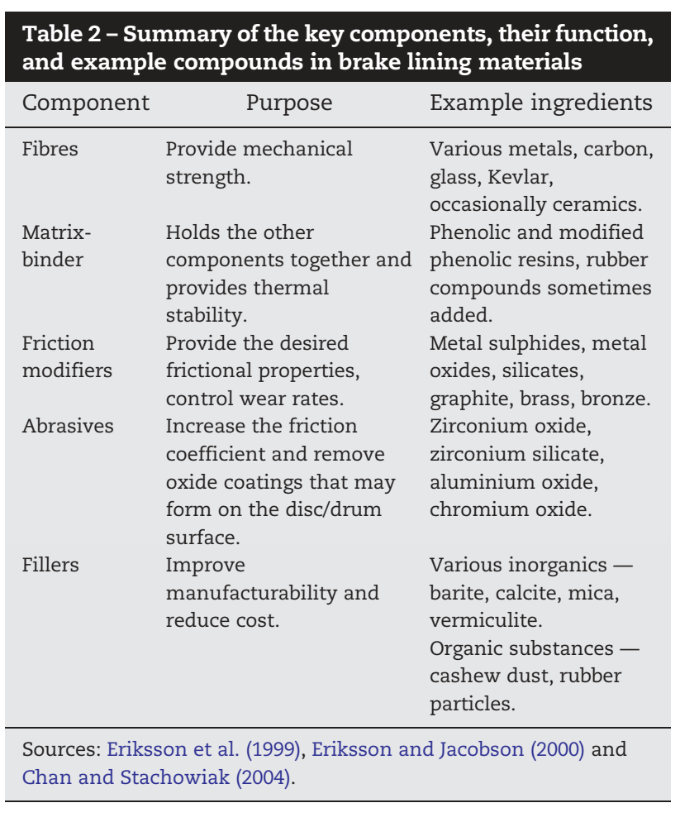
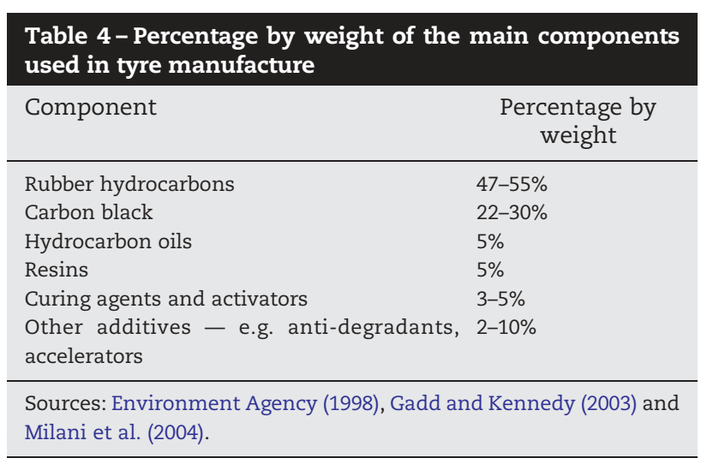
Materials in Brake Linings and Tires
e.g., 6PDD-quinone compound in tire wear known ecotoxicant (coho salmon)

Slide 26
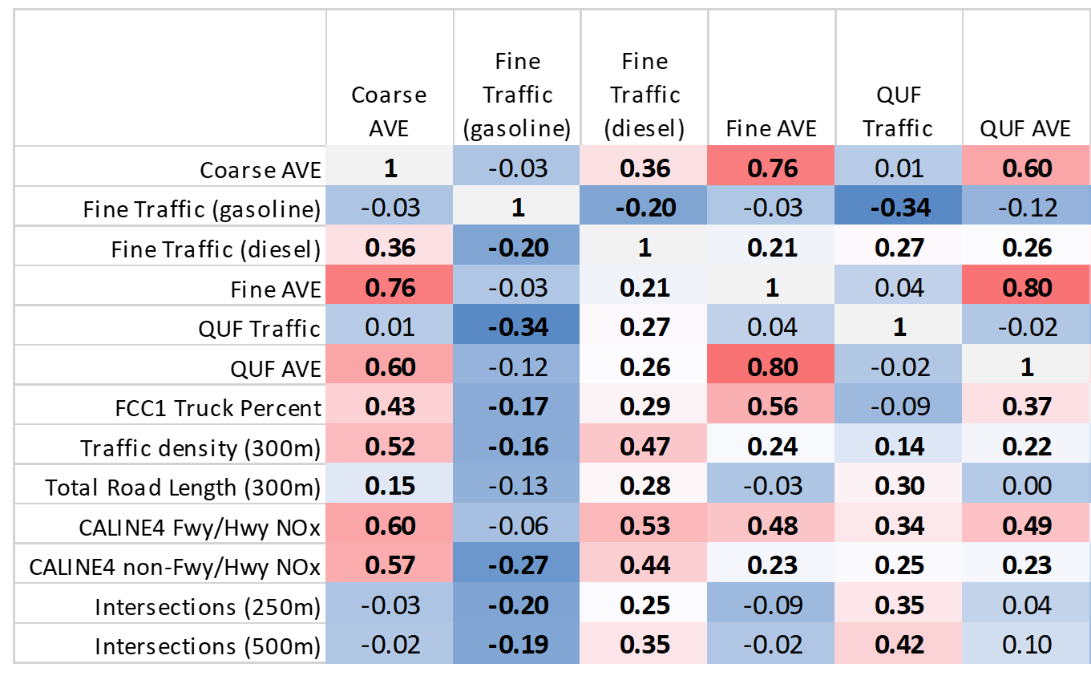
Receptor-Oriented Models Using outdoor community-based measurements
Spearman Correlations, excluding LB data
Habre et al., JAWMA, 2021

Slide 27
Guiding Questions
Aside from exhaust, what are other sources of air pollution from motor vehicles?
How do non-exhaust emissions differ from exhaust emissions?
What do we know about the population health impacts of non-exhaust emissions? Are there specific at-risk groups?
What measures are available to us to help reduce these types of emissions?

Slide 28
Outline
Non-exhaust vs exhaust emissions from motor vehicles
Key characteristics
Sources (brake, tire, road surface wear, road dust)
Chemistry, size distribution, spatial gradients, temporal profiles, trends
Exposure assessment approaches and challenges
Modeling (LURs, etc.)
Source apportionment (line source dispersion models, receptor models)
ICV2 analysis, others
Measurements of concentrations vs exposures
Ambient vs near-road vs on-road
Outdoor, indoor, personal
Challenges with source collinearity – what does this mean for epi?
Population health impacts
What do we know from tox or epi studies
Specific at-risk groups
Emissions reduction strategies
Reformulated materials (tire pads/discs, road surfaces, etc.)
Street washing/cleaning – not very effective
Hybrid/EV fleet changes, regenerative braking, and expected future trends
Real-world conditions?

