Slide 1




Unpacking the Chemical and Meteorological Profiles of Road Dust in Prince George: Implications for Climate Change Impacts in BC
Eric Coker, PHD, MS
Senior Scientist, BCCDC, Environmental Health Services
Adjunct Professor, UBC

Slide 2
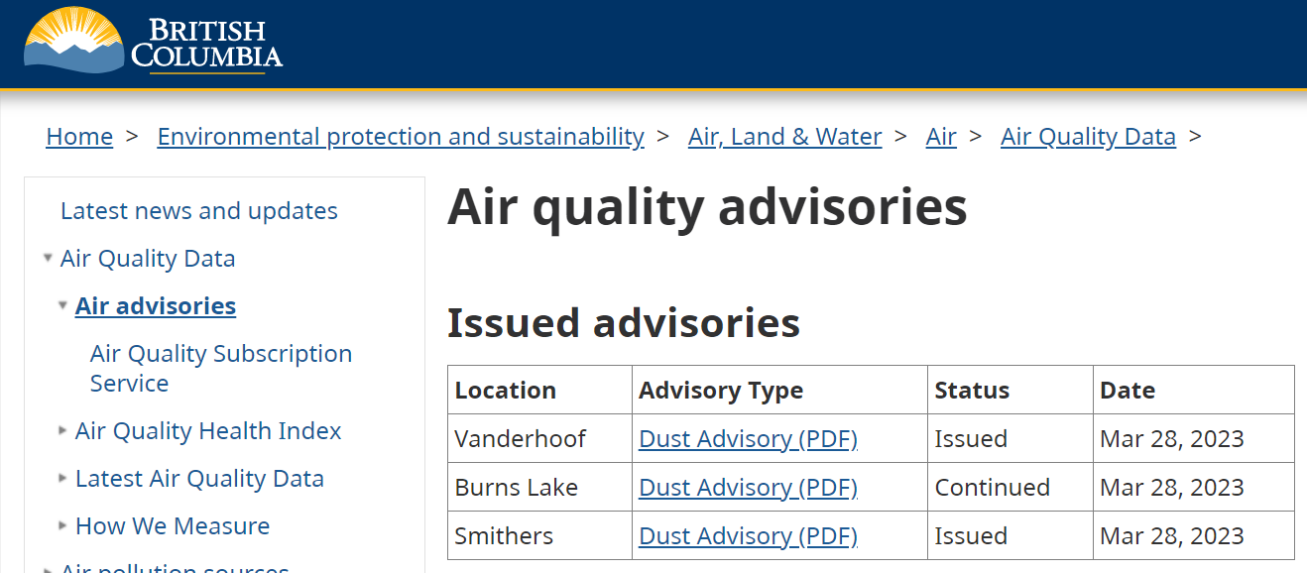

Slide 3
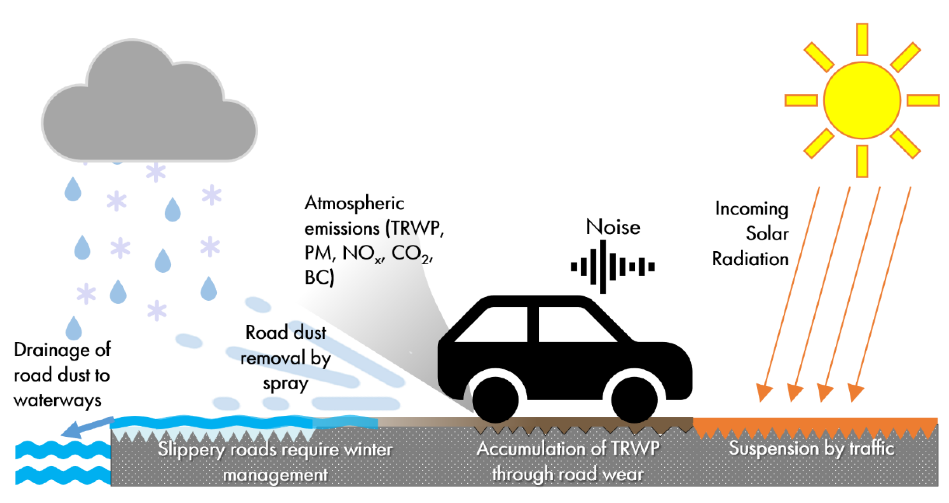
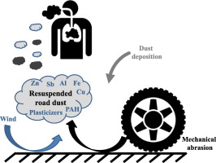
Road Dust
Airborne earthen material or dirt
Composition
Coarse particulate matter (PM_{10-2.5})
Complex mixture of man-made and naturally-occurring pollutants
Road traction material (e.g., sand and salt), wear of road surfaces, brakes, and tires
Source of microplastics (tires/bitumen asphalt)
Friction of tires moving on unpaved dirt roads and dust-covered paved roads
Complex interplay between the road surface, traffic, and meteorological conditions

Slide 4

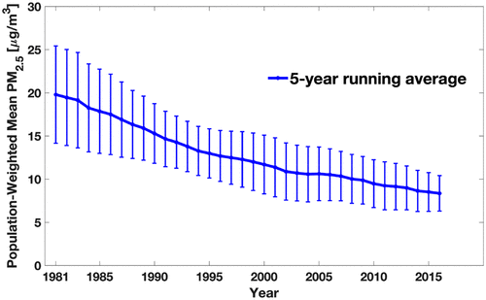
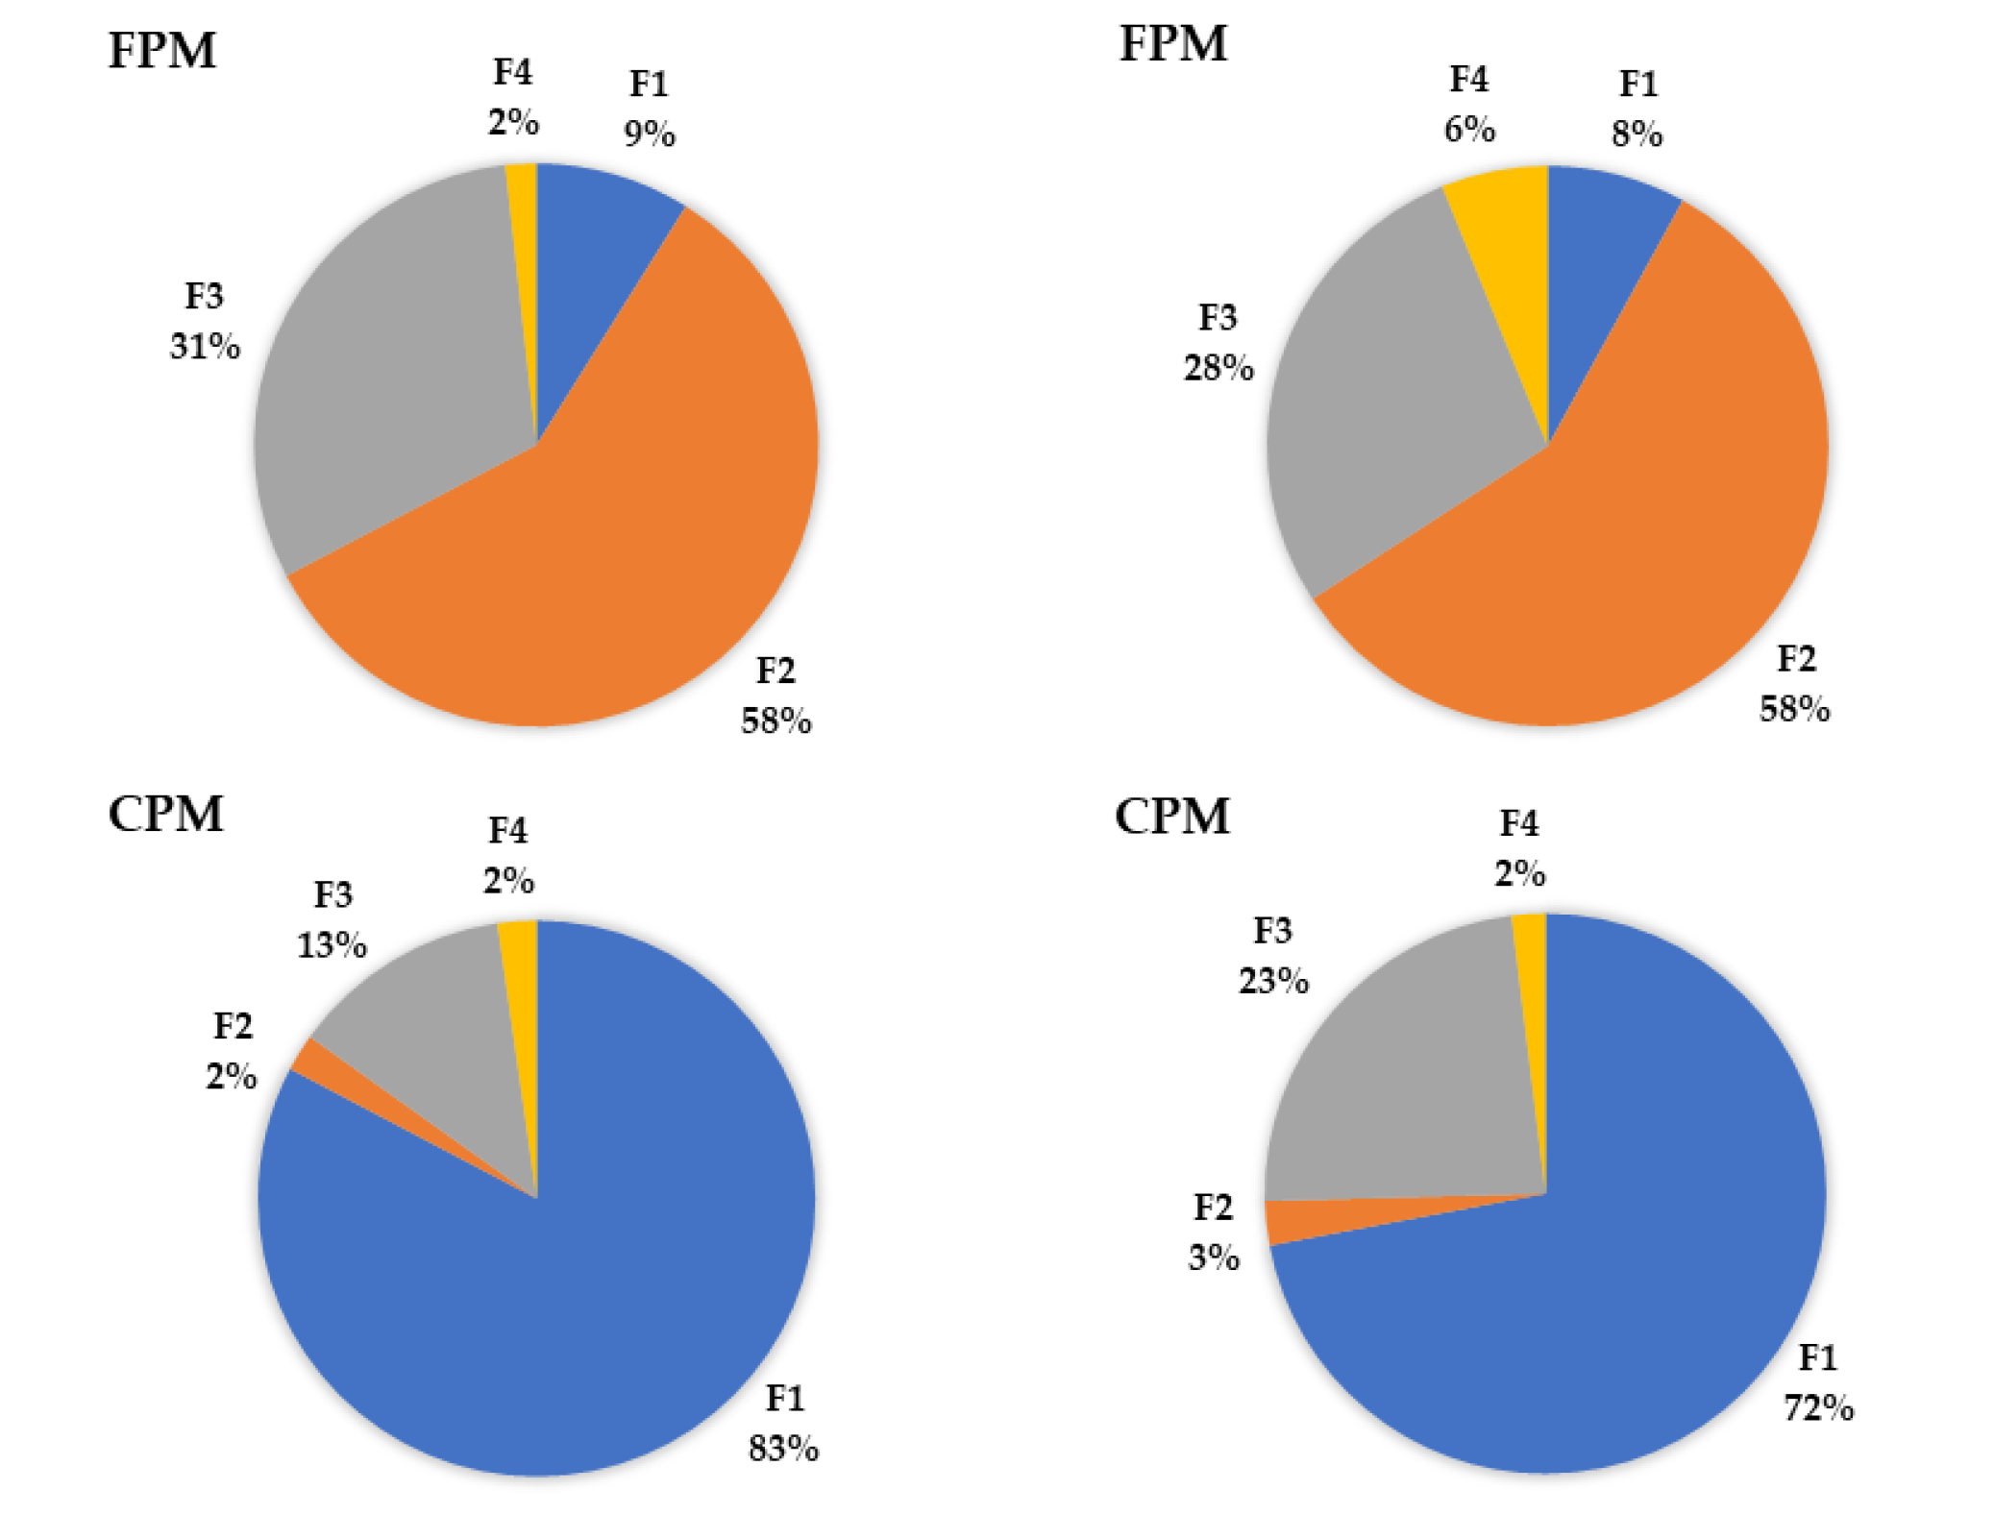
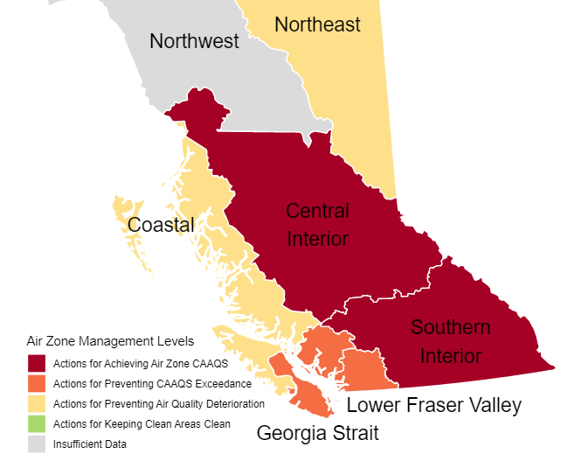
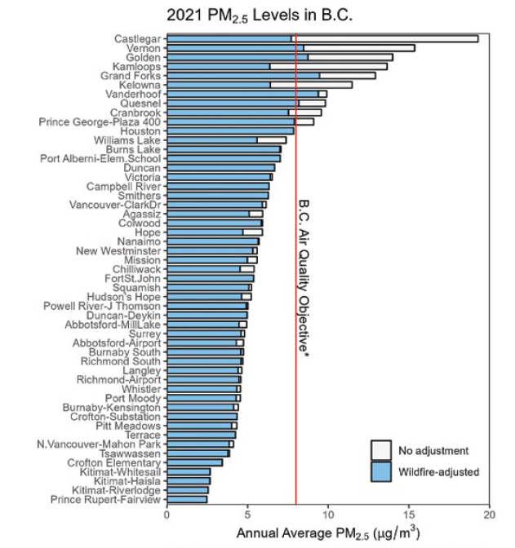
The Growing Importance of Coarse PM Fraction (PM10-2.5) & Road Dust
North America
Meng, J et al. (2019)
Toronto
Vancouver
PM2.5
PM2.5
PM10-2.5
PM10-2.5
F1 = Mineral/Road Dust
F2 = Regional/Local Industry
F3 = Brake/Tire Wear
F4 = Unexplained
Celo, V et al. (2021)

Slide 5
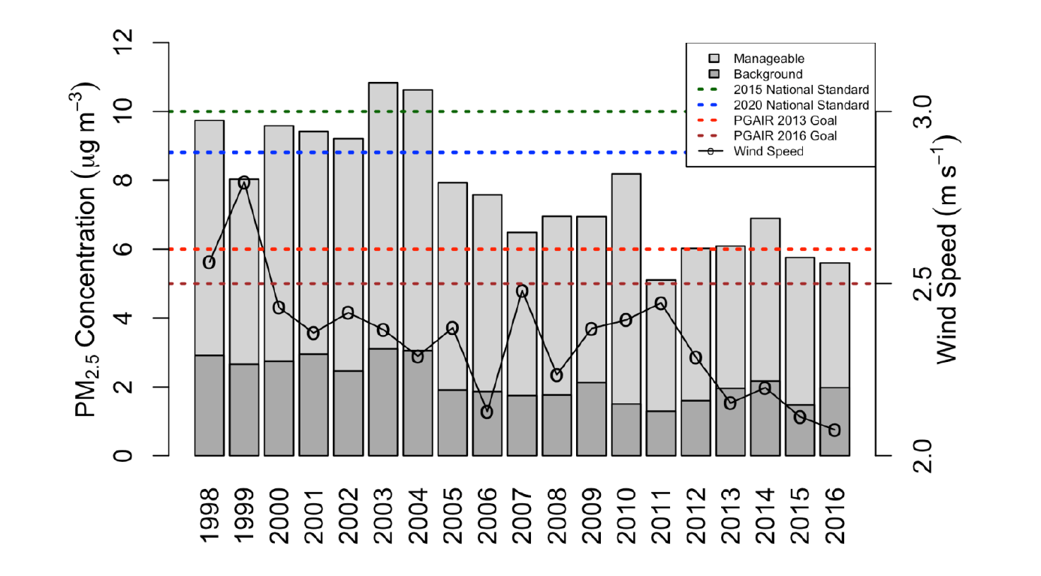
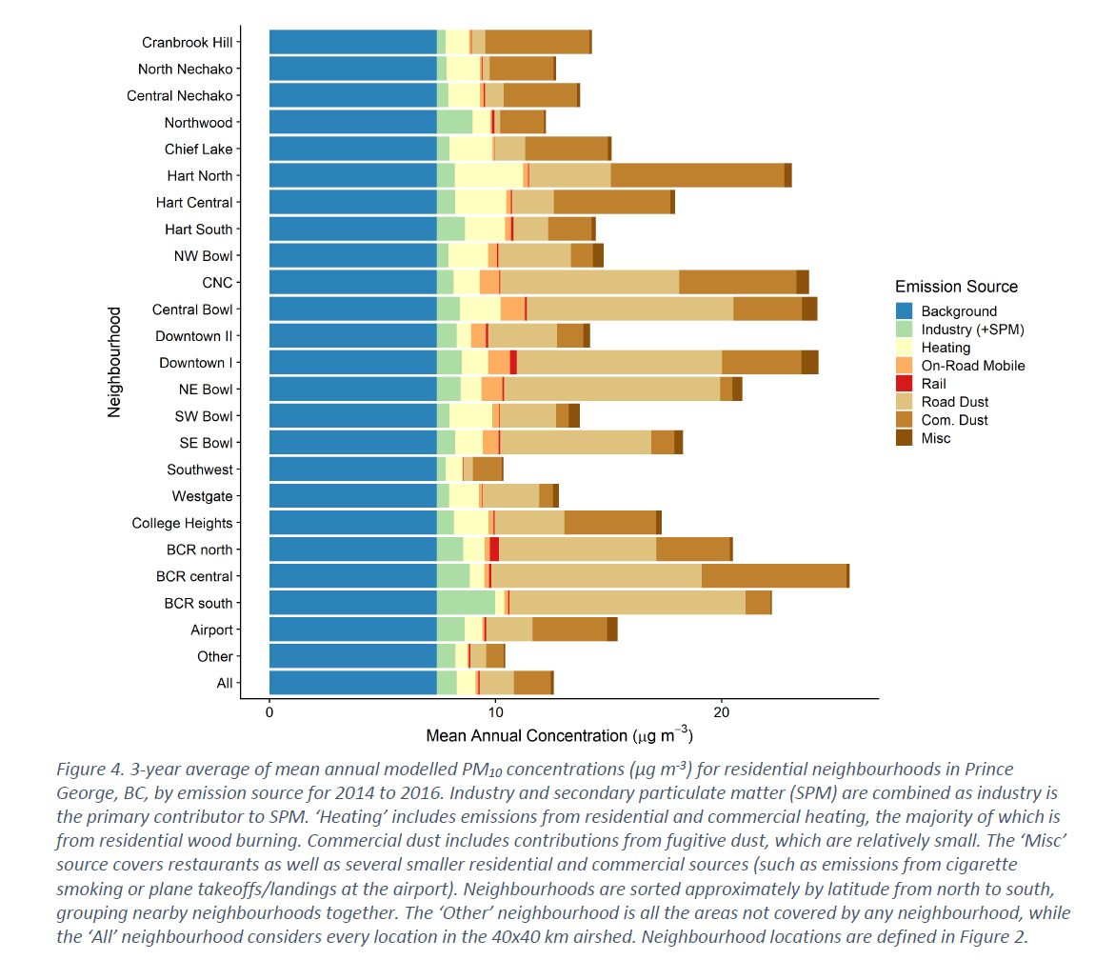
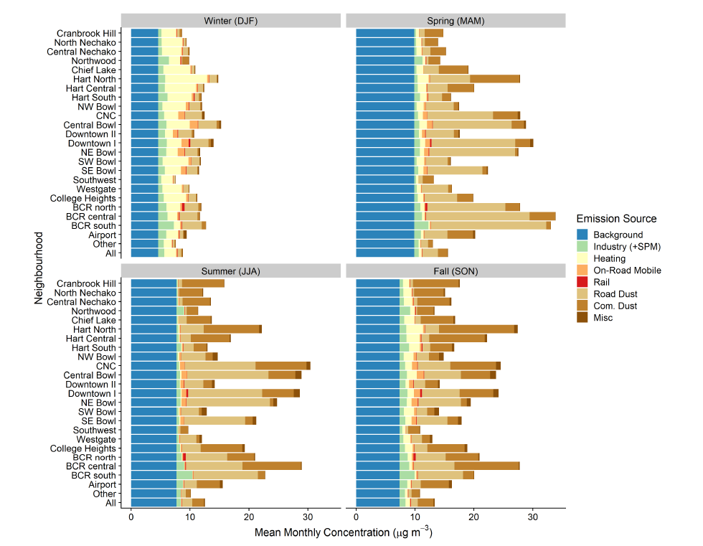
Context of PM2.5 and PM10 in Prince George, BC
*Wildfire impacts excluded

Slide 6

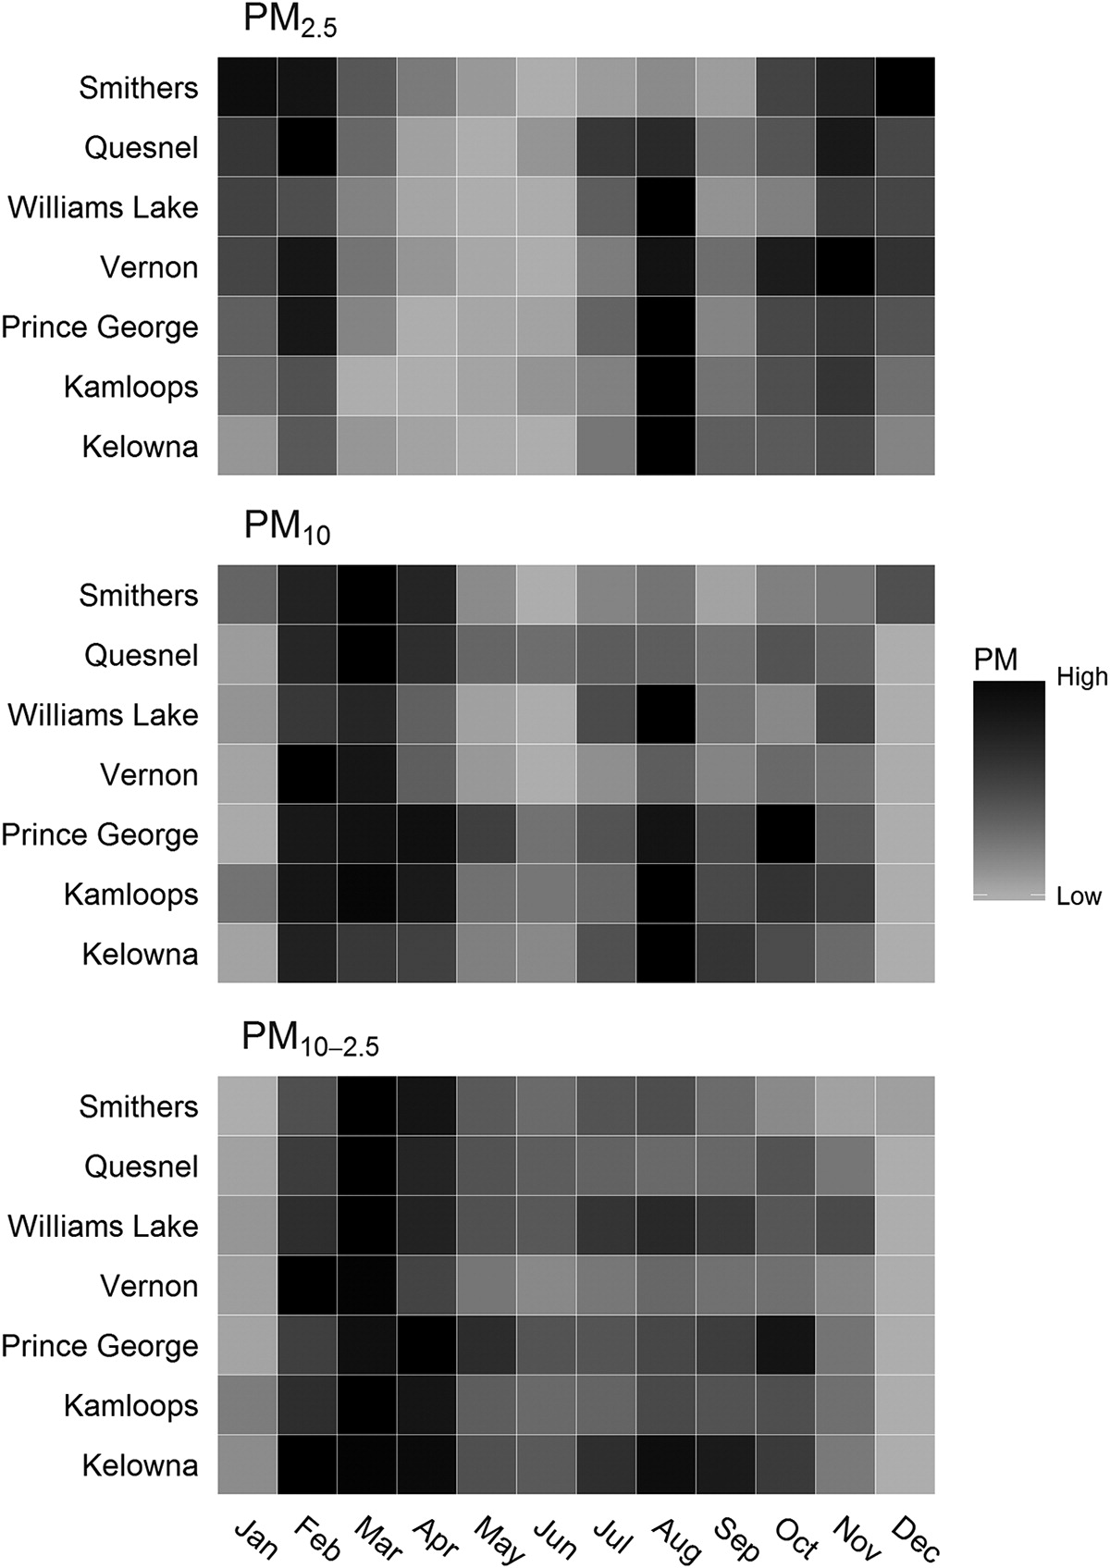
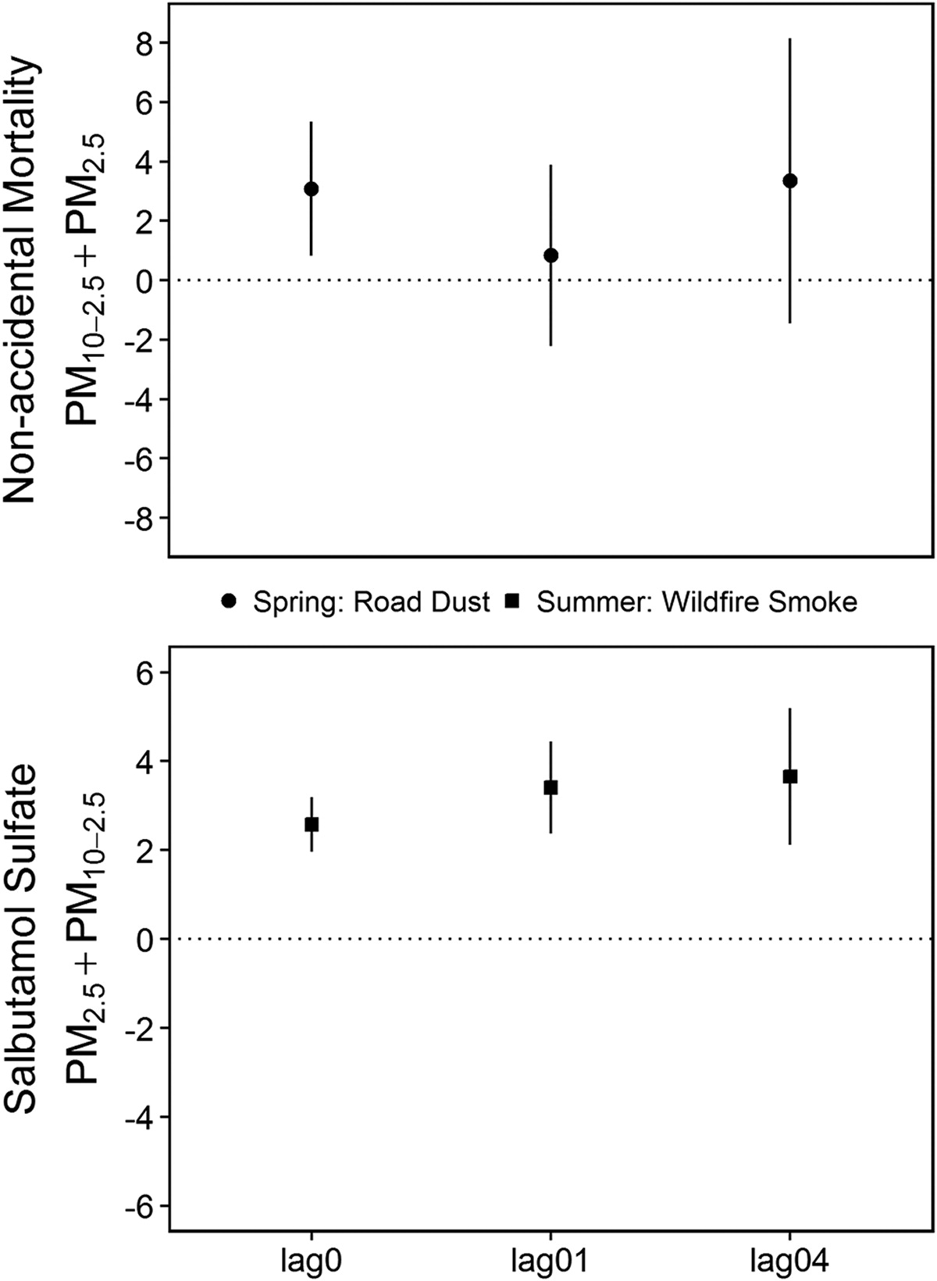
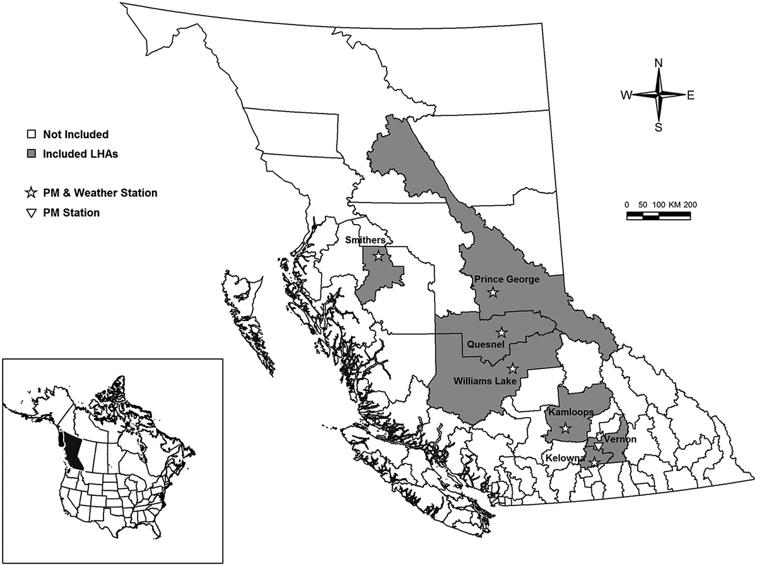


Slide 7
IRR = 1.02 (95% CI: 1.00, 1.04) for respiratory mortality
Days characterized by high non-primary PM
Spring and fall seasons

Slide 8
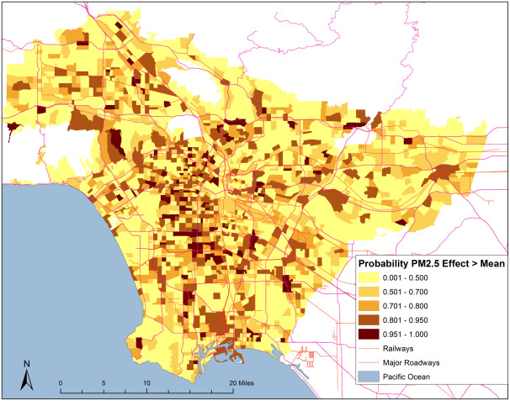
Modeling spatial effects of PM_{2.5} on term low birth weight in Los Angeles County (Coker et al., 2015)

Slide 9
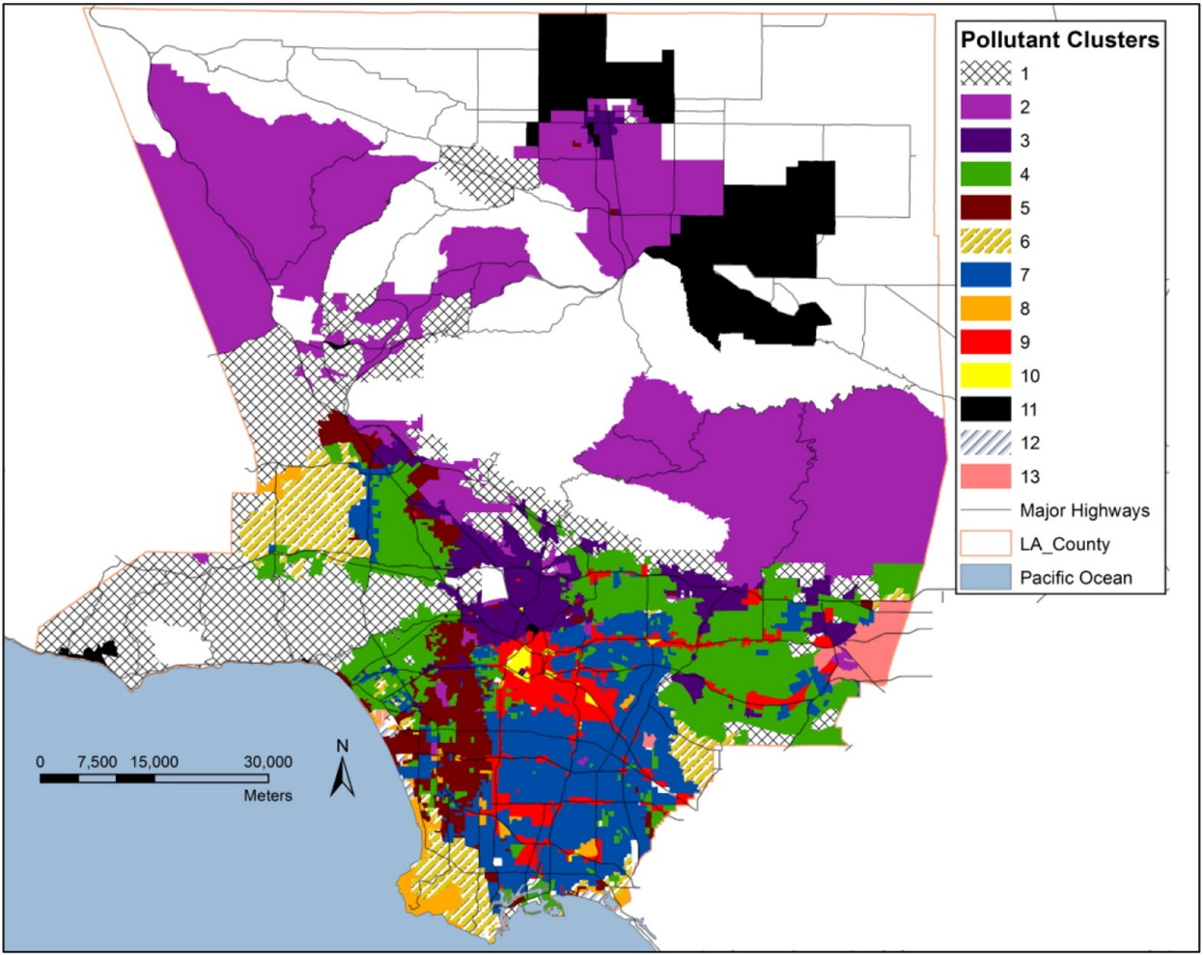
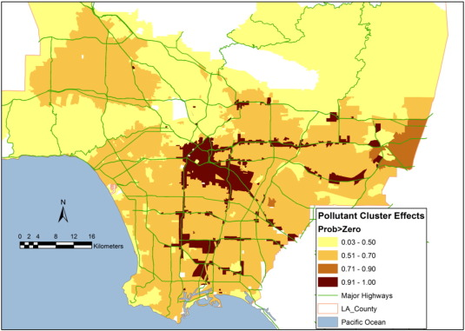
Multi-pollutant exposure profiles associated with term low birth weight in Los Angeles County (Coker et al., 2016)

Slide 10
Overall goal of this study
Focusing on the springtime road dust season in Prince George
  Measure the daily contributions of trace elements (including heavy metals) to near-road PM10
  Explore the within-season temporal trends of PM_{10-2.5} and PM_{2.5} in PM₁₀
  Classify days with high levels of springtime road dust based on a threshold of the percentage of PM_{10-2.5} in PM₁₀
  Identify the chemical-weather profiles of days with high levels of road dust

Slide 11
Study Hypotheses
PM₁₀ is characterized by high within-season variability of chemical mixture composition
Chemical mixtures vary significantly between high road dust days compared with low road dust days
PM₁₀ chemical mixtures cluster together with distinct meteorological profiles

Slide 12
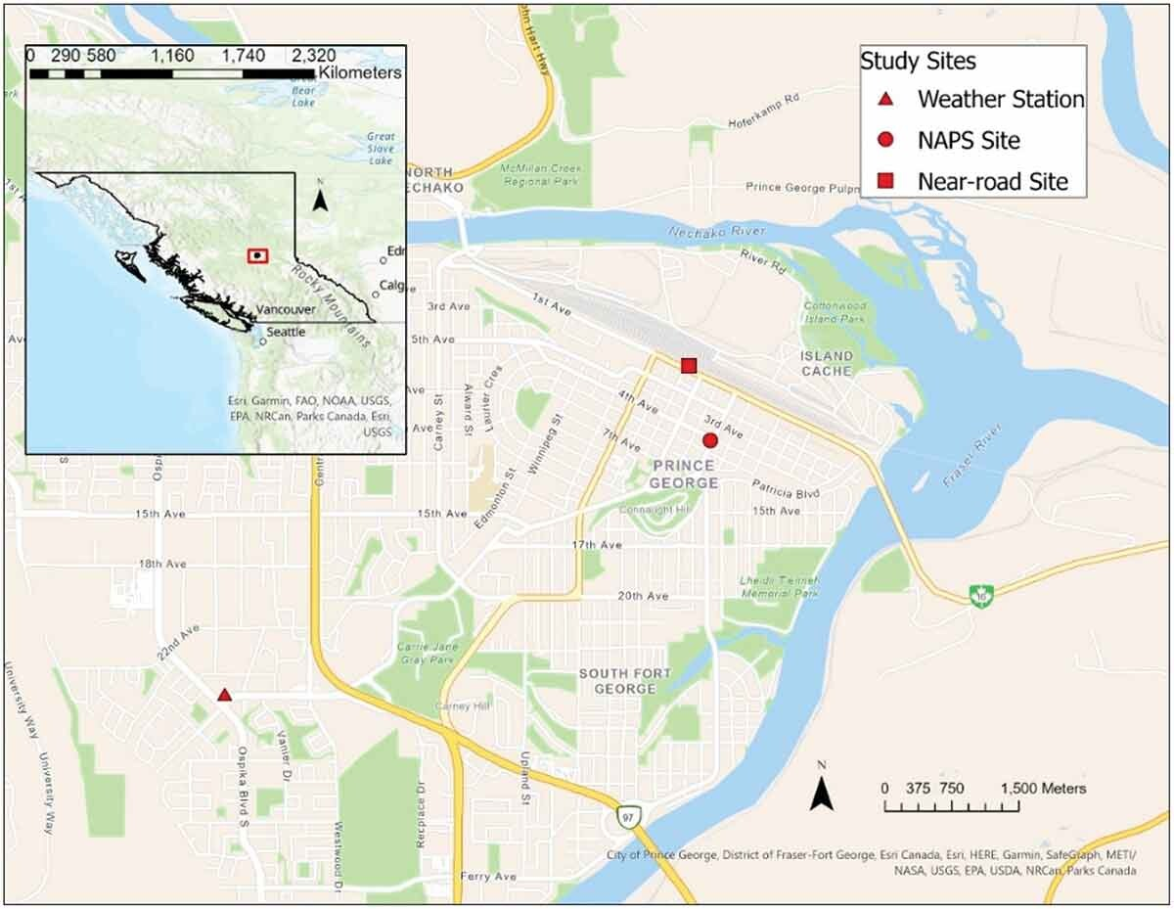
Study Setting and Air Sampling
Prince George, BC
High-volume PM₁₀ air samplers at a near-road site
  24-hour sampling on Tuesdays and Thursdays, from 26 January 2021 to 17 March 2021
  24-hour continuous daily air sampling from 22 March 2021 to 09 May 2021
Hourly PM_{2.5} and PM₁₀ data
  National Ambient Pollution Surveillance (NAPS) regulatory air quality monitoring site
  Used to calculate PM_{10-2.5}
Meteorological data from ECCC weather station
  temperature, humidity, precipitation, wind speed, wind direction, dew point

Slide 13


Laboratory Analysis
Mass concentration
Filters weighed before and after sampling
Temperature/humidity-controlled environment
Filter extractions
NIOSH 7303 method
Extracted PM used for chemical analysis
Chemical analysis
Three elements had >75% below MDL are were removed from the computation of summary statistics
Inductively Couple Plasma Optical Emission Spectroscopy (ICP-OES)
Samples with trace elements at sufficient detection frequencies were imputed using LOD/sqrt(2) if the samples was below the detection limit
Element | MDL (ng/m³)
Arsenic | 10.92
Barium | 0.1572
Cadmium | 0.1572
Cobalt | 0.6544
Chromium | 0.3272
Copper | 0.3272
Iron | 8.808
Mercury | 2.8529
Manganese | 0.4158
Nickel | 0.6544
Lead | 3.034
Sulfur | 50.41
Antimony | 7.864
Vanadium | 0.3272
Zinc | 0.3272

Slide 14
Data Analysis
Near-road study site
PM_{10-high-vol}
Individual trace elements
Sum of trace elements
Percentage trace elements of PM₁₀
NAPS site
PM_{2.5}, PM₁₀, PM_{10-2.5}
Percentage PM_{10-2.5} of PM₁₀
≥65% to indicate high road dust days (75th percentile)
Linear and generalized linear regression to test adjusted associations between meteorological variables and the different PM metrics
Summary statistics, correlational analysis, time series plots, and boxplots
Bayesian profile regression (BPR)
Cluster analysis
Daily meteorological and trace element profiles
Logistic regression to link the different profile clusters with risk of road dust days

Slide 15
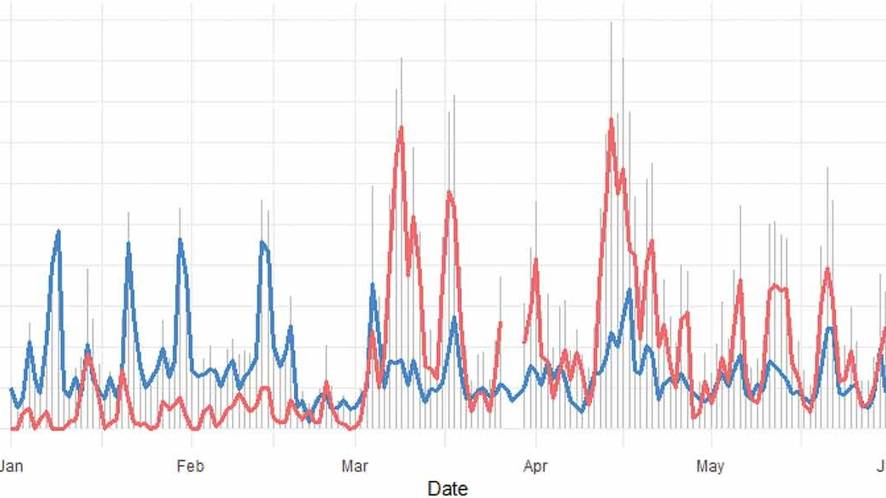
RESULTS

Slide 16
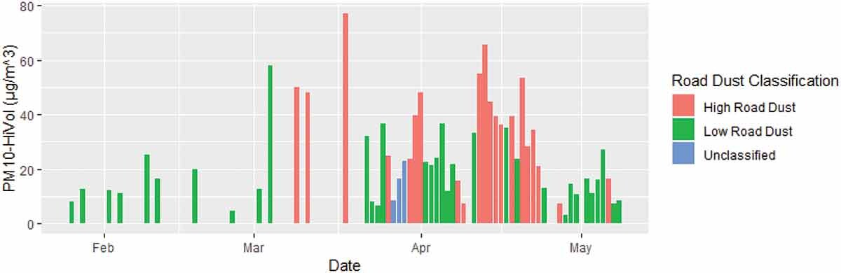
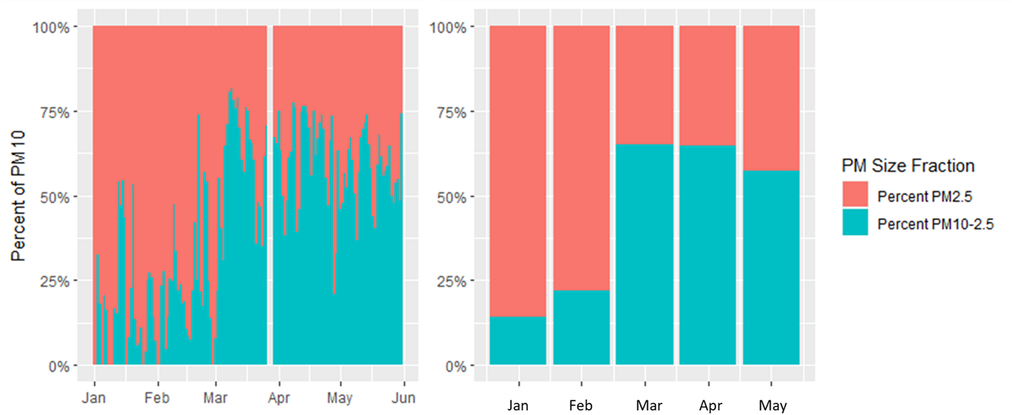
Near-road Study Site
NAPS Site

Slide 17
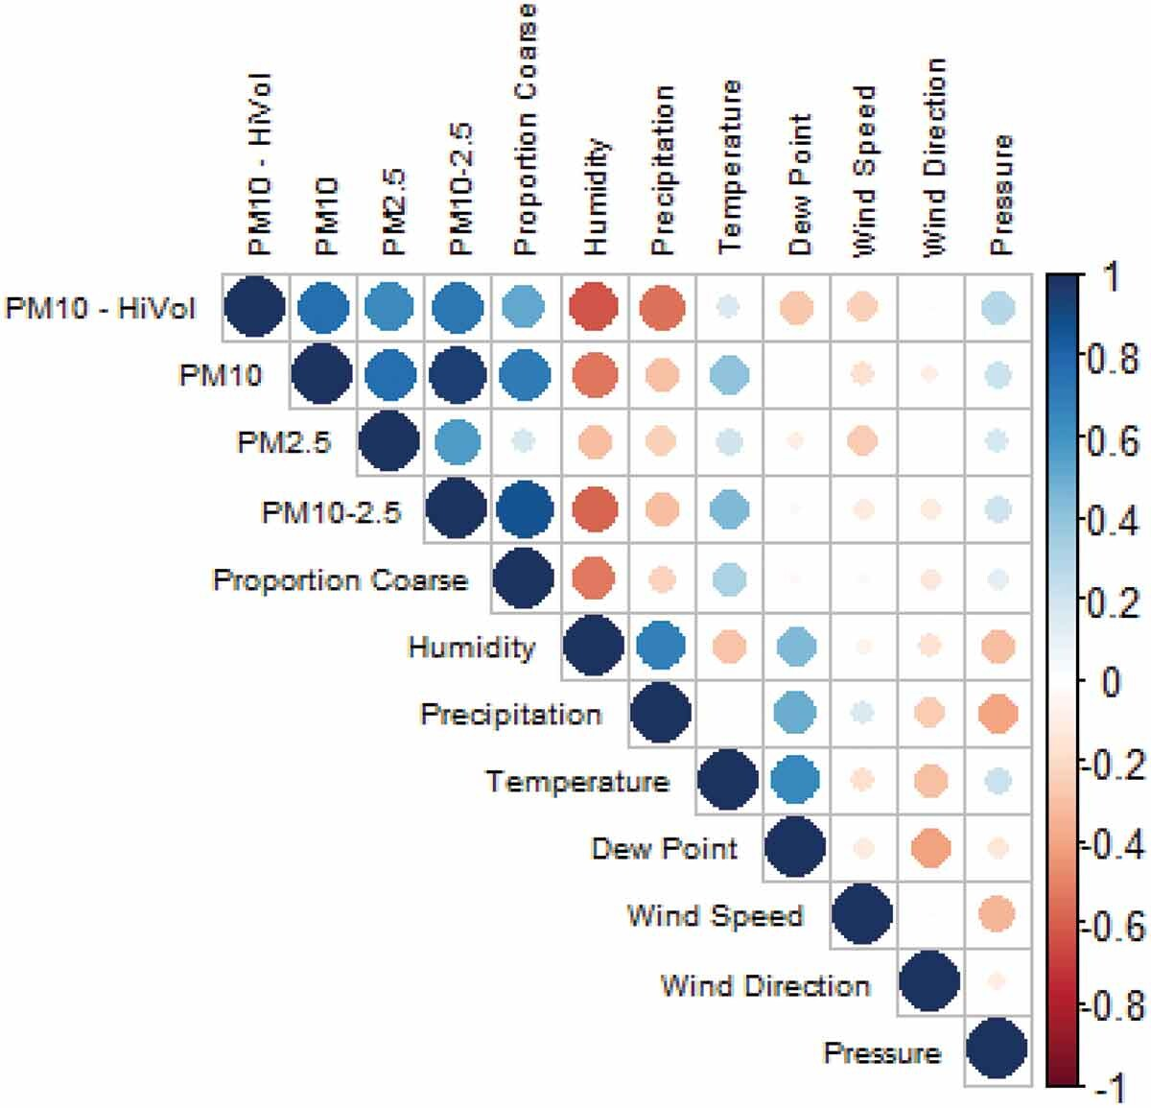
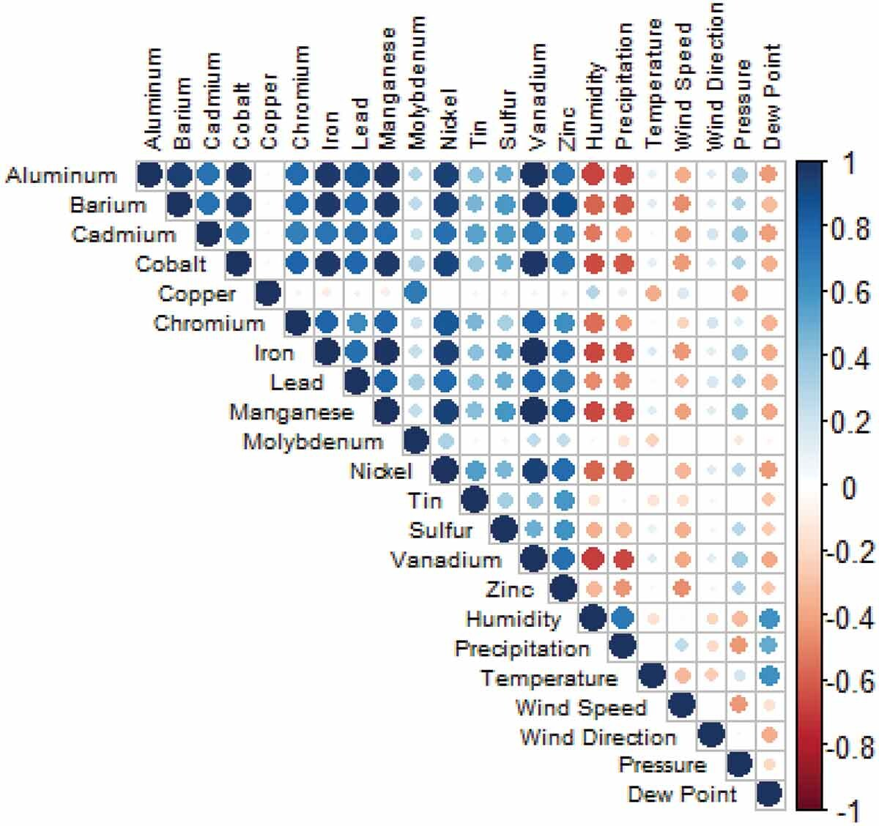

Slide 18
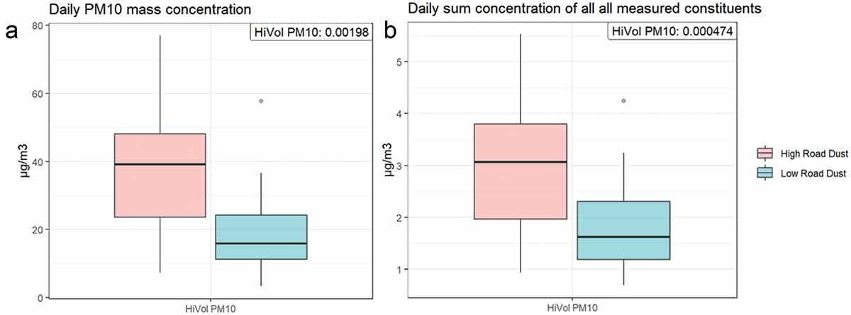
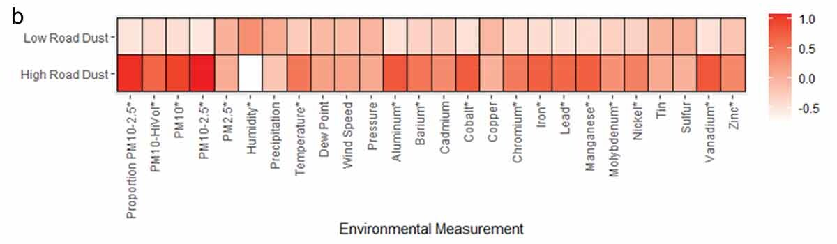

Slide 19
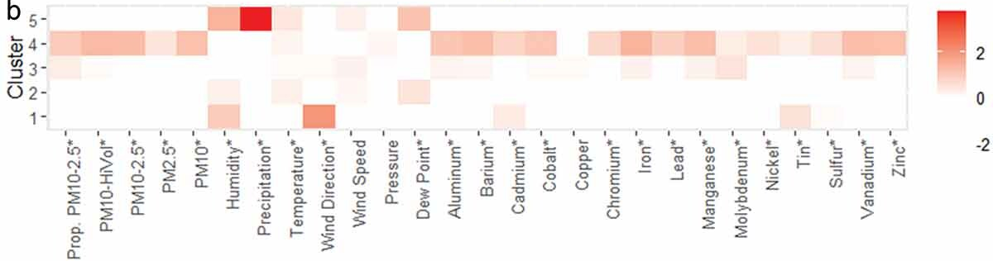
Cluster Analysis Results
Characteristic | Cluster
 | C1 (n=51) | C2 (n=201) | C3 (n=151) | C4 (n=141) | C5 (n=31) | p-value
High Road Dust Day | 0% | 20% | 27% | 93% | 33% | <0.001
PM_{10-2.5} in PM₁₀ | 22% (4, 27) | 53% (36, 62) | 62% (48, 65) | 75% (71, 76) | 47% (34, 60) | <0.001
PM_{10-HiVol} (µg/m3) | 13 (12, 16) | 13 (10, 16) | 27 (23, 34) | 48 (39, 55) | 7 (5, 8) | <0.001

Slide 20
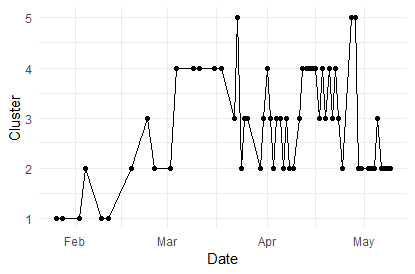

Slide 21
Discussion on springtime road dust in Prince George, BC
Cluster analysis of PM₁₀ samples from the near-road study site indicates that springtime PM₁₀ comprises complex mixtures of trace elements.
Chemical composition varied significantly between high road dust days and low road dust days
Heavy metals of high public health concern, such as chromium and lead, were significantly elevated on high road dust days. Several of these chemicals have known non-carcinogenic and carcinogenic health effects
Meteorological factors appear to work in combination to determine the occurrence of high road dust days, particularly humidity and temperature
Cluster analysis of coarse PM, its chemical composition, combined with meteorological data has promise to improve assessment of springtime road dust exposure assessment in epidemiologic research

Slide 22
Concluding thoughts on possible implications for climate change impacts
Signatures of trace elements and PM_{10-2.5} concentrations were driven by a particular combination of local meteorological factors
The percentage of PM_{10-2.5} in PM₁₀ was the only PM metric significantly positively associated with temperature after adjusting for other meteorological factors
We also found suggestive evidence that the effect of humidity on road dust may be temperature-dependent. Temperature, humidity, and their complex relationship with road dust have been observed by other studies conducted in northern latitude regions
Climate change is already increasing annual ambient temperatures in northern latitudes, meaning that the timing and duration of road dust exposures could be exacerbated in cities such as Prince George
Further research is needed to understand the complex role of meteorological factors on airborne road dust generation and the potential for climate change to affect road dust events and their related health risks

Slide 23
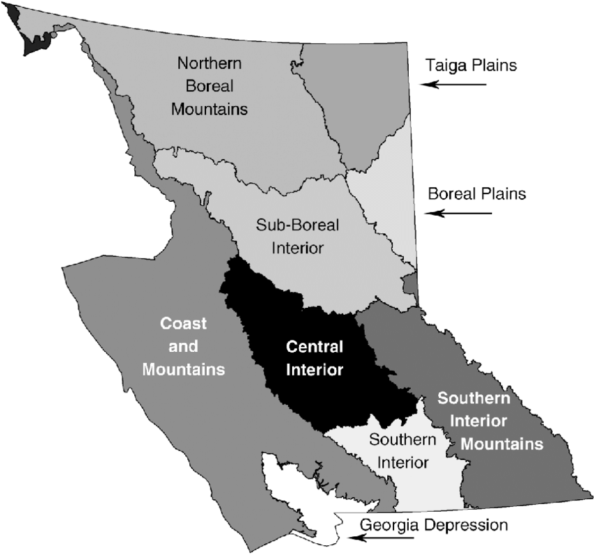
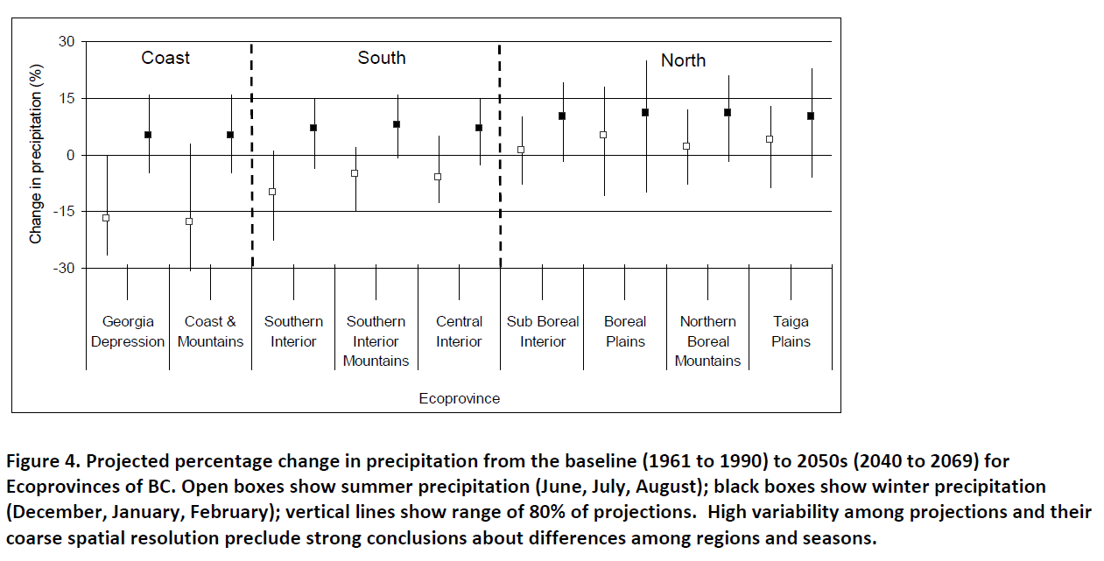
Could springtime road dust events be impacted by climate change?
Earlier onset of snowmelt?
Drier conditions and lengthier periods of dry conditions during springtime?
Potential for geographic variation in this type of impact?

Slide 24

Thank you!
BCCDC Team
  Sarah Henderson
  Michael Kuo
  Molly Mastel
  Nikita Saha Turna
UNBC & Northern Analytic Lab Services
  Hossein Kazemian
  Mya Schouwenburg
  Ahmad Jalil
  Charles Bradshaw
Health Canada
  Meghan Roushorne
Disclaimer
The opinions expressed in this presentation are those of the authors and do not necessarily reflect the views of Health Canada or the government of British Columbia.

Slide 25
Strengths and Limitations of Study
Strengths
Limitations
Specificity - We collected daily PM₁₀ air samples at a near-road site affected by highway traffic in a city known to be heavily impacted by springtime road dust
Sensitivity - High volume air sampler ensured we could collect sufficient material on the filters for laboratory analysis and characterization of day-to-day heterogeneity of trace elements in near-road PM₁₀
Contextualizing - We supplemented the PM₁₀ chemical composition data using data from a nearby NAPS site and a nearby weather station, which allowed us to link together PM₁₀ chemical mixtures with local levels of coarse PM and meteorological factors
Complexity - Cluster analysis enabled us to identify the complex nature of the road dust chemical and meteorological signatures, despite a small sample size
We lacked direct chemical composition data for PM measured at the NAPS site, so we do not directly know how it compares with the near-road composition of PM₁₀
  Prior to this study we completed pilot work to assess whether we could characterize the chemical composition of TEOM PM₁₀ filters, but the sample was inadequate
We did not measure PM_{2.5} at the near-road site, so we could not compare the chemical composition of different size fractions on high road dust days.

