Slide 1
Air Pollution in Public Transit Systems: Characterization and Mitigation
Keith Van Ryswyk
Senior Indoor Air Quality Researcher
Air Pollution Exposure Science Section, Water and Air Quality Bureau
Health Canada
BC Lung Foundation
Air Quality and Health Workshop 2023

Slide 2
Overview
Air Pollution Exposure Across Transit Methods
Active transit
Complexities of comparing air pollution exposures across transit methods
Improving air pollution in public transit systems
The Urban Transportation Exposure Study
Bus Transit: impact of fuel emission standards and propulsion systems
Subway Transit: Health Canada’s Guidance for Improving Subway Air Quality
The Characterization and Mitigation of Air Pollution in Public Transit
2

Slide 3
Air Pollution Exposure Across Transit Methods
Active Transit Methods
AT methods: cycling, running, walking
can increase:
Transit time
Proximity to traffic sources
Breathing rate
Benefits of physical activity outweigh health risks of increased exposure/dose
Mueller et al., 2015 & Cepeda, et al., 2017
Motorized Transit Methods
MT methods: private vehicles and public transit (buses and subways)
Determinants of exposure can be nation or city-specific
Cepeda, M., Schoufour, J., Freak-Poli, R., Koolhaas, C. M., Dhana, K., Bramer, W. M., & Franco, O. H. (2017). Levels of ambient air pollution according to mode of transport: a systematic review. The Lancet Public Health, 2(1), e23–e34. https://doi.org/10.1016/S2468-2667(16)30021-4
Mueller, N., Rojas-Rueda, D., Cole-Hunter, T., de Nazelle, A., Dons, E., Gerike, R., Götschi, T., Int Panis, L., Kahlmeier, S., & Nieuwenhuijsen, M. (2015). Health impact assessment of active transportation: A systematic review. Preventive Medicine, 76, 103–114. https://doi.org/10.1016/j.ypmed.2015.04.010
The Characterization and Mitigation of Air Pollution in Public Transit
3

Slide 4
Air Pollution Exposure Across Transit Methods
Research Comparing Air Pollution Exposures of Transit Methods
Heterogeneity in findings across studies
Ventilation
Private car recirculation, cabin filtration, mechanical ventilation in subways
Route selection / network design
distance from traffic congestion
separation of bus/cyclist lanes
proportion of rail transit lines below- (BG) and above-grade (AG)
Propulsion types (i.e. diesel, electric, hybrid)
Built environment
Regional ambient air pollution and vehicle emission standards
Indoor air quality standards (i.e. Indoor Air Quality Act)
The Characterization and Mitigation of Air Pollution in Public Transit
4

Slide 5
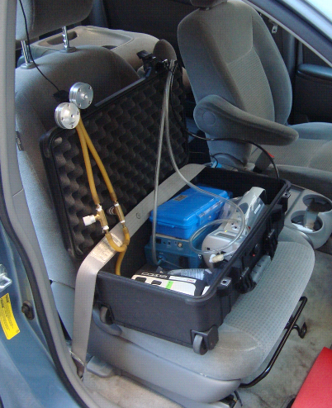
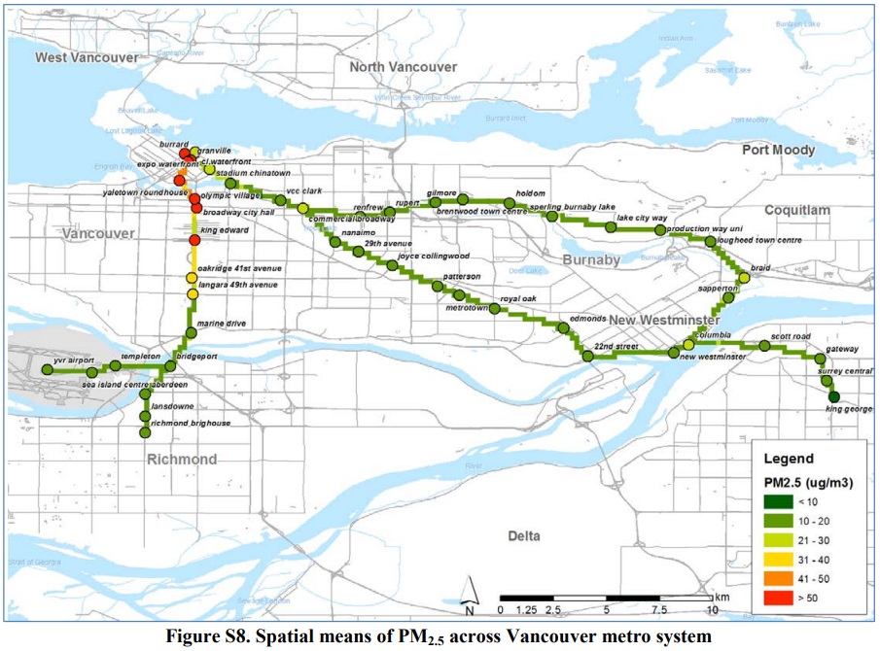
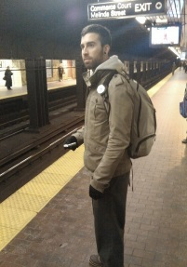
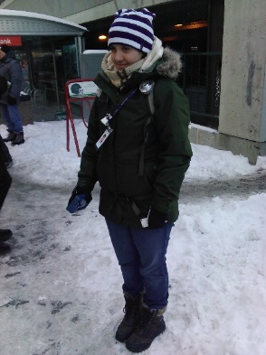
Health Canada’s Urban Transportation Exposure Study
Private Vehicles:
Vancouver, Toronto, & Montreal
Objectives
System-wide characterization
Identification of determinants of air pollution variability
Pollutants:
NO₂
PM_{2.5}
PM₁₀
UFP
BC
Rail Transit:
Vancouver, Toronto, & Montreal
Bus Transit:
Vancouver, Toronto, & Ottawa
Estimating contribution to daily air pollution exposure
Weichenthal, S., Van Ryswyk, K., Kulka, R., Sun, L., Wallace, L., & Joseph, L. (2015). In-vehicle exposures to particulate air pollution in Canadian metropolitan areas: the urban transportation exposure study. Environmental Science & Technology, 49(1), 597–605.
Van Ryswyk, K., Evans, G. J., Kulka, R., Sun, L., Sabaliauskas, K., Rouleau, M., Anastasopolos, A. T., Wallace, L., & Weichenthal, S. (2021). Personal exposures to traffic-related air pollution in three Canadian bus transit systems: the Urban Transportation Exposure Study. Journal of Exposure Science & Environmental Epidemiology, 31(4), 628–640.
Van Ryswyk, K., Anastasopolos, A. T., Evans, G., Sun, L., Sabaliauskas, K., Kulka, R., Wallace, L., & Weichenthal, S. (2017). Metro commuter exposures to particulate air pollution and PM2. 5-associated elements in three
Canadian cities: the urban transportation exposure study. Environmental Science & Technology, 51(10), 5713–5720.
The Characterization and Mitigation of Air Pollution in Public Transit
5

Slide 6
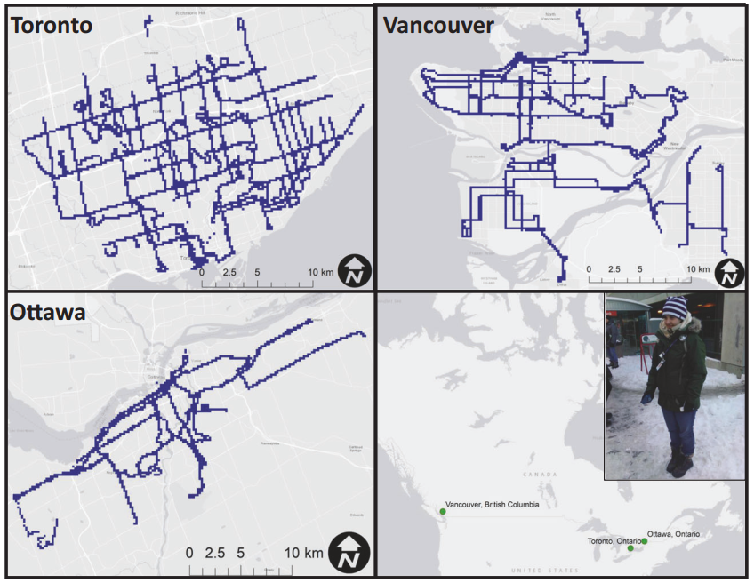
Air Quality in Public Transit Systems: Buses
Estimating the impact of bus propulsion type on in-bus air pollution
Buses categorized by propulsion and make year groups
Diesel: Pre 2004: referent condition
Diesel: 2004-2006: emission standards introduced in 2004 targeted the reduction of NOx emissions
Diesel: 2007-: 10-fold improvement in emission standards
Hybrid diesel/electric
Electric: Trolley buses (Vancouver only)
Benefits of reducing bus emissions to bus air quality
2007- diesel class: lower PM_{2.5}, BC, & UFP in all three cities
Similar improvements for hybrid diesel/electric
Sources of in-bus air pollution
~60-70% of daily exposure to PM_{2.5}-Fe and PM_{2.5}-Ba
Diesel exhaust and brake dust
Van Ryswyk, K., Evans, G. J., Kulka, R., Sun, L., Sabaliauskas, K., Rouleau, M., Anastasopolos, A. T., Wallace, L., & Weichenthal, S. (2021). Personal exposures to traffic-related air pollution in three Canadian bus transit systems: the Urban Transportation Exposure Study. Journal of Exposure Science & Environmental Epidemiology, 31(4), 628–640.
The Characterization and Mitigation of Air Pollution in Public Transit
6
Notes:
2007 diesels employ Diesel particulate filters and selective catalytic reduction systems

Slide 7
Air Quality in Public Transit Systems: Buses
Electrification of Bus Fleets?
May results in a significant decrease in diesel exhaust emissions for Canadian cities
Regenerative braking systems could also reduce the emission of non-exhaust emissions (brake dust)
Zero Emission Transit Fund
Infrastructure Canada
Electrification of municipal bus fleets
Municipalities purchasing ‘zero-emission buses’
Ottawa, Vancouver, Calgary, Winnipeg, and others
https://www.infrastructure.gc.ca/zero-emissions-trans-zero-emissions/index-eng.html
The Characterization and Mitigation of Air Pollution in Public Transit
7

Slide 8
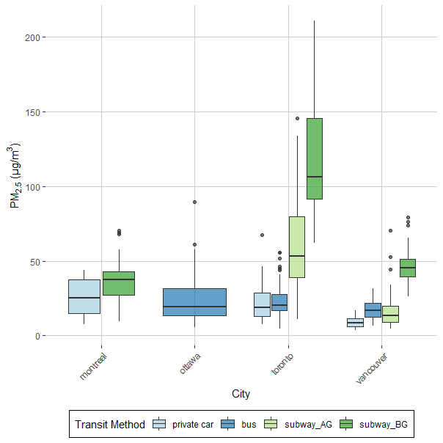
Air pollution variability by transit method: PM_{2.5}
Montreal
subway ~ private car
Toronto
subway >> bus
subway >> private car
Vancouver
subway BG > subway AG
subway AG ~ private car ~ bus
High PM_{2.5} and PM₁₀ concentrations in BG rail lines reliant on piston-effect for ventilation
The Characterization and Mitigation of Air Pollution in Public Transit
8

Slide 9
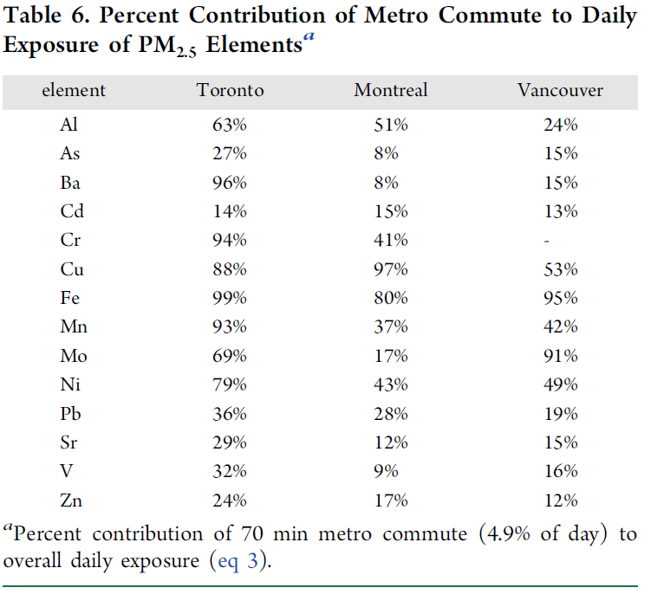
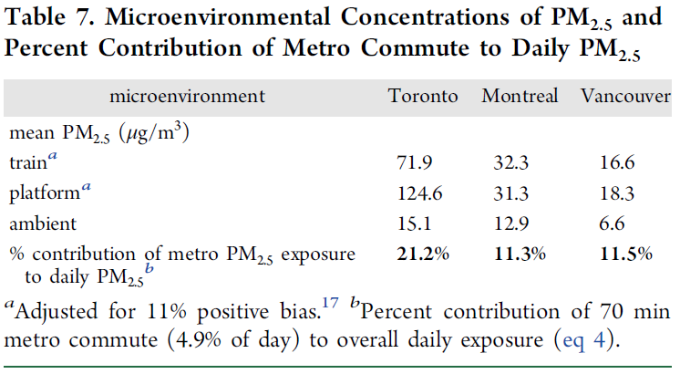
Air Quality in Public Transit Systems: Rail Transit
Subway commuting’s contribution to daily PM_{2.5}
Van Ryswyk, K.; Anastasopolos, A. T.; Evans, G.; Sun, L.; Sabaliauskas, K.; Kulka, R.; Wallace, L.; Weichenthal, S. Metro Commuter Exposures to Particulate Air Pollution and PM2.5-Associated Elements in Three Canadian Cities: The Urban Transportation Exposure Study. Environ. Sci. Technol. 2017, 51, 5713– 5720, DOI: 10.1021/acs.est.6b05775
The Characterization and Mitigation of Air Pollution in Public Transit
9

Slide 10
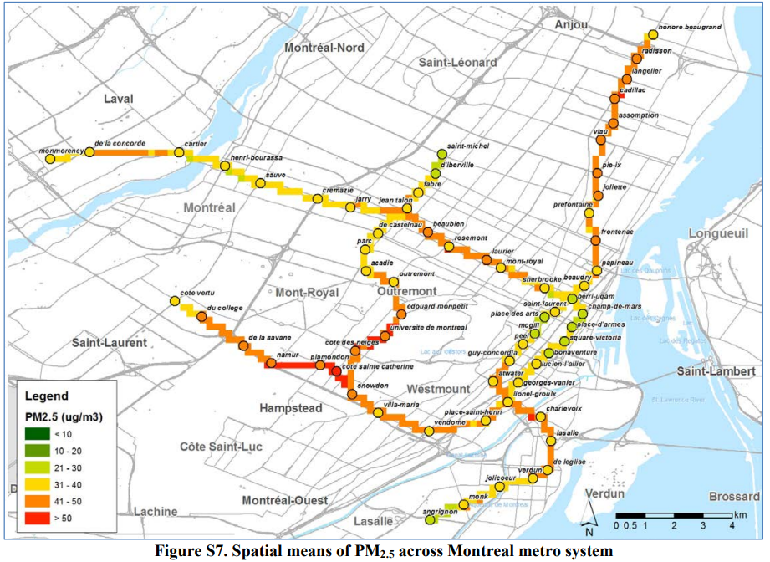
Air Quality in Public Transit Systems: Rail Transit
Summer PM_{2.5}
=
½
Winter
PM_{2.5}
continually
operating
ventilation
n=90 units
to ensure thermal comfort
The Characterization and Mitigation of Air Pollution in Public Transit
10

Slide 11
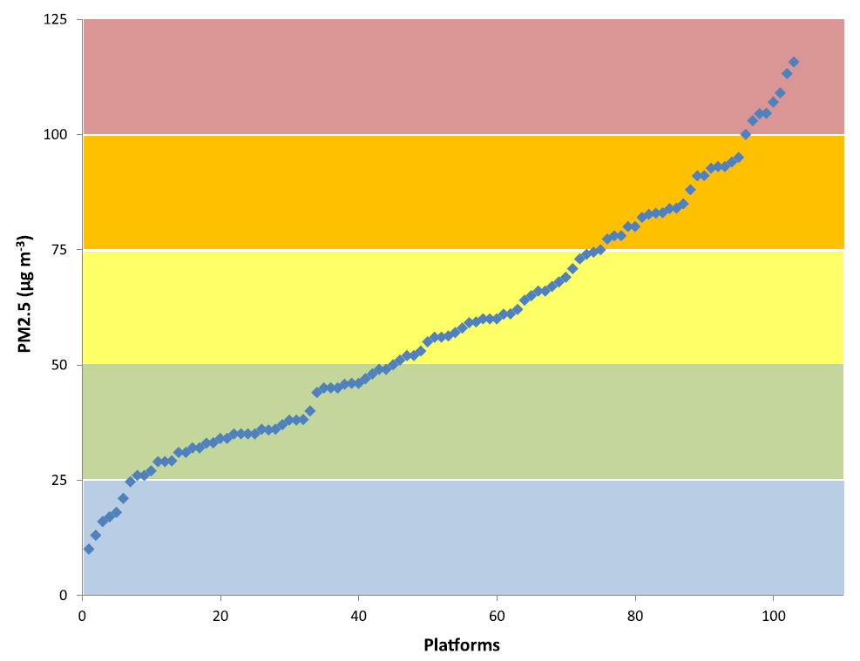
Air Quality in Public Transit Systems: Rail Transit
BG piston-effect-reliant systems (µg/m³)
Toronto: ~140
Stockholm: ~150
London: ~300
Washington DC: ~340
Boston: ~325
New York: ~470
Copenhagen : ~160
PM_{2.5} Highly enriched in FeO
(London: 47-71%, Toronto: ~75%,
Stockholm & Copenhagen: ~85%)
Extensively below-grade rapid transit rail systems can significantly increase daily PM_{2.5} for its patrons
Moreno T, de Miguel E. Improving air quality in subway systems: An overview. Environ Pollut. 2018;239:829-831. doi:10.1016/j.envpol.2018.01.077
The Characterization and Mitigation of Air Pollution in Public Transit
11

Slide 12
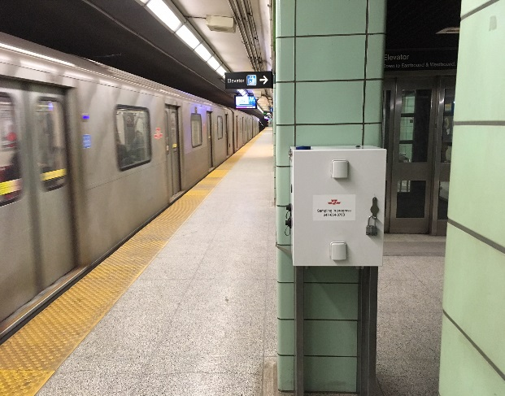
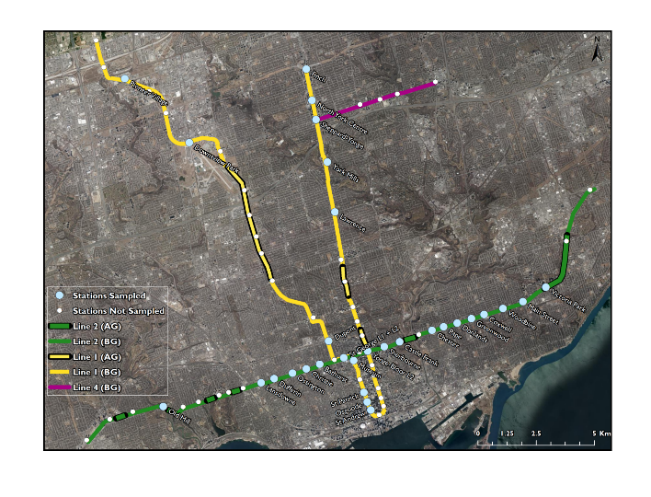
Air Quality in Public Transit Systems: Rail Transit
Data collection
Gravimetric and Continuous PM_{2.5}
Lines 1 & 2
Platform: 2010/11, 2018
In-Train : 2010/11, 2018, & 2019/20
Results
Track Bed Vacuuming ineffective at reducing PM_{2.5}
Newly opened line attained high PM within 1 year
Estimated impact of high rate of wheel flats and friction brake use
Subway PM_{2.5}
freshly emitted > legacy dust
Van Ryswyk, K., Kulka, R., Marro, L., Yang, D., Toma, E., Mehta, L., McNeil-Taboika, L., and Evans, G., 2021. Impacts of Subway System Modification on Air Quality in Subway Platforms and Trains. Environ. Sci. Tech. 55(16): 11133– 11143.
The Characterization and Mitigation of Air Pollution in Public Transit
12

Slide 13
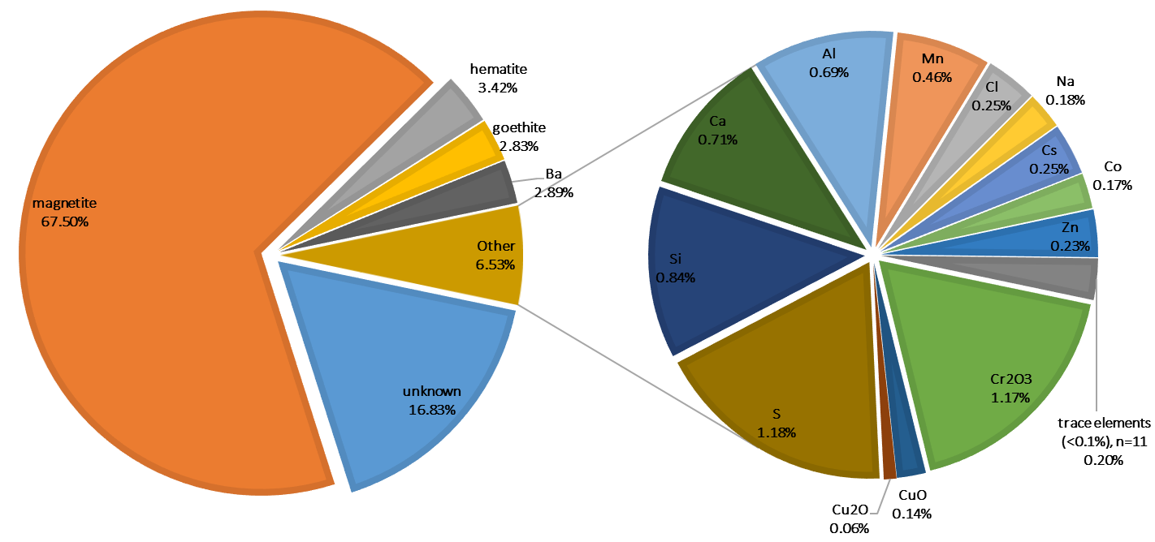
Air Quality in Public Transit Systems: Rail Transit
Composition of Subway PM_{2.5} in Toronto subway (piston-effect reliant ventilation):
Extensively composed of Fe oxides and steel-sourced elements
contribution to Subway PM_{2.5}
system sources >>> outdoor sources
The Characterization and Mitigation of Air Pollution in Public Transit
13

Slide 14
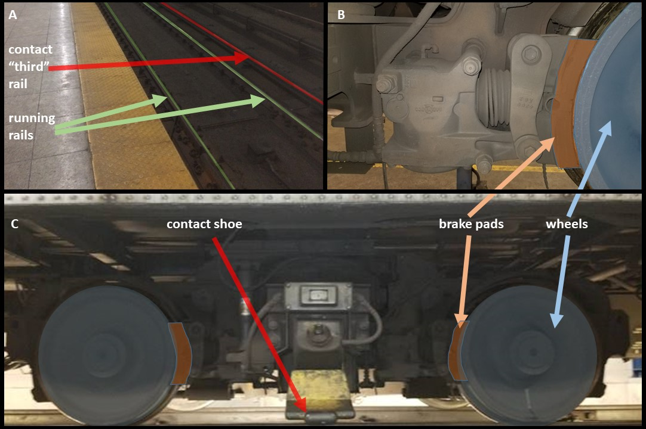
Air Quality in Public Transit Systems: Rail Transit
Subway Components
Frame A: view of track bed from platform with running and contract ’third’ rails.
Fame B: close up of train bogie with brake and wheel contact.
Frame C: full view of train bogie with wheels, brake pads, and contact shoe.
The Characterization and Mitigation of Air Pollution in Public Transit
14

Slide 15
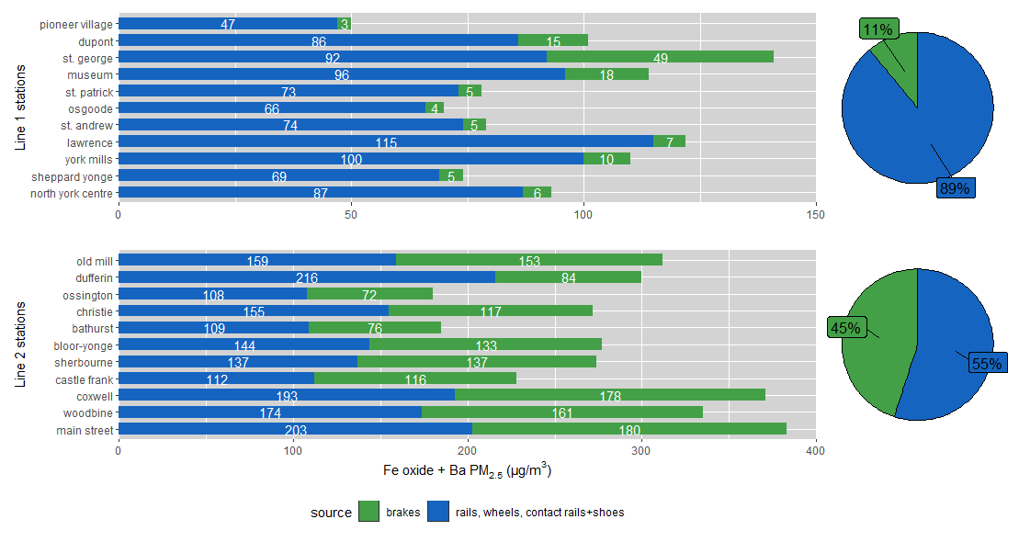
Air Quality in Public Transit Systems: Rail Transit
Two-Source Chemical Mass Balance Model
Fe-dominated components
Wheels, rails, contact rails, and contact shoes
>94% Fe
Brake pads: Fe, Ba, Cr, Sr
Line 1:
Mainly sourced by steel components
Regenerative braking:
engages at 5km/h
Line 2:
Even contribution of sources
High rate of friction brake use
The Characterization and Mitigation of Air Pollution in Public Transit
15

Slide 16
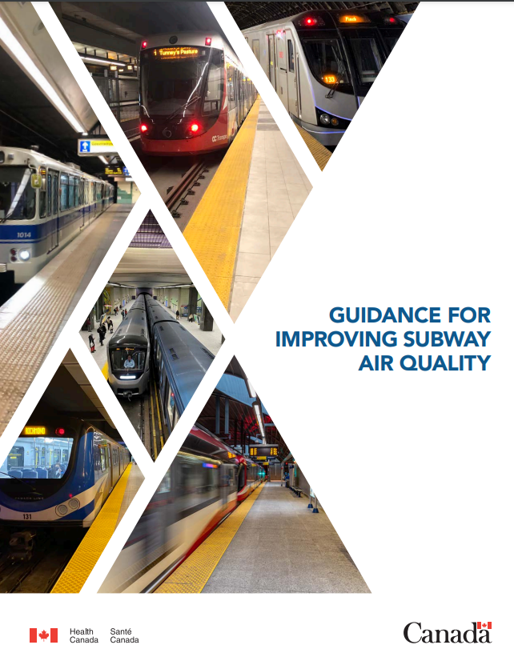
Air Quality in Public Transit Systems: Rail Transit
Forced ventilation systems
operating forced mechanical ventilation systems
automation based on train schedules
In-train filtration
potentially more effective relative to platform filtration
commuters spend the majority of their time within subway trains.
Monitoring subway air quality
identifies the seasons and stations with higher PM concentrations
can inform strategies to improve subway air quality
Reducing Subway PM emissions
reducing friction brake use
performing an audit of the wear and replacement rates of subway components
The Characterization and Mitigation of Air Pollution in Public Transit
16

Slide 17
Air Quality in Public Transit Systems: Rail Transit
Platform Screen Doors (PSDs).
PSDs have been installed in many systems for their safety benefits
effective at reducing platform PM by restricting air flow from tunnels
can result in an increase of PM in trains and thus overall passenger exposure
Vacuuming and washing
intervention studies have found limited impact of vacuuming and washing on improving system air quality.
Health Canada. Guidance For Improving Subway Air Quality. March 2022. ISBN: 978-0-660-42505-4. https://www.canada.ca/content/dam/hc-sc/documents/programs/guidance-for-improving-subway-air-quality/subway-guidance-en.pdf
The Characterization and Mitigation of Air Pollution in Public Transit
17

Slide 18
Summary
Active Transit
Benefits of physical activity outweigh health risks of increased exposure/dose
Comparing Air Quality Across Modes
Complicated by factors of city, system, and regulatory factors
Improving Air Quality in Public Transit
Reducing the emission of traffic-related air pollution
key for the betterment of air quality in all modes
Increased use of active transit + public transit
decreased private vehicle use = decreased traffic congestion = increased urban air quality
Ongoing electrification of bus transit fleets
Air pollution in below-grade rail transit (subways)
A unique PM source and composition profile
Unknown health effects
Reductions in PM concentrations are possible
The Characterization and Mitigation of Air Pollution in Public Transit
18

Slide 19
Acknowledgements
Health Canada: Ryan Kulka, Angelos Anastosopoulos, Morgan MacNeill, Hongyu You, Tim Shin, Lui Sun, Scott Weichenthal
University of Toronto: Greg Evans, Cheol Jeong
National Research Council: Elton Toma
Imperial College London: David Green
Copenhagen University: Hugo Russell
The Characterization and Mitigation of Air Pollution in Public Transit
19

Slide 20
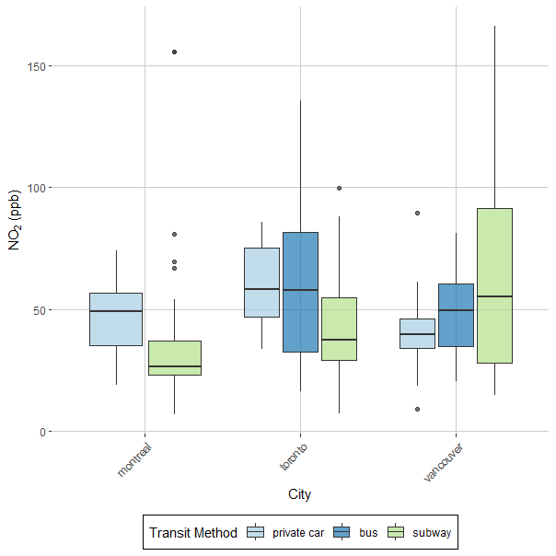
Air pollution variability by transit method: NO₂
Montreal (subway = Metro)
Lower NO₂ in subway
100% below-grade (BG)
electrical propulsion
Toronto
Lower NO₂ in subway
~80% BG
electrical propulsion
private car ~ bus
Vancouver (subway = SkyTrain)
high NO₂ variability in subway
~80/20% AG/BG Similar levels
private car ~ bus
The Characterization and Mitigation of Air Pollution in Public Transit
20

Slide 21
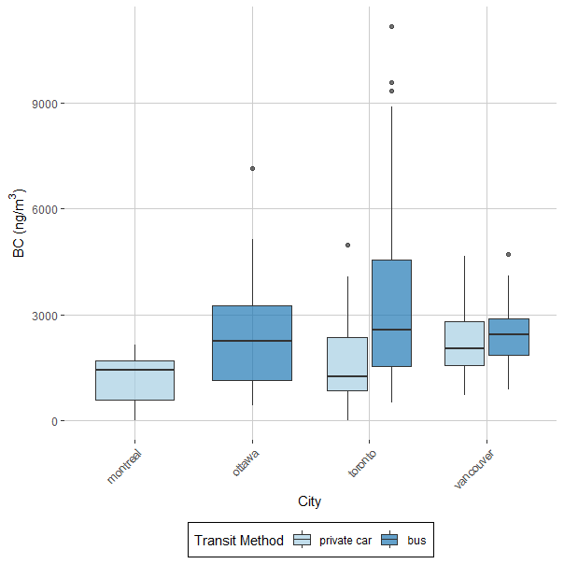
Air pollution variability by transit method: Black Carbon
Subways
no black carbon data
High content of Fe Oxides
Not true representation of BC
Bus vs Private car
Comparable between methods
Some variability between methods by city
The Characterization and Mitigation of Air Pollution in Public Transit
21

Slide 22
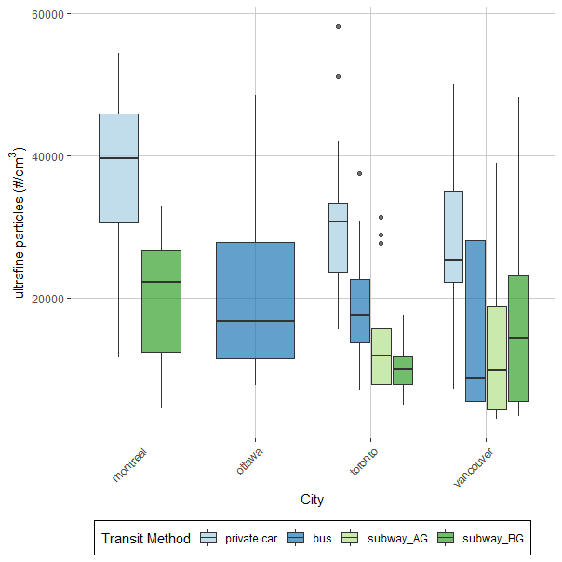
Air pollution variability by transit method: UFP (PM_{0.1})
Subway
below grade (BG)
above grade (AG)
Montreal
Private vehicle > subway
Continual ventilation in subway
Toronto
Private vehicle > bus > BG subway
subway is unventilated
‘piston-effect’ driven
Vancouver
Private vehicle > bus ~ subway
The Characterization and Mitigation of Air Pollution in Public Transit
22

