Slide 1
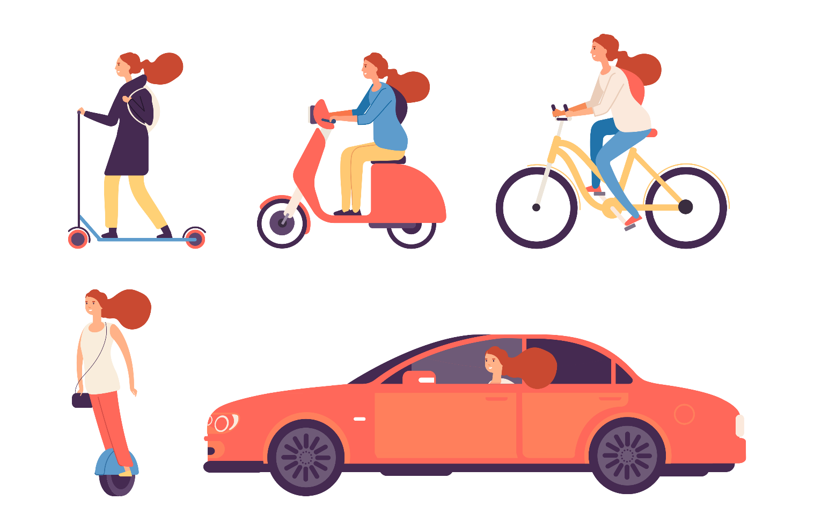
All you need is a shove:
Active travel with human-electric hybrid vehicles
Alex Bigazzi & REACT Lab team
University of British Columbia
Department of Civil Engineering
BC Lung Foundation Air Quality and Health Workshop
March 30, 2023

Slide 2


Slide 3
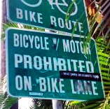
Outline
What are the main costs/benefits/motivators?
How does micromobility change things?
How do we increase active travel?

Slide 4
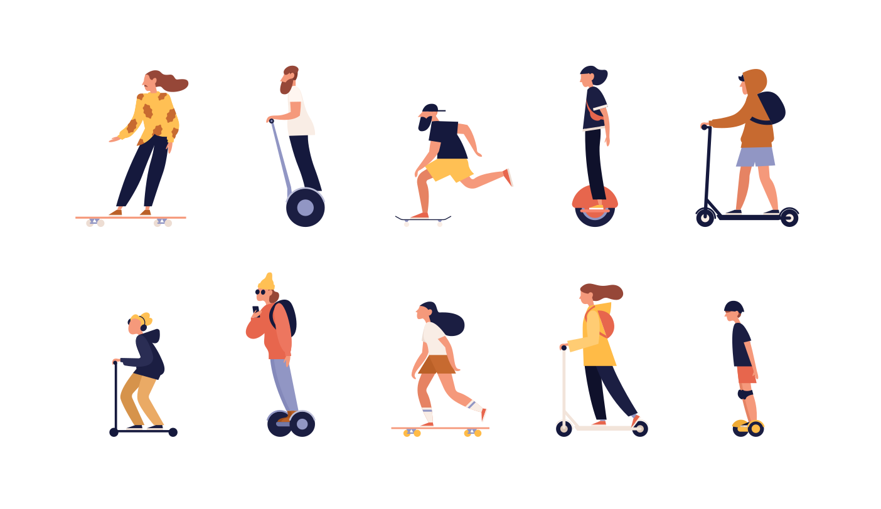
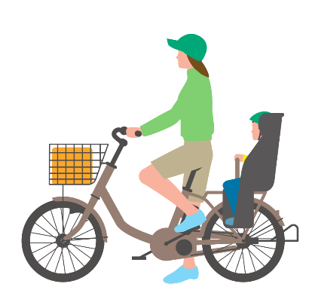

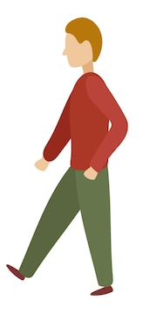
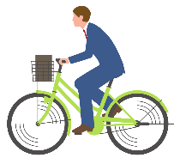



“Active” “Alternative” “Non-motorized” “Vulnerable” “Micromobility” “Human-electric hybrids”

Slide 5

Active Transportation: Benefits & Costs
Internal
Effort
Crashes
Fun
Exercise
Time
Air pollution
($) Cost
Crashes
($) Cost
Air pollution
External
Notes:
WRT cars, b/c we’re in a completely auto-dominated transport system
Useful for short/moderate distance trips
A large share of urban trips (high LU/BE determined, and co-causal)

Slide 6
Motivators & Deterrents
Factor
Safe & comfortable facilities
Preference variation
Distance/time
Weather
Effort, perspiration
Cargo, equipment, parking
Exposure variation
Age
Experience
Income/wealth
Race/ethnicity
HH composition/roles
Urban/rural, Region
Gender
Gender
Risk aversion
Physical condition/capacity
Notes:
Social/cultural norms & risks (visibility, status)
Gender influences the experience of highly visible physical activity in public
People of colour experience
Less safe facilities
Higher injury & fatality rates when walking or cycling
Excessive enforcement & harassment by police & others

Slide 7
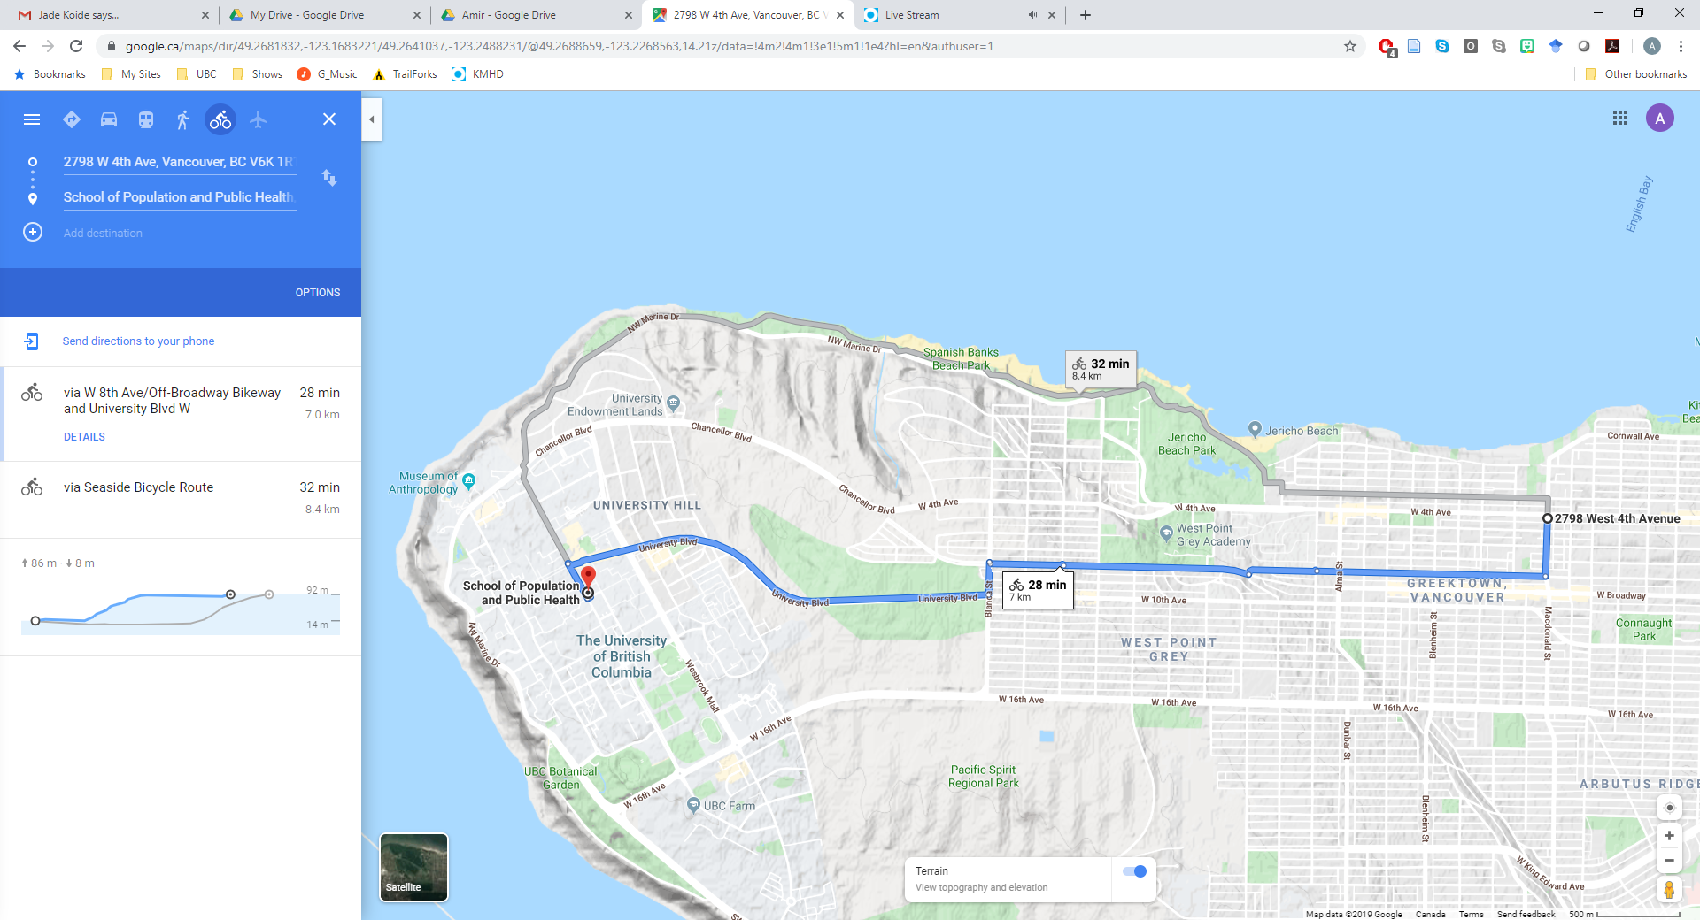
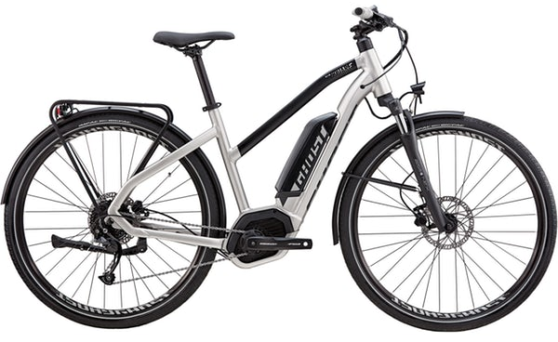
E-assist moderates motivators
Factor
?
Safe & comfortable facilities
Safe & comfortable facilities
Distance/time
Distance/time
Weather
Weather
Effort, perspiration
Speed
Effort, perspiration
Effort
Cargo, equipment, parking
Cargo, equipment, parking
Notes:
Average speeds 10-30% higher than conventional bicycles
Greater on (steeper) up-grades
Less difference in maximum speeds (e-bikes limited ~32 kph)
Longer trips
Less deterrence from hills, perspiration, effort

Slide 8
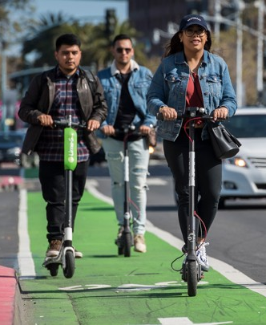
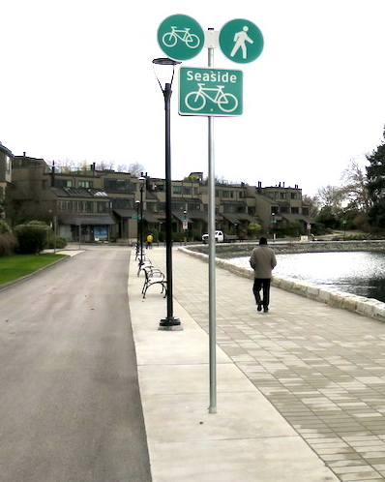
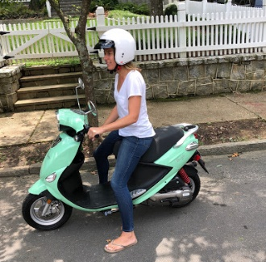
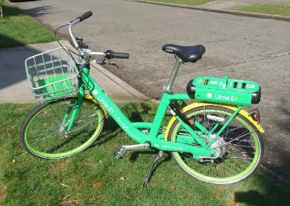
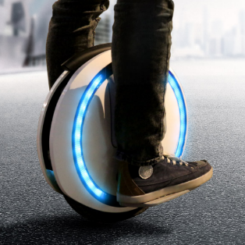
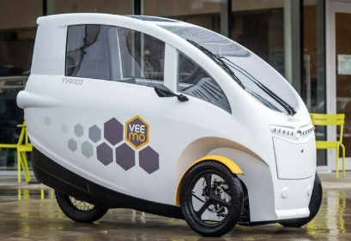
Conflicts among active travellers

Slide 9
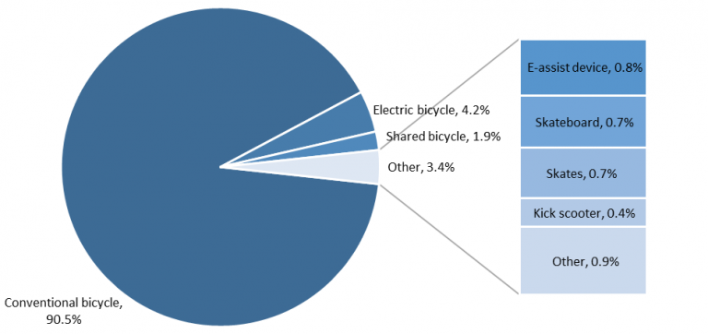
Off-street facilities around Metro Vancouver
25,300 observations
[12 locations over 4 seasons 2020]

Slide 10
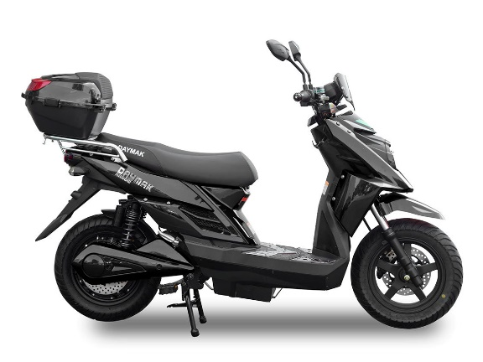
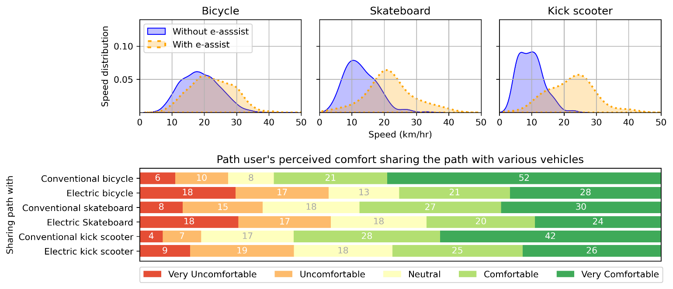
Electric-assist and speed
E-assist speeds in low 20’s kph
Relatively little speeding (>32 kph) - except for sit-down scooters
Notes:
E-assist

Slide 11
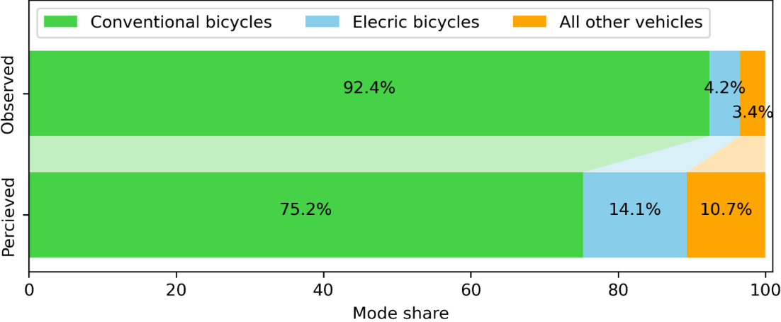
Biased (high) perception of e-bike volumes and speeds

Slide 12
Comfort of path users
E-assist reduces comfort equivalent to +9 kph
Previous experience of incident equivalent to +11 kph

Slide 13
How do we promote active travel?

Slide 14
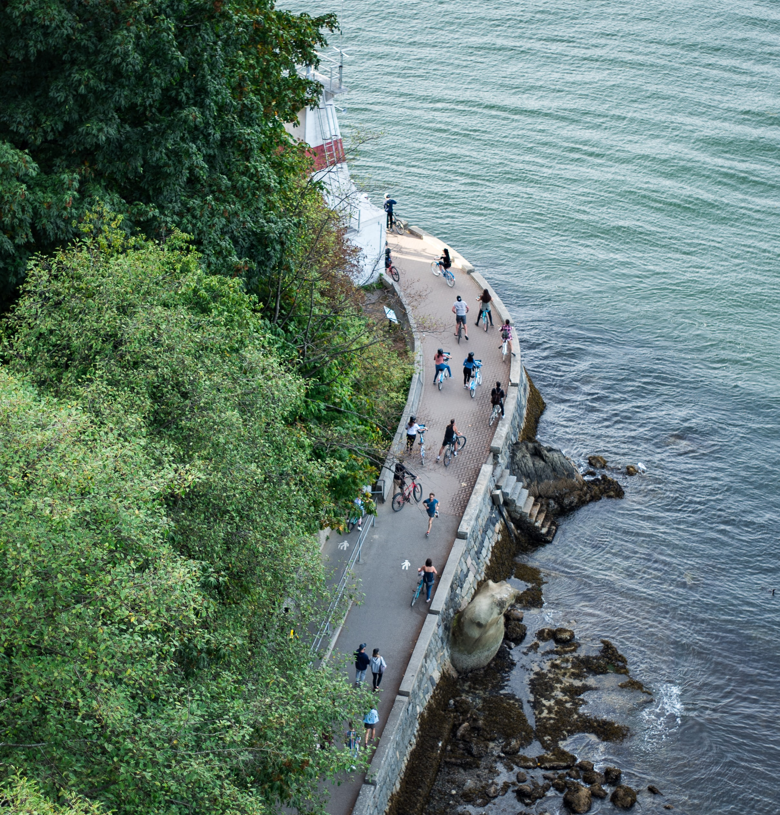
1. Build safe, comfortable, & useful networks
Protected, separated facilities
  All from motor vehicles
  Peds from rollers (esp. e-assist)
Cohesive, connected, complete
  Equitably accessible
Access to destinations

Slide 15
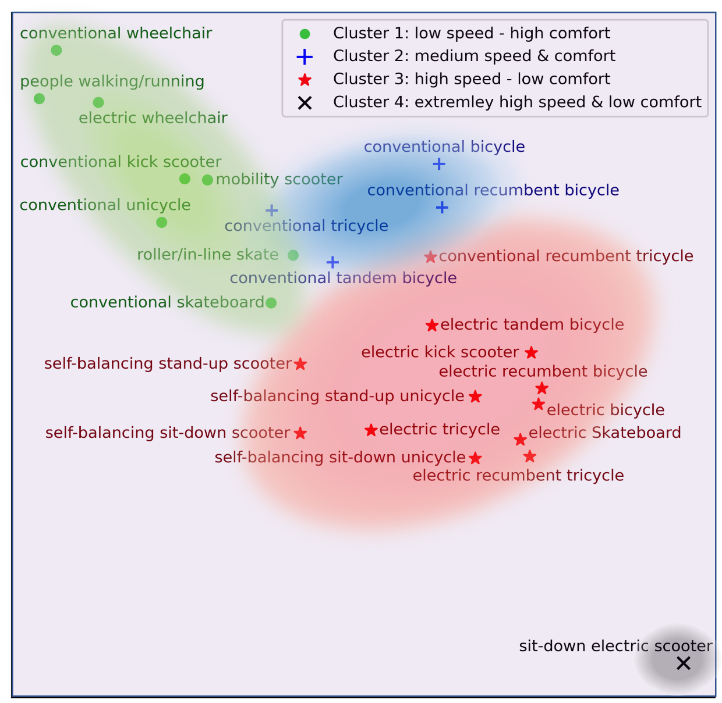
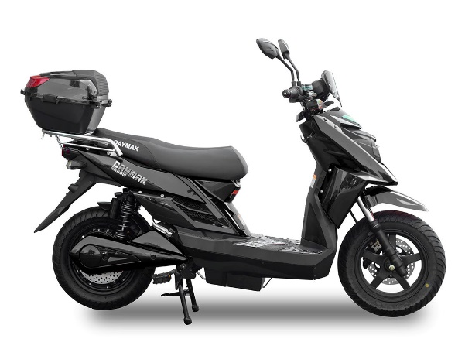
2. Enable e-assist w/o discouraging non-motorized
Legalize & regulate e-assist micromobility
Restrict on pedestrian & crowded facilities
Regulate sit-down scooters as low-speed motorcycles
Higher comfort
Higher speed

Slide 16
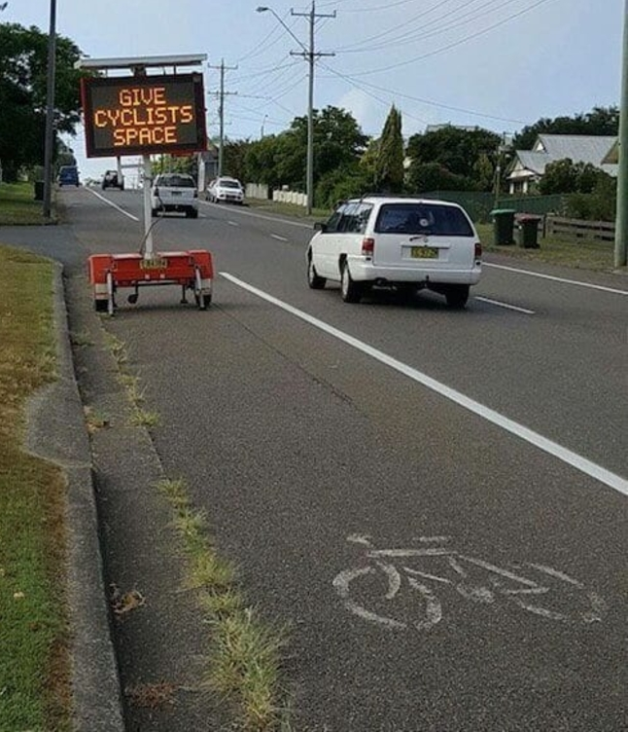
3. Develop multimodal transport systems
Enable car-light lifestyle
  Excellent transit, car-sharing
Enable short trips
  Compact & mixed use development
Internalize full costs of driving
  Road pricing, crash costs
Secure bicycle parking/storage

Slide 17
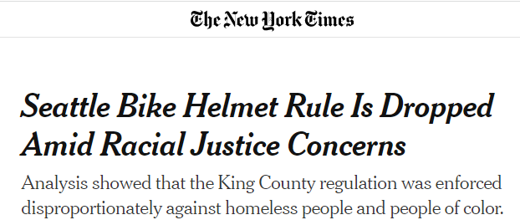
4. End policing of active travellers
Decriminalize all active travel
  (“Jay walking”, “Idaho stops”, etc.)
Eliminate helmet, bell laws
  (which do not measurably
  improve safety)
Shift from victim-blaming
(in media, policing, policy, etc.)
Notes:
25% of hospitalizations from cycling injuries involve a head injury
Yet evidence consistently shows that helmet laws do not improve cyclist safety
Limited impact on helmet use
Limited impact on crash outcomes
Risk compensation by riders & drivers
Suppress cycling activity
No helmet available
Perceptions of risk
Bikeshare systems

Slide 18
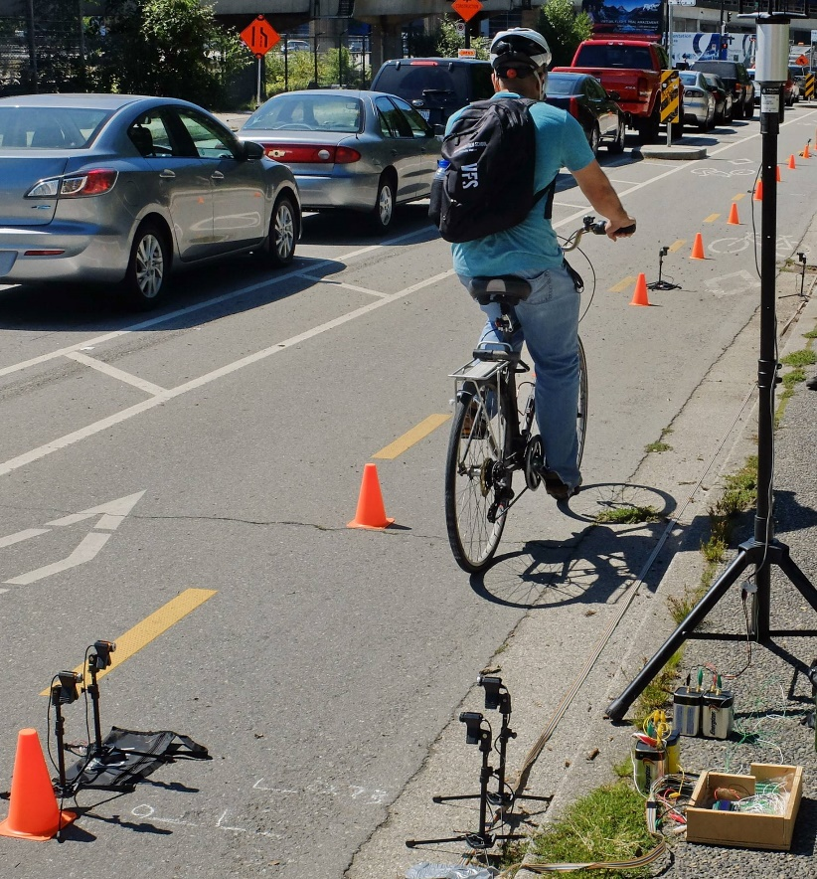
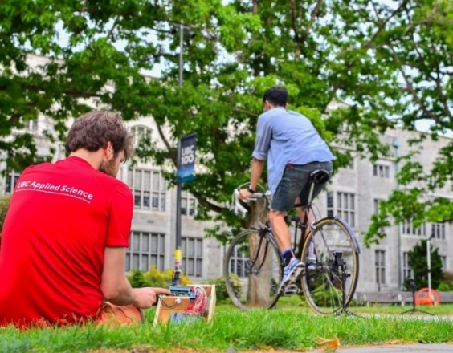
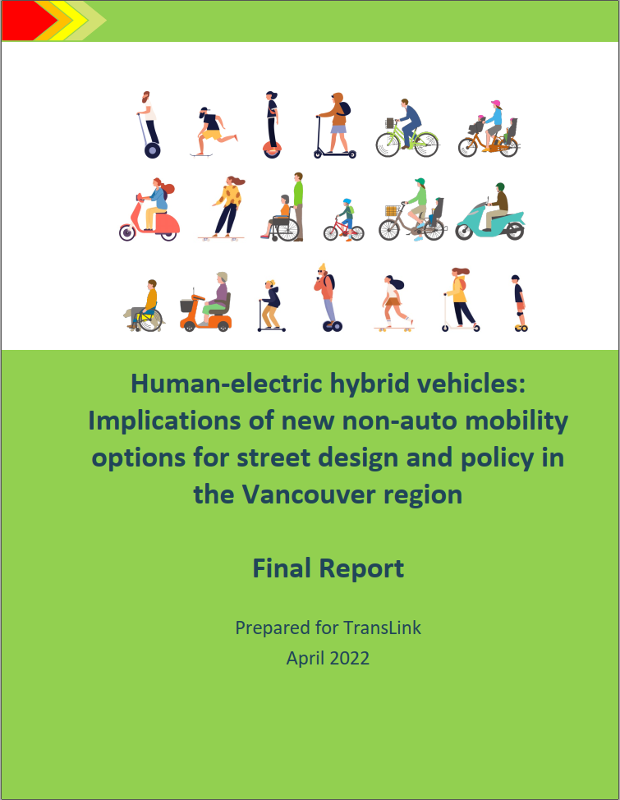


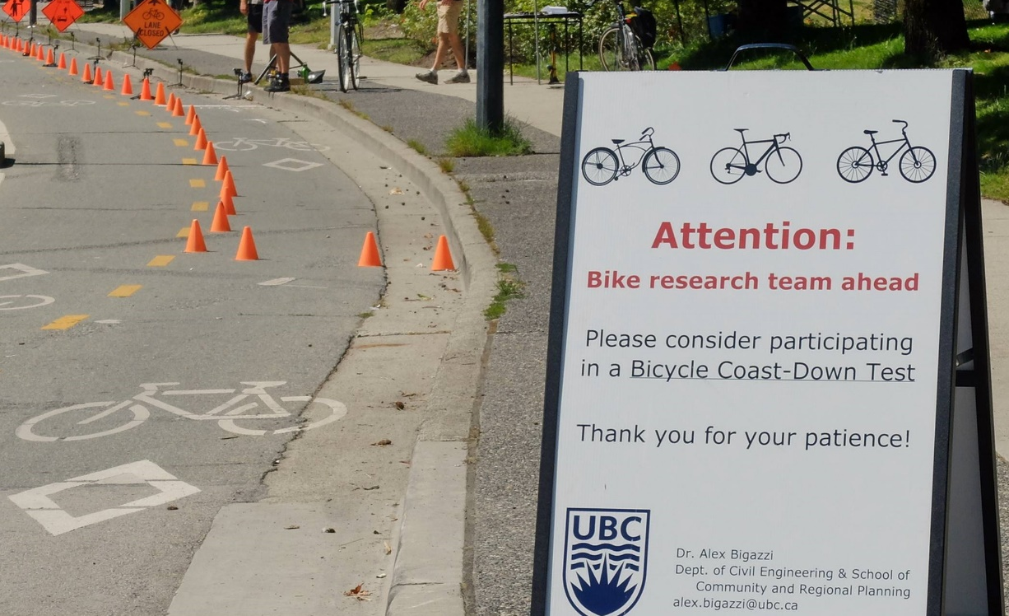
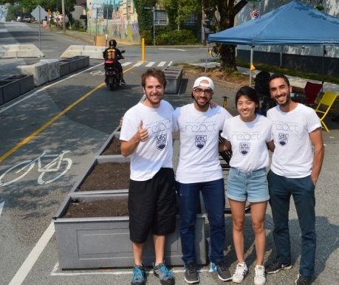
reactlab.civil.ubc.ca
Acknowledgments:
REACT Lab students, esp. E. Berjisian, A. Hassanpour, F. Gkekas
NSERC, SSHRC, TransLink, Vancouver, Victoria, Saanich, & others
alex.bigazzi@ubc.ca

Slide 19


Metabolic Equivalent Task (MET)
Vigorous
8
Difficulty conversing
6
Moderate
Can hold a conversation, but not sing/hum
4
Light
2
Can sing/hum
0
A 15-minute commute gets you 150 min/week!
Notes:
Health recommendation: >150 min/week of moderate-to-vigorous activities

Slide 20
Air pollution
Risks
Mitigation
Prefer low-dose speed/exertion
(moderate MET)
Elevated ventilation
Prefer low-traffic routes
Near exhaust
No vehicle shell
Limited duration
Overall pollution health risk is dwarfed by exercise benefits*
Notes:
4-6 MET, 15-20 kph on level ground
Little health of repeated short-term exposure
There are places where they could start to approach

Slide 21



Safety
Varies with how you measure exposure!
<<
<<
Low risk
High risk
Highly contextual: safer with better infrastructure & more active travel
Vulnerable in collisions, mitigated by lower speeds & lower frequency
Notes:
Highly contextual: cycling is safer than walking in BC, but less safe in the USA

Slide 22
How much active travel is there?
  (1.5 km, 17 min)
  (6 km, 22 min)
  ?

Slide 23
E-Bike mode shift
https://www.sciencedirect.com/science/article/abs/pii/S136192092030599X

Slide 24
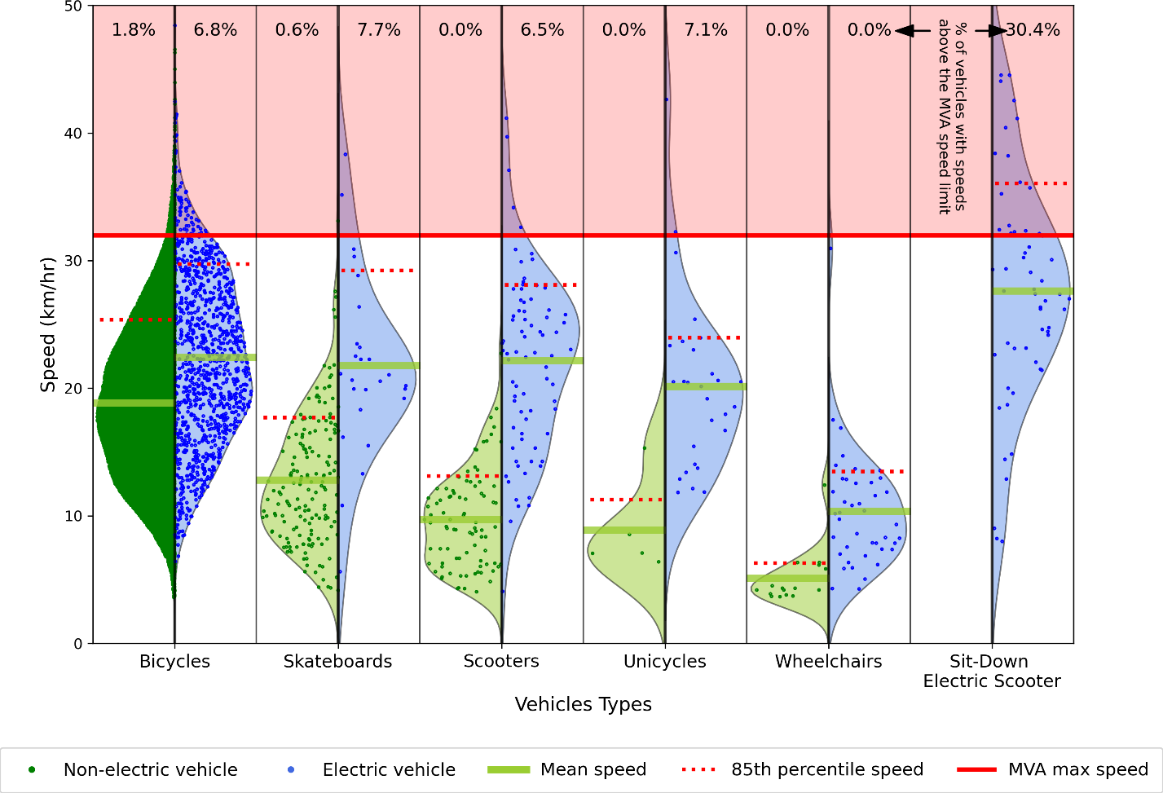
Notes:
E-assist

