Slide 1
How Norway killed the combustion car market
Petter Haugneland
Assistant Secretary General
petter@elbil.no
Notes:
Introduction

Slide 2
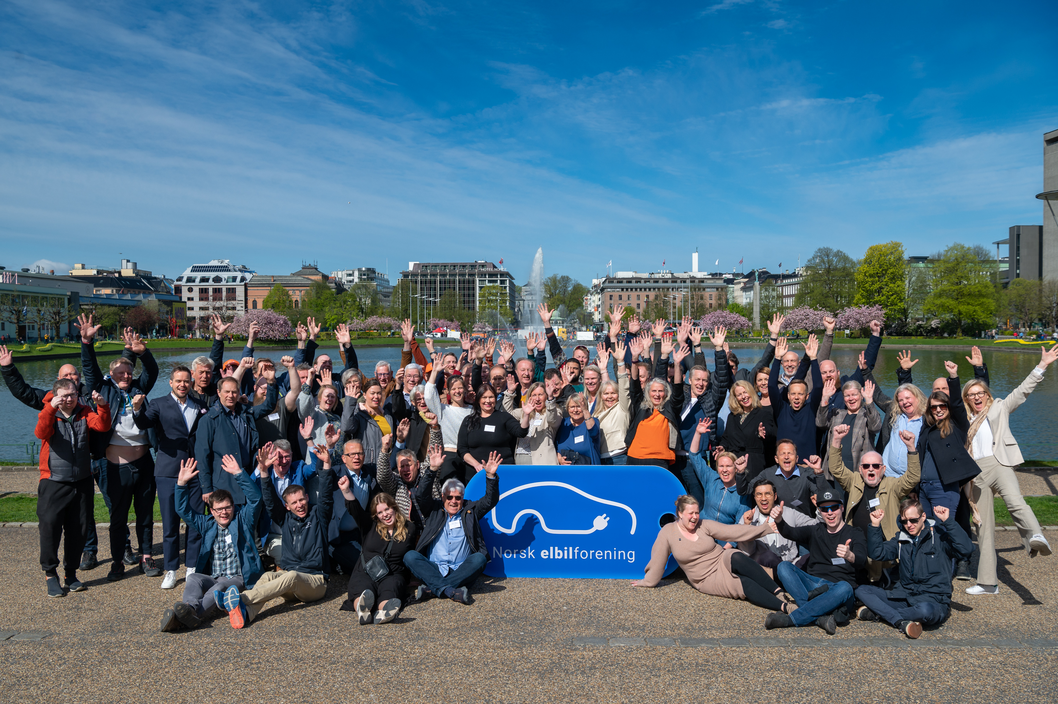
Norwegian EV Association
Non-profit NGO
Over 120,000 members (EV drivers)
50+ employees
14 local branches
Our goal:
Electrify transport as fast as possible!
Notes:
Picture from our national congress meeting in Bergen 2022

Slide 3
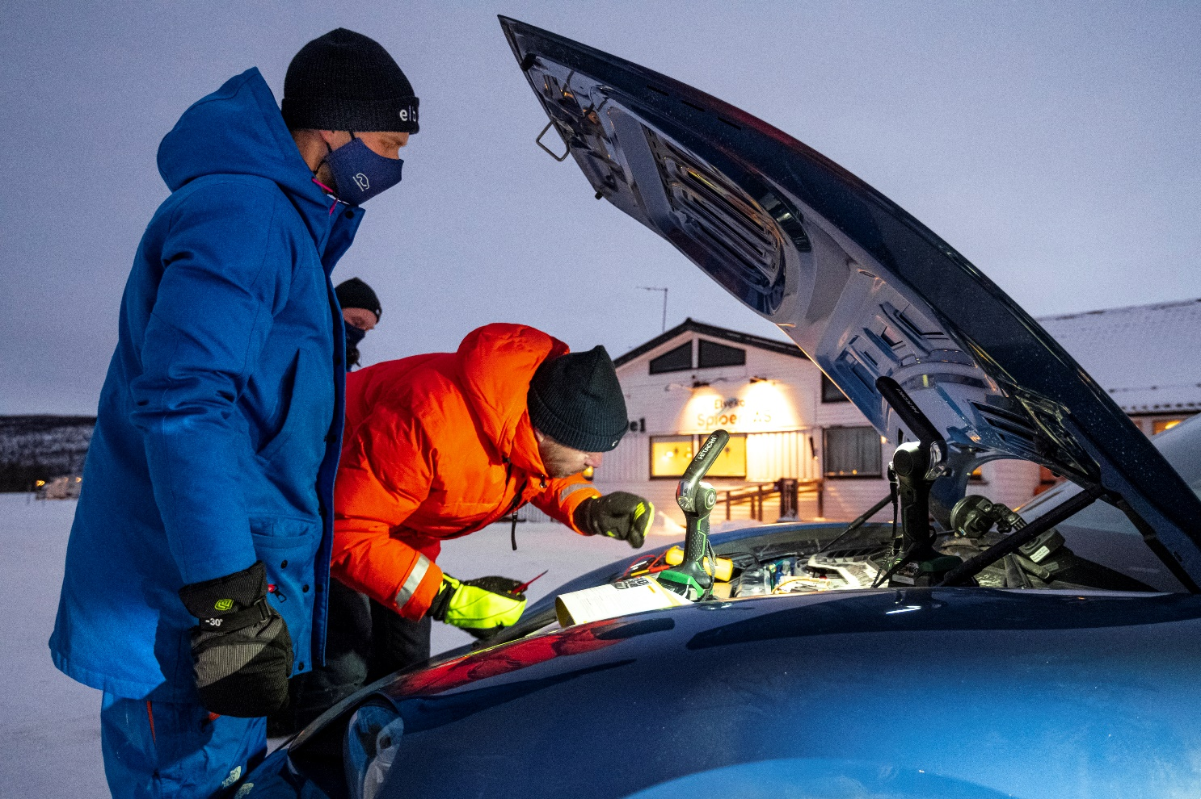
What we do
Local, national and international policy advocacy to speed up transition to electric mobility
Members service: Helping new EV owners with tips, help and charging services
EV app with charging map and route planner
Charging service Ladeklubben
Testing new electric cars and charging infrastructure
The Norwegian EV owners survey

Slide 4
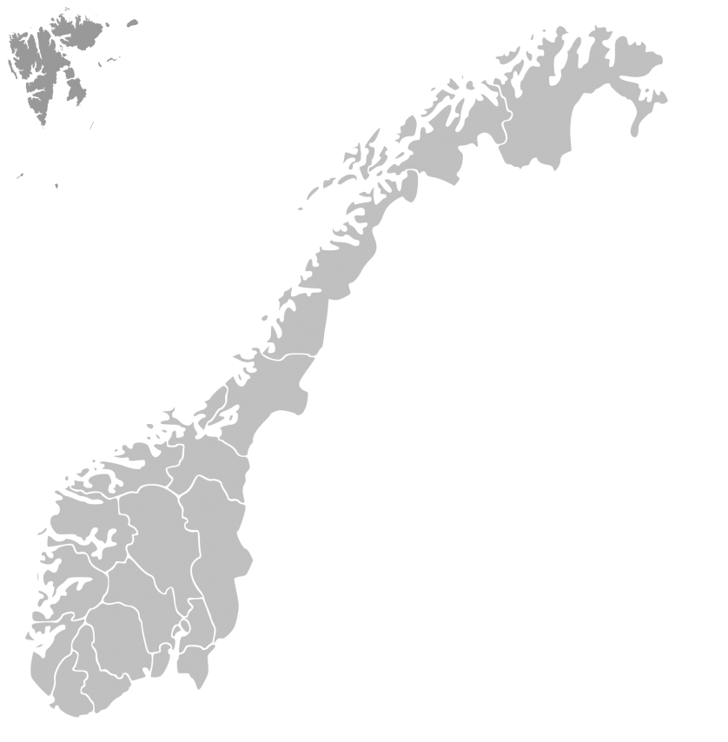
Norway
5,5 million people
2,9 million passenger cars
0,5 million electric cars
Yearly 155 TWh energy production
89 % hydro power
10 % wind energy
= 99 % renewable
Visit norway

Slide 5
Norwegian CO2 Emissions
Other sources
Oil and gas
Road transport 17%
Up 13% since 1990
Reduced by 4,7 % from 2019-2020
Power generation
Agriculture
Air, sea and construction sites
Total 49,3 million tonn
Industry
Road transport
8,7 mill. tonn
Source: SSB 2021
Notes:
Lets look at the bigger picture. Road transport accounts for 17 percent of Norwegian emissions. And they have gone up 13 percent since 1990. Now they have started to og down, from 2019-2020 we saw a 4.7 percent reduction.
Regner egentlig med at dere vet hvorfor det er viktig egentlig.
8,4 millioner tonn fra veitrafikk, totale utslipp 49,3 mill. tonn.
500.000 elbiler kutter 1 mill. tonn.

Slide 6
Norwegian goal: All new cars and small trucks sold are zero emission by 2025

Slide 7
Market share new sales
Target for 2025:
100%
Source: OFV
Notes:
New car sales
When i say EV i mean the fully electric ones. If i mean plug in hybrids, I will say plug in hybrids.
2025-target, is a target not a ban. It has broad political support. There is no no plan to ban buying of new fossil fuel cars.

Slide 8
620 000 EVs in Norway (+190 000 PHEVs)
21% EV fleet share
7% PHEV fleet share
Source: OFV
Notes:
In Oslo and Bergen 30 EVs

Slide 9
How to spot an electric car in Norway

Slide 10
Are we there yet?
20,8%
2.270.000 to go
4,3%
490.000 to go
5,4%
15.000 to go
0,7%
68.000 to go
Source: OFV
Notes:
Oppdatert per juli 2022
This is where we are at right now. Norway – the country in the world with the highest uptake of elecric cars still has a looong way to go. Only 18,2% of the passenger cars are electric – and for vans, busses and trucks we are far behind. So, the job is definitely not done. And the EV policies are absolutely debated. I must stress that to succeed we have to keep at it until we are finished. This message is especially directed to our politicians.

Slide 11
Car fleet by fuel type 2022
Diesel: 1,1 million
Petrol: 0,9 million
BEV: 0,6 million
PHEV: 0,2 million

Slide 12
Support is the key
Buying or leasing:
Low purchase tax
Zero VAT up to 500.000 NOK
LCV support scheme
Using:
Toll roads max 70%
Ferries 50%
Access to bus lanes
Notes:
This is happening because we are using strong incentives.
We started to change the incentives.
And from this year, we have introduced some VAT, and also some purchase tax. Still very strong incentives.
The purchase tax is much on higher on cars with emissions.
Also changed toll roads this from, from a maximum of 50 per cent, to a maximum of 70 per cent.

Slide 13
Purchase taxes
Price before taxes
25% VAT
Purchase tax
400.000,-
400.000,-
Price before taxes

Slide 14
Bonus Malus system – polluter pays
Tax polluting cars
Use revenue to subsidize EVs
Notes:
Not all countries can do what Norway does, but a Bonus Malus system is available to all.
Countries like Sweden and New Zealand have done this.
Better way than taxing fuels etc. because this affects people that are buyng a new car, not everyone.

Slide 15
From 2% to 10% market share
Norway
2.5 years
UK
1.5 years
Germany
1 year
Source: ACEA

Slide 16
The Norwegian EV driver survey at a glance
Conducted by the Norwegian EV Association in April 2022
Digital questionnaire with 16.000 respondents
Experiences and attitudes of Norwegian EV drivers
Notes:
And we do that.
We do an annual EV driver survey
15 000 respondents.
and we try to find out what norwegian EV drivers think about driving electric.

Slide 17
Happy EV drivers
93%
are satisfied or very satisfied with being an EV driver
Source: The Norwegian EV Driver survey
Notes:
We have some challenges, but EV drivers love driving electric.
And that is really important to keep in mind.

Slide 18
97%
have their own parking spot
80%
of charging at home
Source: The Norwegian EV Driver survey
Notes:
Almost all have access to parking at home (normal in Norway)
And we know that roughly 80 percent of the total charing happens at home.
Home charging is important, but lets focus on fast charging.

Slide 19
How often do you charge at..
Source: The Norwegian EV Driver survey

Slide 20
Public funding
Public tenders for initial network
Fast charging stations every 50 km on all main roads (7 500 km)
Small stations (50 kW*2+AC)
Notes:
Finnmark
Good start, but not large scale.

Slide 21
Fast chargers and EVs
Source: OFV, Nobil and Norwegian EV Association
Notes:
At 4300 today. Including Tesla with 1200 something

Slide 22
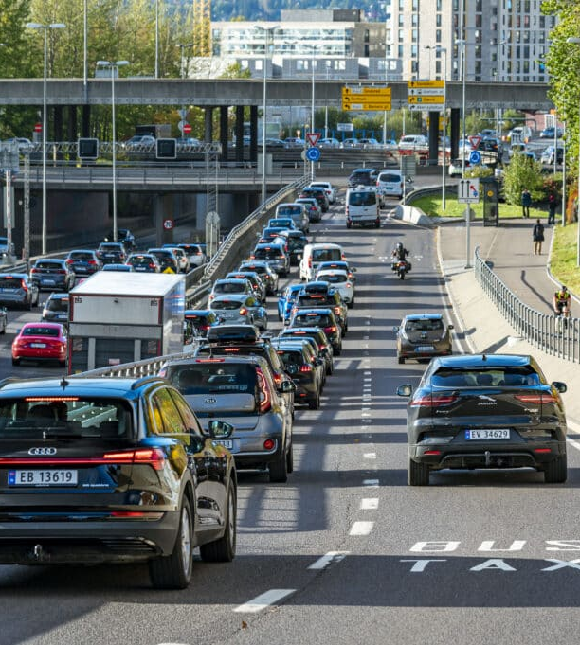
Local and regional policies
Access to bus lanes
Free or cheaper toll roads
Charging infrastructure
Home charging in shared apartement buildings
Notes:
Electric bikes extend your range and also makes all hills flat. Perfect commute to work.
Electric bikes revolution in Norway
40 electric ferries in Norway

Slide 23
Local and regional policies
Car restrictions in city centres
Support schemes for electric bikes
New bike lanes and corridors
Electric buses and ferries
Zero emission delivery trucks
Notes:
Electric bikes extend your range and also makes all hills flat. Perfect commute to work.
Electric bikes revolution in Norway
40 electric ferries in Norway

Slide 24
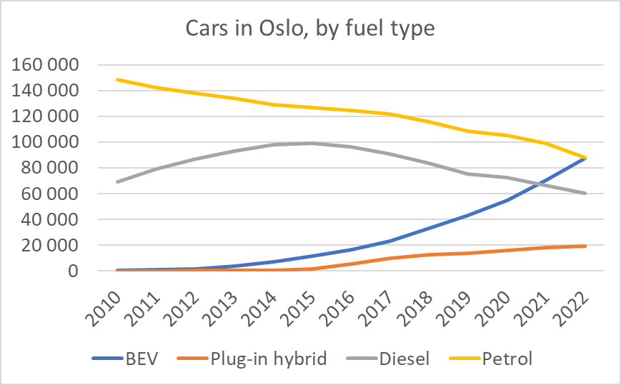
Cars in Oslo by fuel type
Notes:
34 % Electric cars in Oslo, 30 % in Bergen area

Slide 25
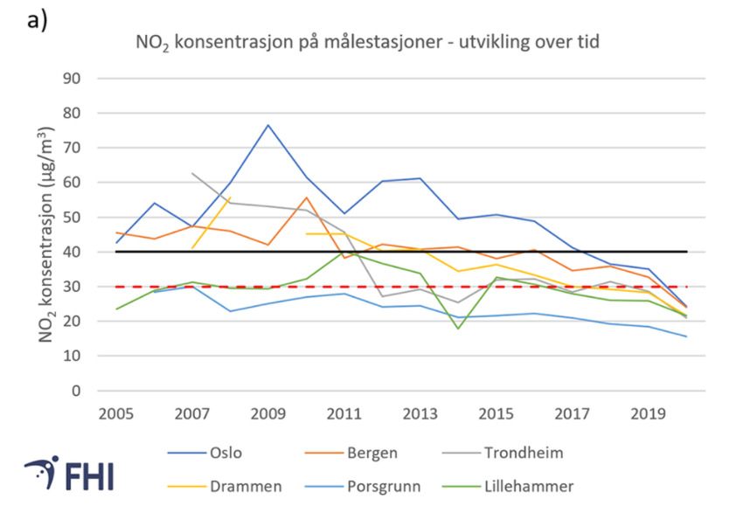
NO2 consentrations in Norwegian cities
Notes:
Limit value (black line) and air quality criteria (dotted red line).

Slide 27
Room for improvements
New battery technology
Large scale production
Recycling and re-use
New car technology
Cleaner power mix
European battery production
Notes:
Kommer stadig små og store forbedringer – også på hvilke materialer vi putter inn i batteriene. For eksempel så finnes det allerede batterier uten kobolt på norske veier (Tesla model 3 fra kina). MEN kobolten bringer fortsatt hodebry og utfordringer som må håndteres:
Equity
Over 20 000 used electric cars for sale from 25000 NOK
Charging infrastructure

Slide 28
