Slide 1

Beyond GHG: The challenge of achieving fair, healthy,
and community-centered transport decarbonization
Marianne Hatzopoulou
Professor, Civil and Mineral Engineering
Director, Positive Zero Transport Futures

Slide 2
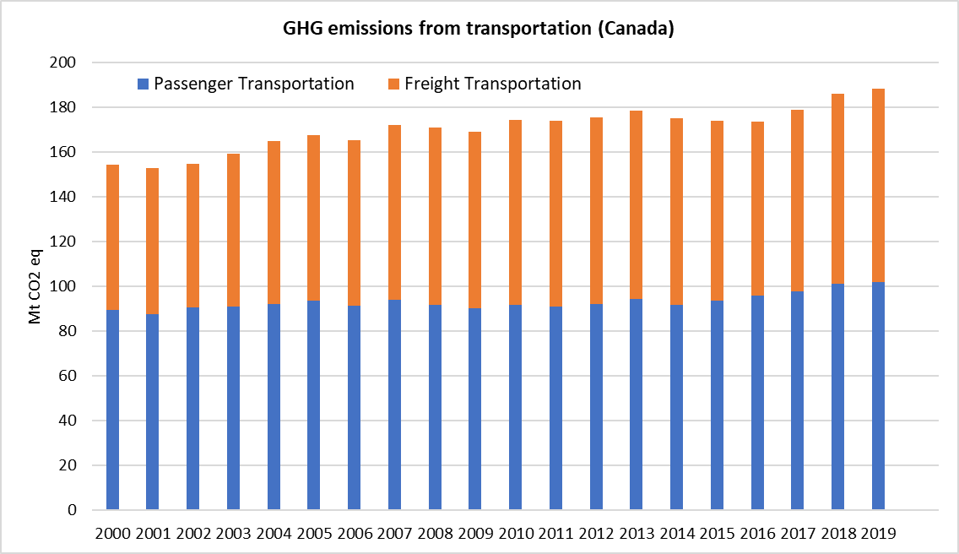
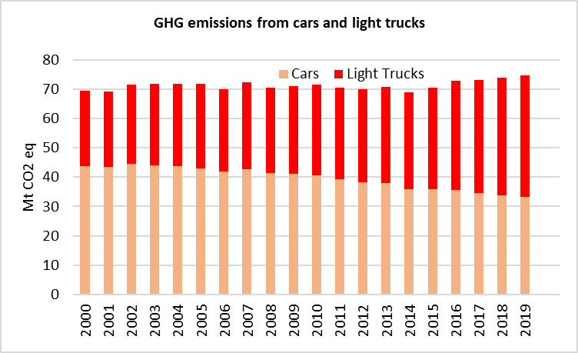
Let’s acknowledge our current position
Environment and Climate Change Canada (2022) Canadian Environmental Sustainability Indicators: Greenhouse gas emissions. Consulted on March 15, 2023. Available at: www.canada.ca/en/environment-climate-change/services/environmental-indicators/greenhouse-gasemissions.html.

Slide 3
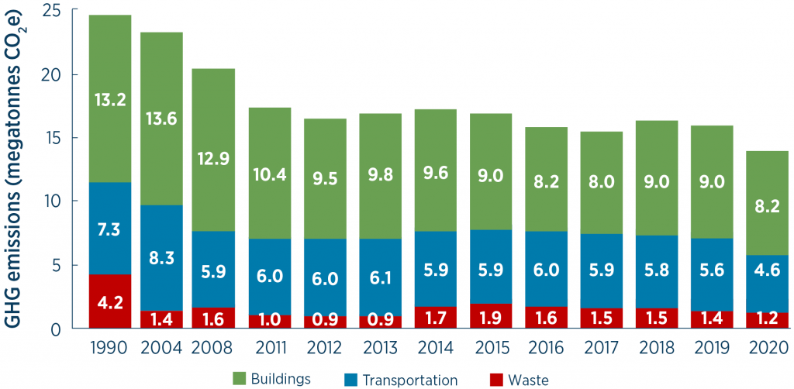
Toronto’s GHG emissions: where we are now
TransformTO Net Zero strategy

Slide 4
Toronto’s GHG emissions: Where we want to go
With the adoption of the Net Zero Strategy, the City’s GHG reduction targets, from 1990 levels, are:
30 per cent by 2020
45 per cent by 2025
65 per cent by 2030
net zero by 2040

Slide 5
Toronto’s GHG emissions: Where we want to go
43% reduction from 1990
Largest drop in transport emissions ever recorded

Slide 6
Toronto’s GHG emissions: Where we want to go
Needs to drop to 2.5Mt to meet 2030 goal

Slide 7
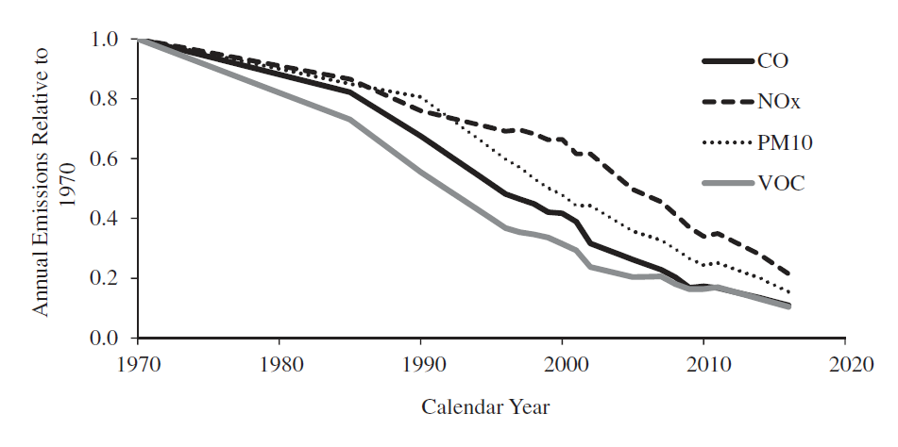
What we know that worked
Vehicle emission standards enabled the development and continuous improvements of new control technology, which
reduced exhaust emissions substantially since the 1990’s
Figure 7: relative trends in U.S. annual highway vehicle CO, NOx, VOC, and PM₁₀ emissions, based on EPA data. From Frey, 2018. Trends in on-road transportation energy and emissions, Journal of the Air & Waste Management Association, 68:6, 514-563

Slide 8
Highlights from the 2022 USEPA Automotive Trends Report
EPA-420-R-22-029 December 2022

Slide 9
Highlights from the 2022 USEPA Automotive Trends Report
EPA-420-R-22-029 December 2022

Slide 10
Highlights from the 2022 USEPA Automotive Trends Report
EPA-420-R-22-029 December 2022

Slide 11
- Electrification
- Mode shift and VKT reduction
- Land-use and densification
How do we achieve these deep reductions in the transportation sector?

Slide 12
- Electrification
- Mode shift and VKT reduction
- Land-use and densification
How do we achieve these reductions in the transportation sector?
Climate mitigation
Transport equity
Environmental justice

Slide 13
What is your vision for the future of transportation?

Slide 14

The future of transportation needs to achieve much more than reducing GHG emissions
A bold vision…
But are all transportation innovations guaranteed to mitigate climate change and improve societal goals?

Slide 15
Benefits of light-duty electric vehicles in a local context

Slide 16
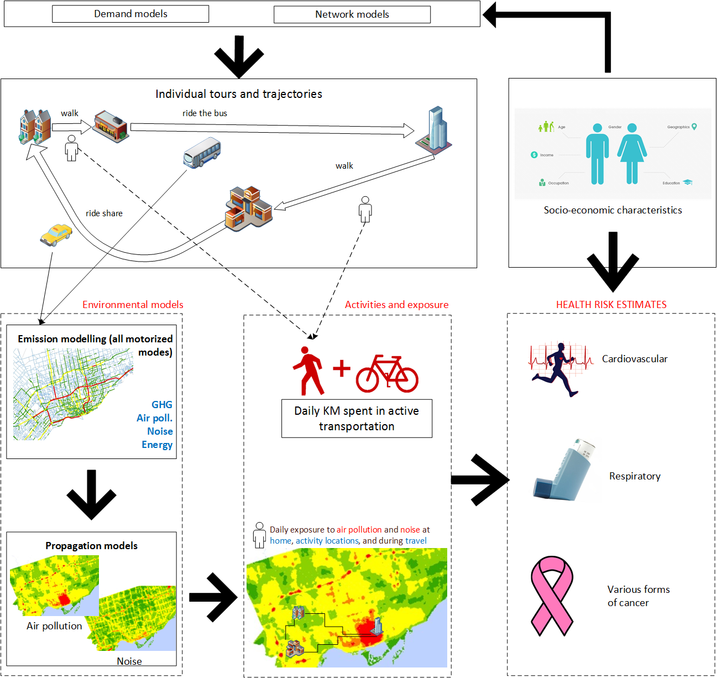

Slide 17


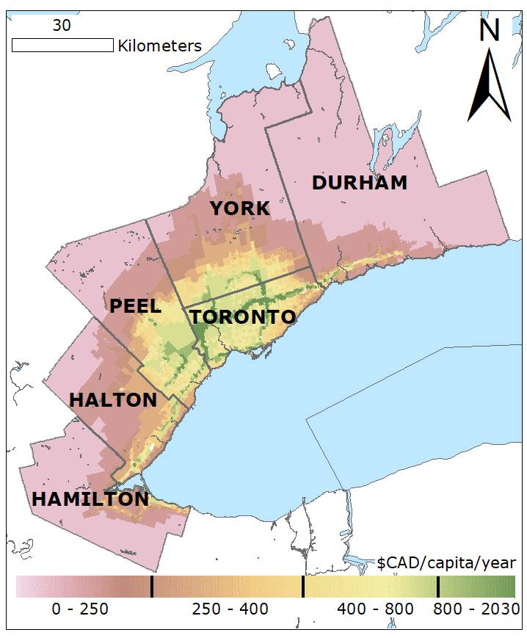
Annual benefits of electric vehicles in the GTHA
313 premature deaths prevented
$2.4 billion per year in social benefits
7.6 mega tonnes (68.5% GHG reductions from base for 2016)
$9,850 social benefits per electric car deployed (over the lifetime of the vehicle)
313 premature deaths prevented

Slide 18
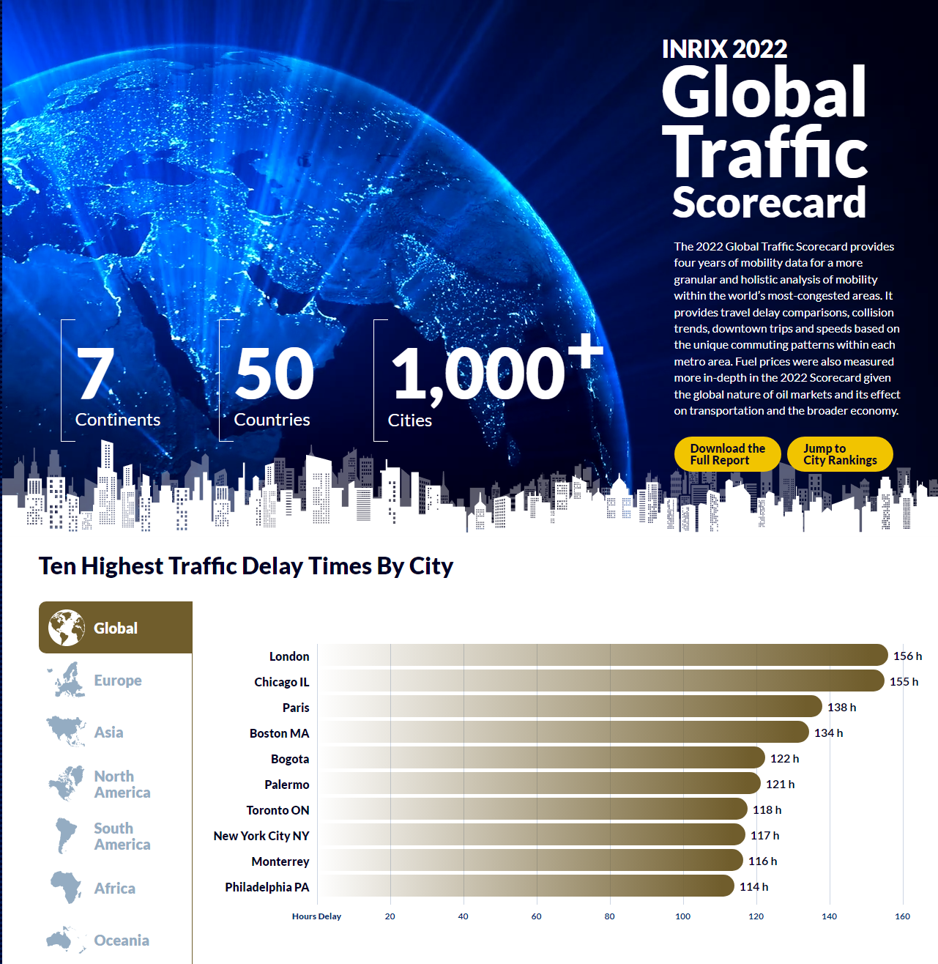
Toronto is the 7th most congested city globally

Slide 19
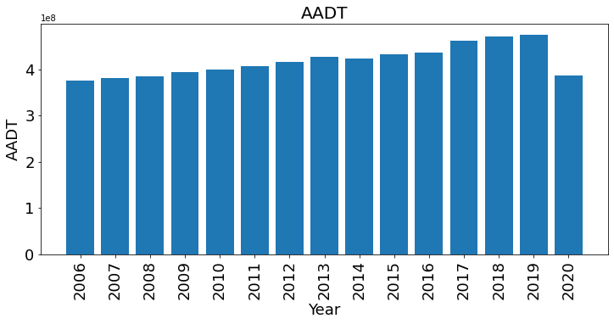
Evolution of total traffic in Toronto

Slide 20
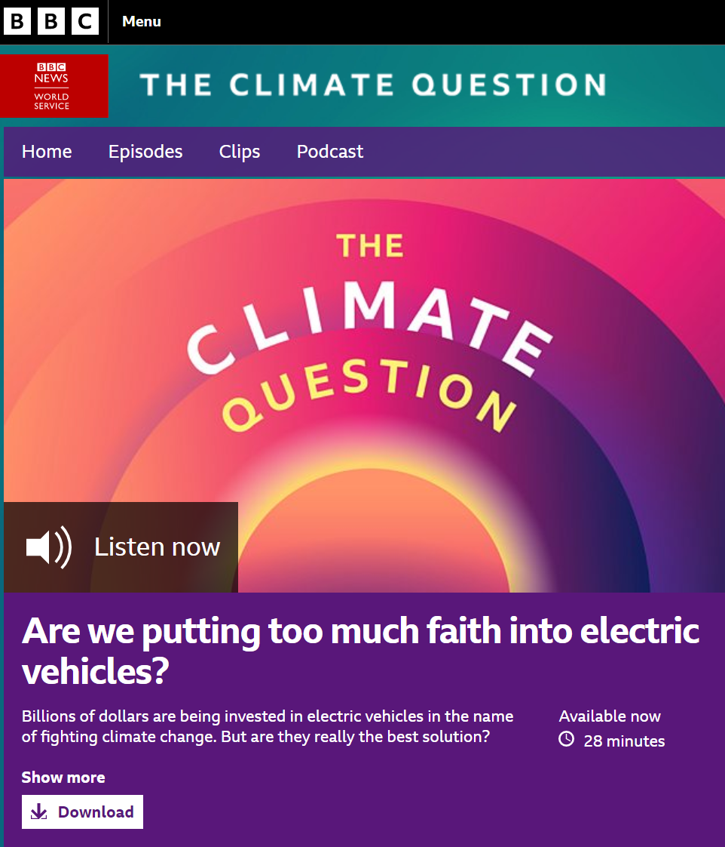

Technology alone is not sufficient!
CIRCUIT
oil on canvas, 48"x48", 2015
Michael Kerbow

Slide 21
Travel behaviour, residential location, and equity in GHG generation from transportation

Slide 22
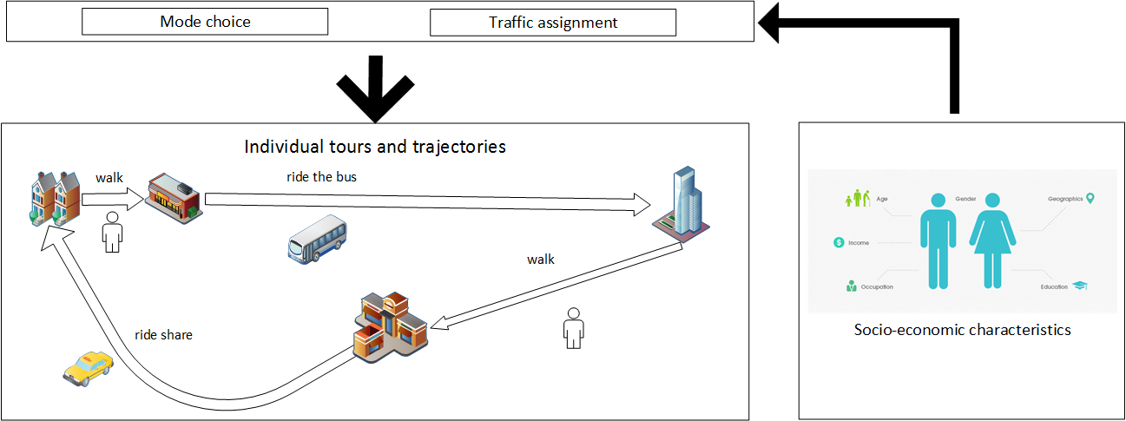

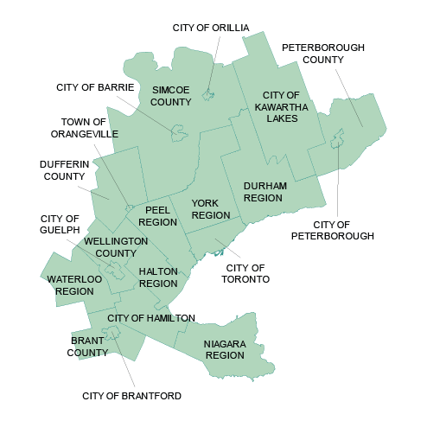
Personal GHG emissions from transportation

Slide 23
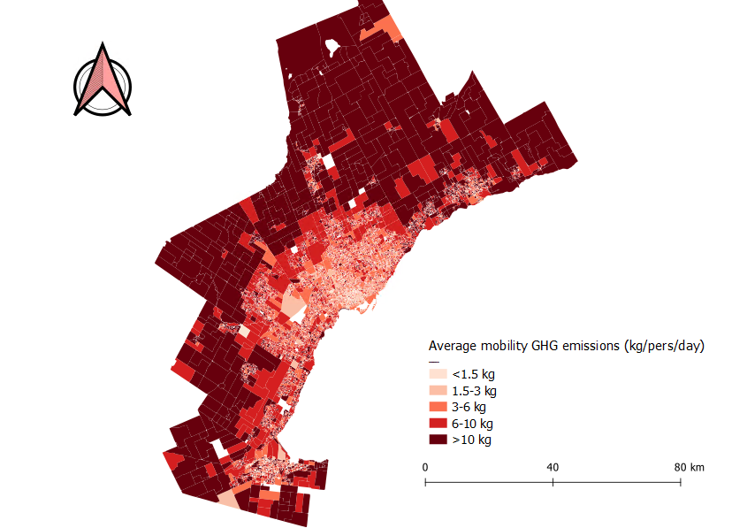
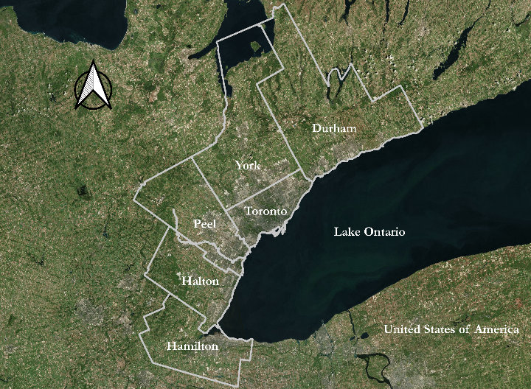
Daily transport GHG emitted (Kg/person)

Slide 24
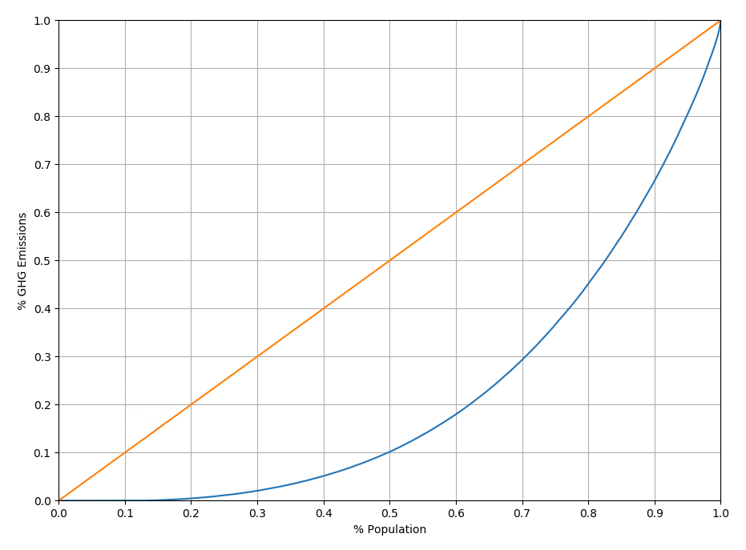
Distribution of GHG emissions from transportation across individuals in the GTHA (Gini = 55.48%)
Distribution of GHG emissions from transportation across individuals in the GTHA (Gini = 55.48%)
The top 30% of the population is responsible for 70% of total emissions

Slide 25
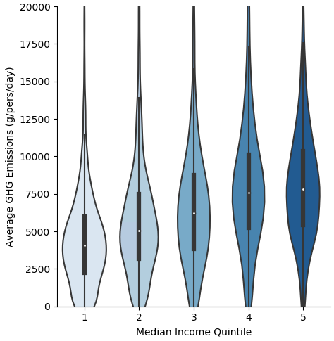
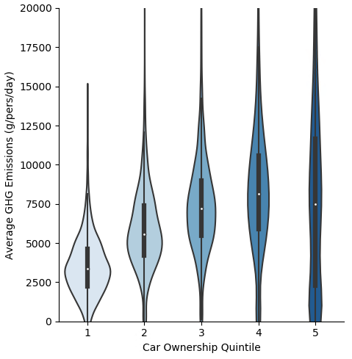
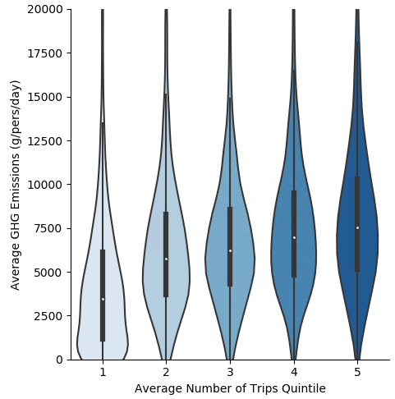
Income, car ownership, trip frequency are associated with higher personal emissions

Slide 26
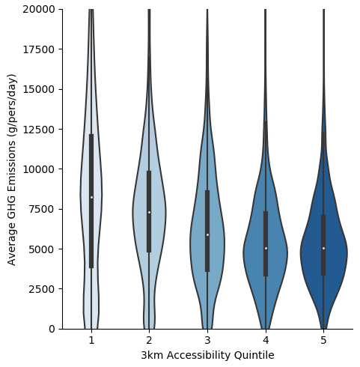

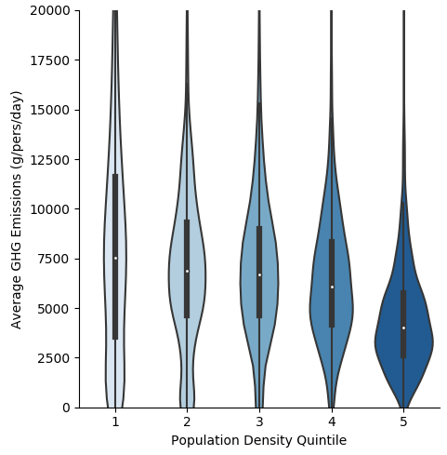
Land-use matters!

Slide 27
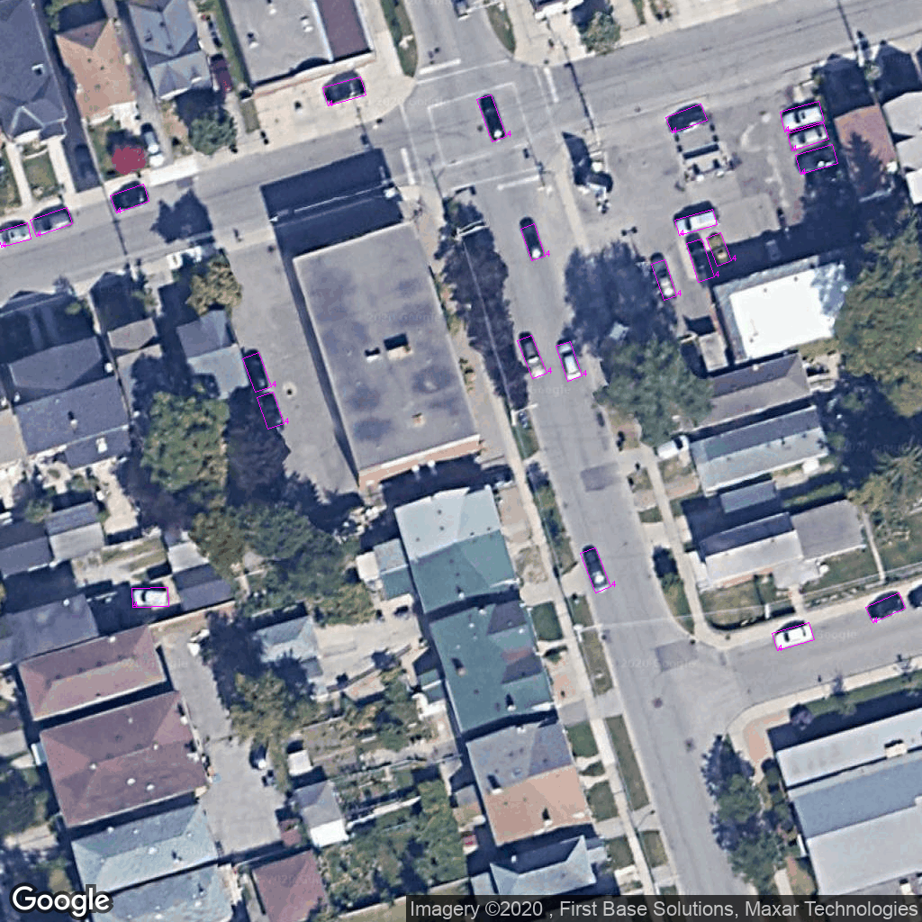
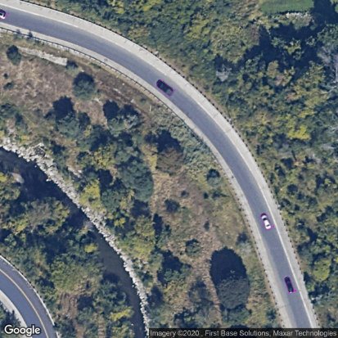
Training deep learning models by labelling aerial images of neighborhoods with the mean per capita GHG emissions: Can we predict transportation emissions using images of urban environments?

Slide 28
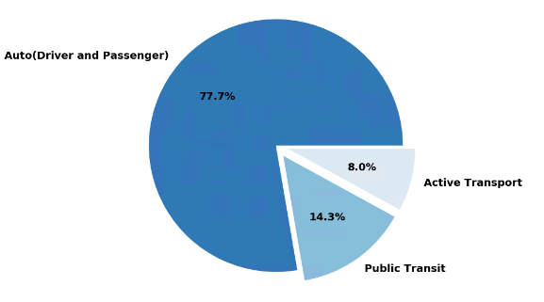
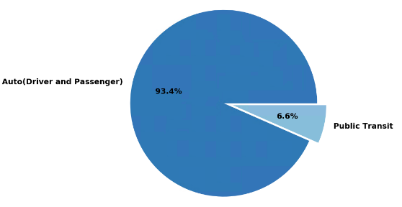
Trips by mode and GHG and mode in the region
Distribution of trips
Distribution of GHG

Slide 29
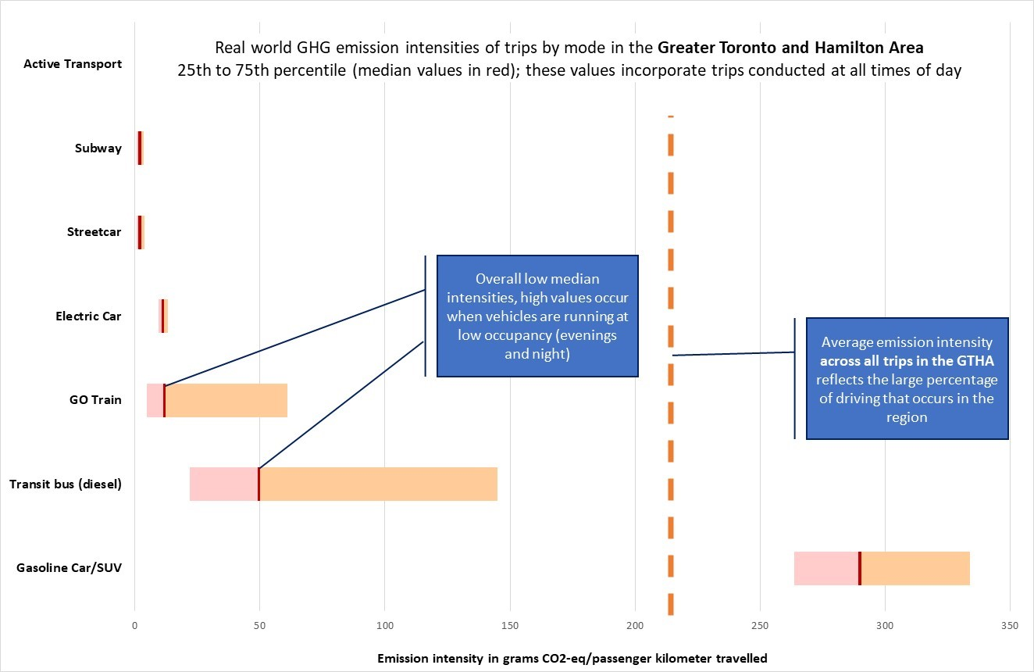

Slide 30

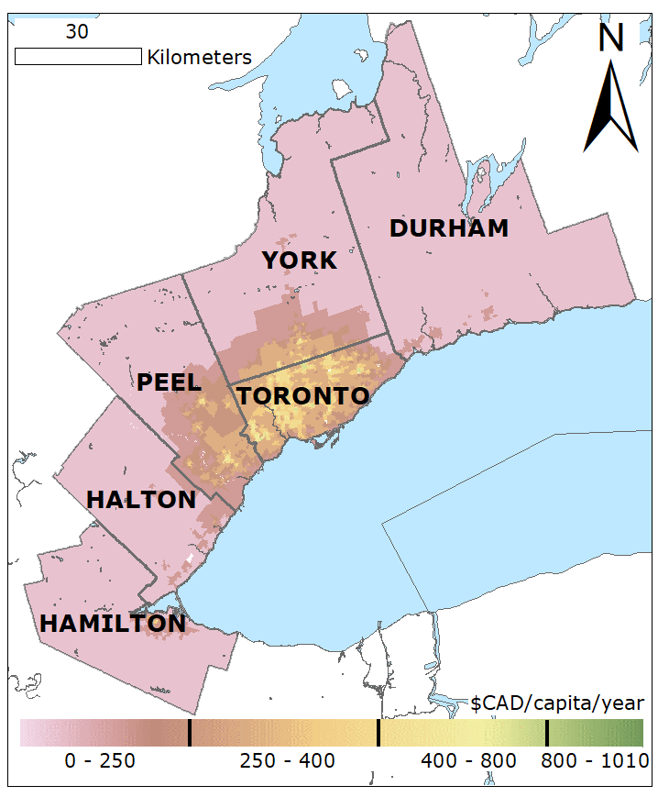
Transit bus electrification has positive co-benefits for local air quality
143 premature deaths prevented
$1.1 billion per year in social benefits
0.3 mega tonnes annual GHG reductions

Slide 31
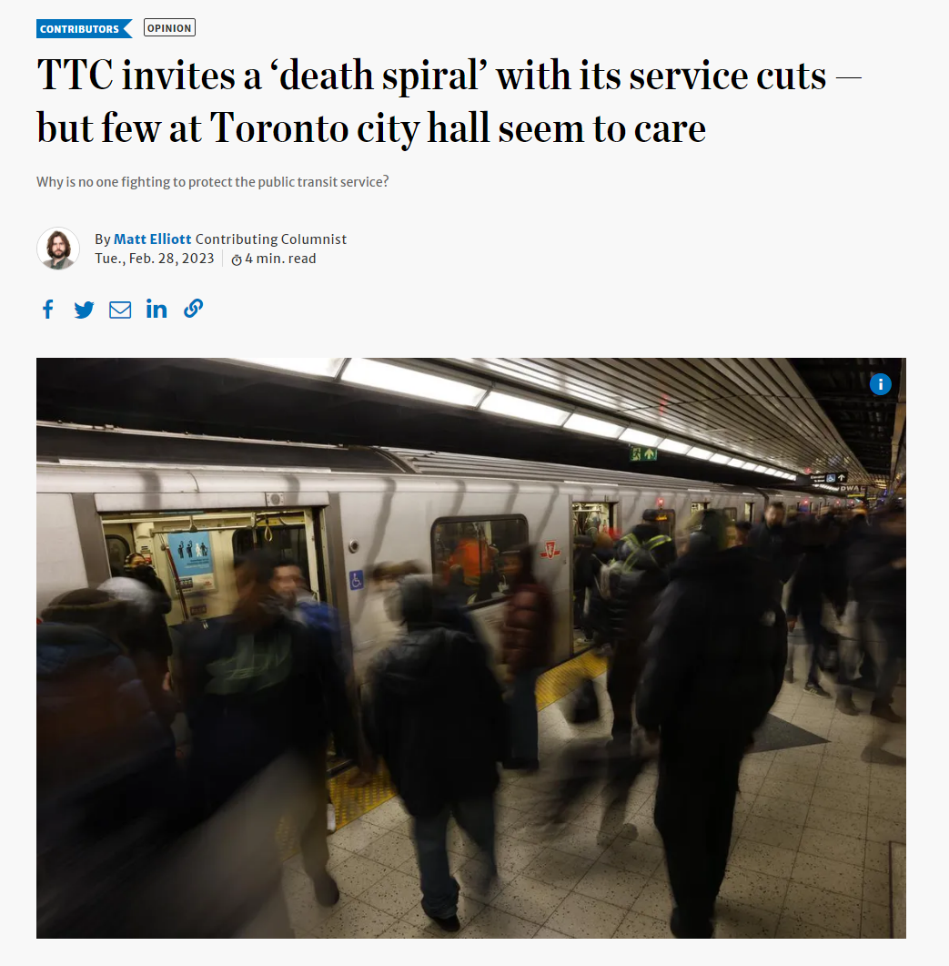
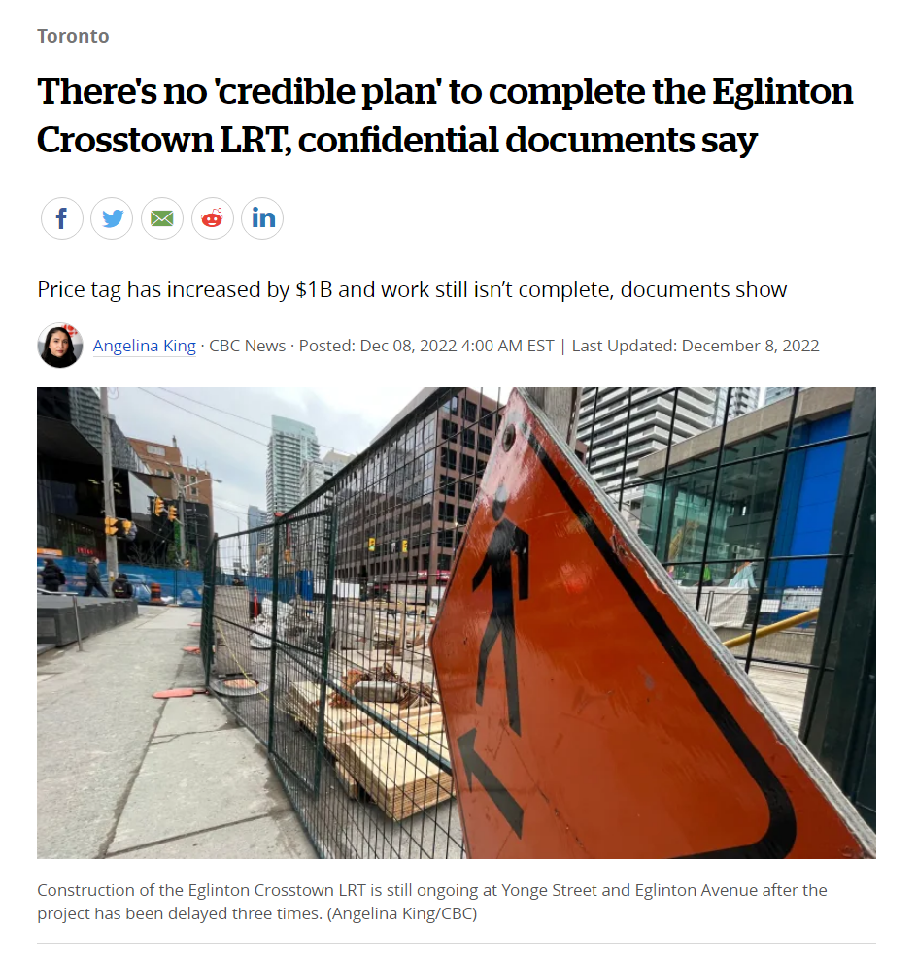
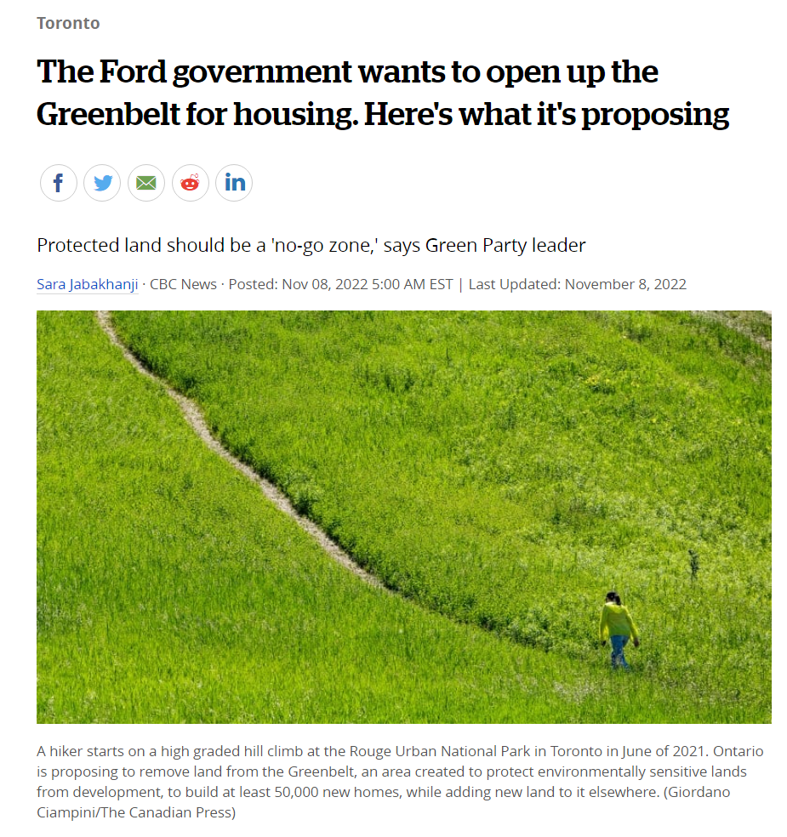
Instead of densifying and improving transit, we are:
Cutting transit service
Failing at the delivery of
public infrastructure
Solving the housing crisis through sprawl

Slide 32
Still…
Passenger transport decarbonization may not even be our biggest challenge:
The rising threat of urban truck movements

Slide 33
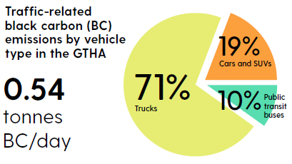
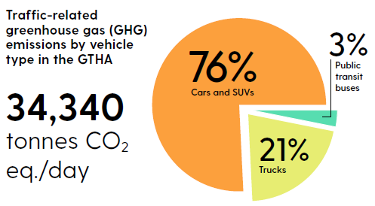
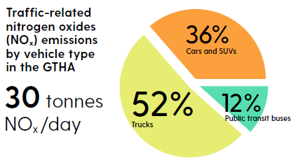
Diesel trucks contribute the majority of air pollutant emissions

Slide 34
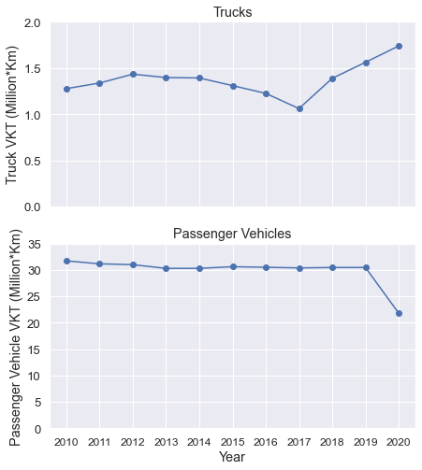
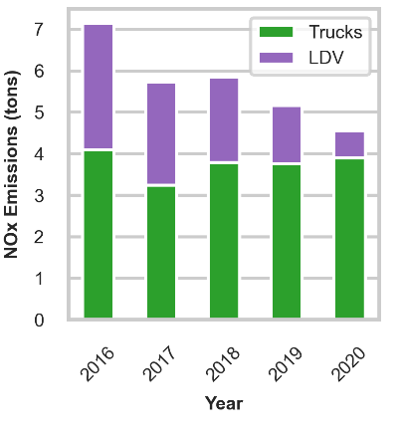
Truck VKT and emissions on the rise (2016-2020)

Slide 35
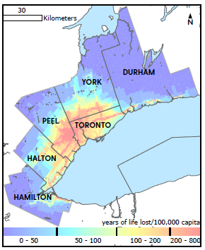
The burden of trucks has strong spatial gradients
407 premature deaths per year

Slide 36
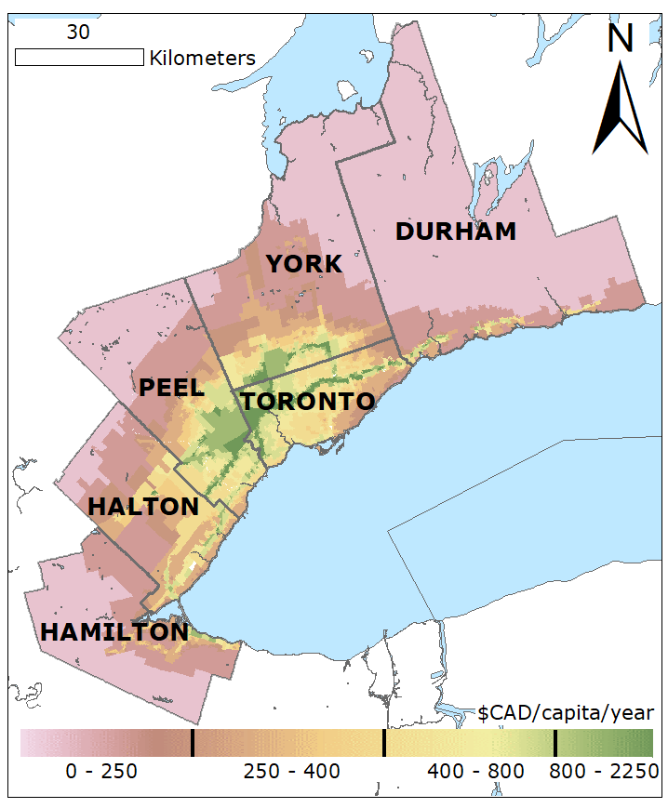
Benefits of new diesel trucks
275 premature deaths prevented
Social benefits of $308,000 / cleaner truck (over the lifetime of the truck)

Slide 37
Reduction in NO₂ exposures as a result of bus, car, and truck policies for 1st and 5th quintile of selected SES variables
Median
Improvement for lowest SES is highest

Slide 38
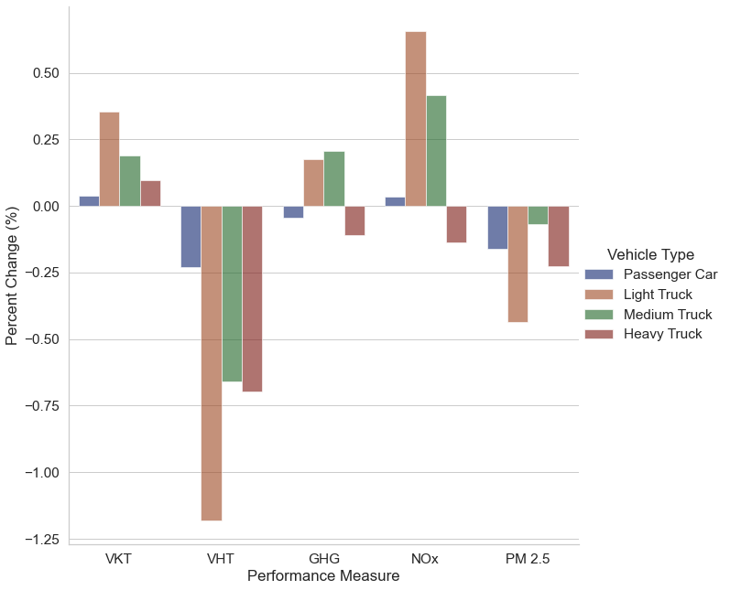
Off-peak delivery is not a viable solution
Empty roads in the evening promote higher mileage for trucks (with lower travel times) and induce passenger traffic in the daytime

Slide 39
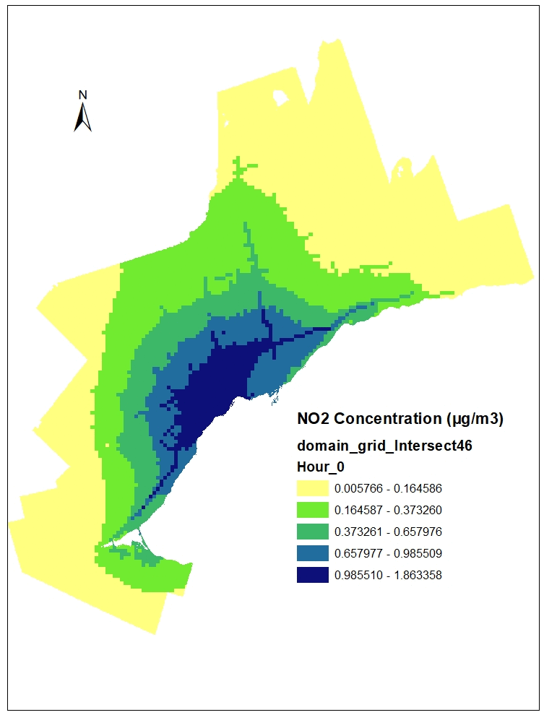
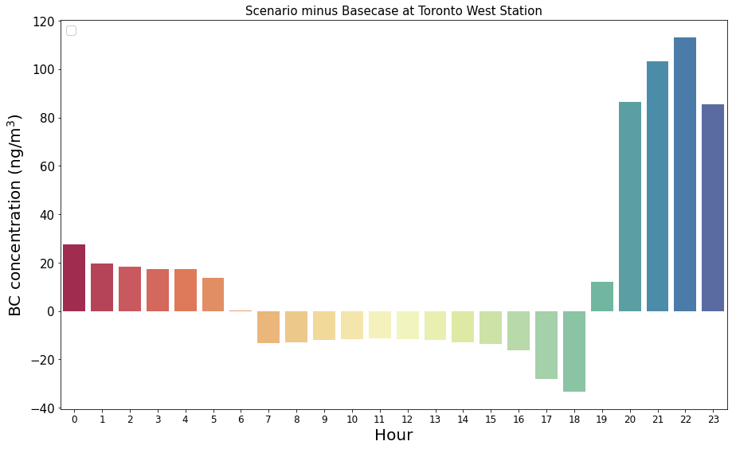
Diurnal Pattern of Air Pollutant Concentrations (daytime)
Reduction in air pollution during daytime
11

Slide 40
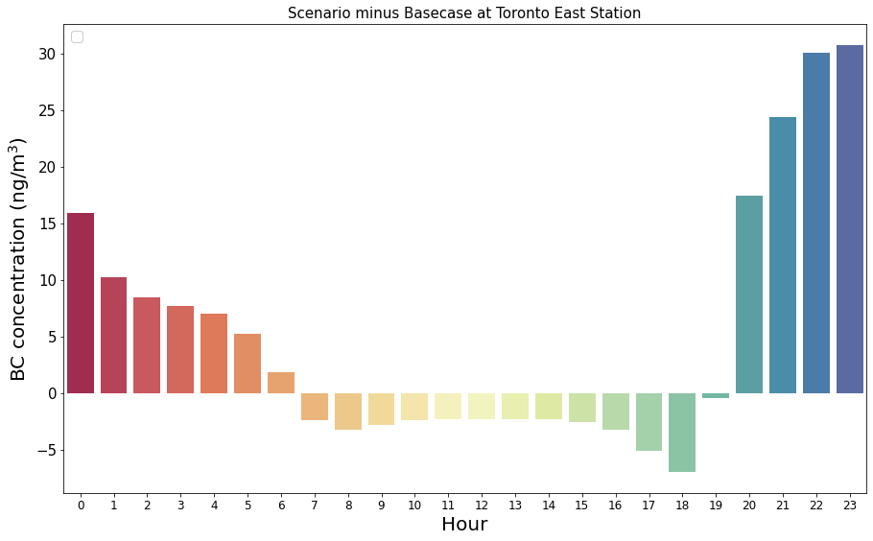
Diurnal Pattern of Air Pollutant Concentrations (night)
Increase in air pollution during night-time

Slide 41
Automation and connectivity

Slide 42
Impact of Automated Vehicles on car ownership and empty kilometers when vehicles are shared within household members
Two stage Optimization:
1- Greedy Algorithm to determine # automated vehicles needed
2- Mixed Integer Programing to minimize distance

Slide 43
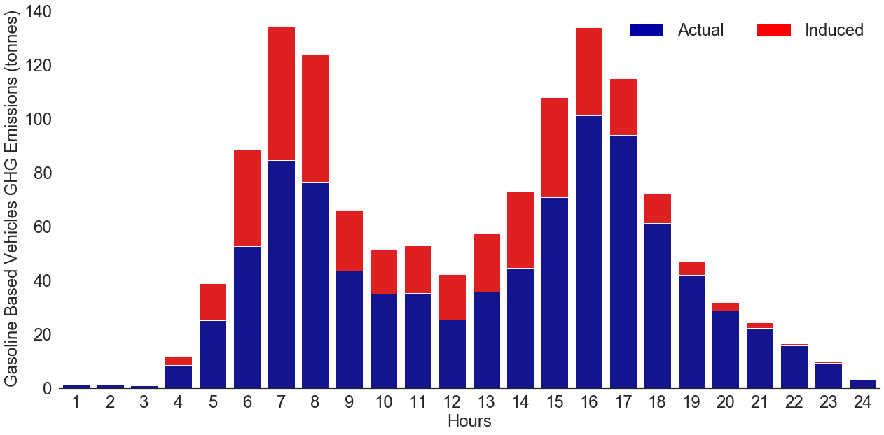
Scenario 1: AVs reducing car ownership in drive-only households
Daily GHG emissions increase by 51%

Slide 44
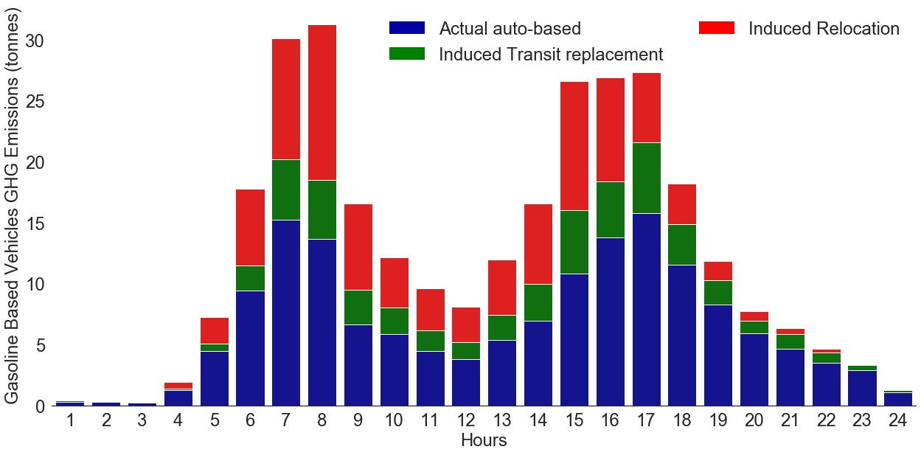
Scenario 2: AVs replacing transit trips in households that drive and use transit
Doubling of GHG emissions

Slide 45
Car sharing is not there yet
There is value in reducing car ownership
If we do not reduce car usage, we need much higher efficiencies and a more optimized system to achieve reductions in GHG emissions

Slide 46
The solution to transport decarbonization is multi-faceted

Slide 47
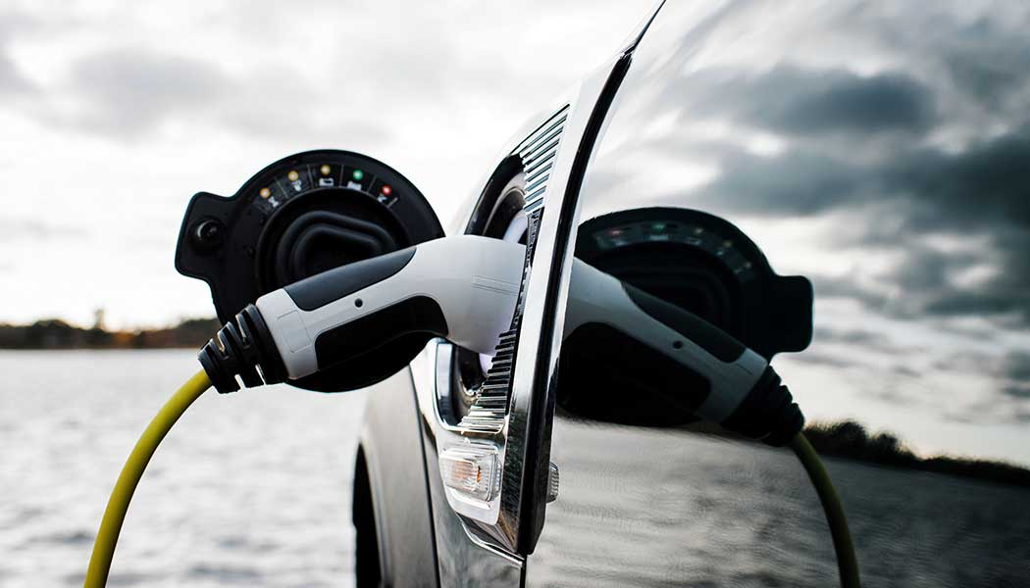
The solution to transport decarbonization is multi-faceted
Not just electrification

Slide 48
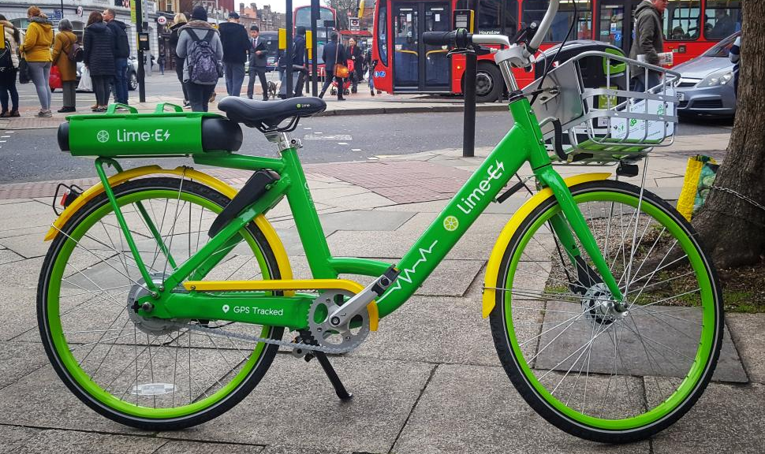
The solution to transport decarbonization is multi-faceted
But affordable electrification!

Slide 49
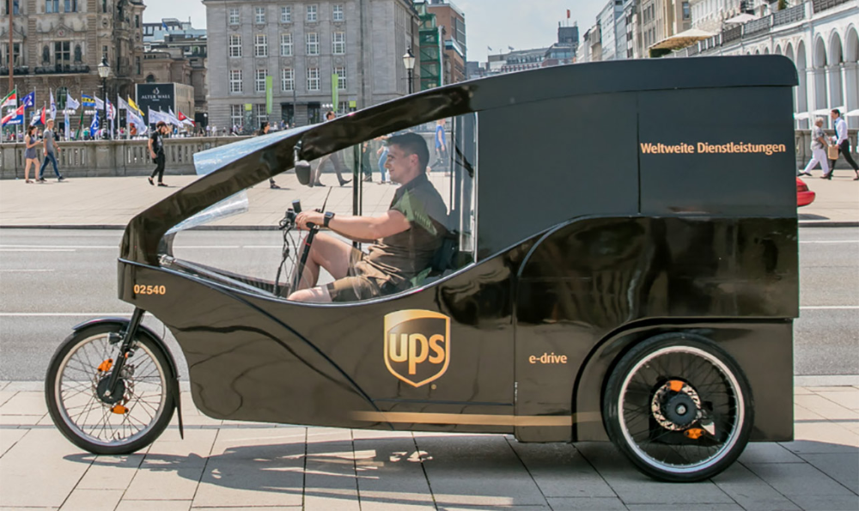
The solution to transport decarbonization is multi-faceted
Freight decarbonization is just as important as passenger mobility

Slide 50
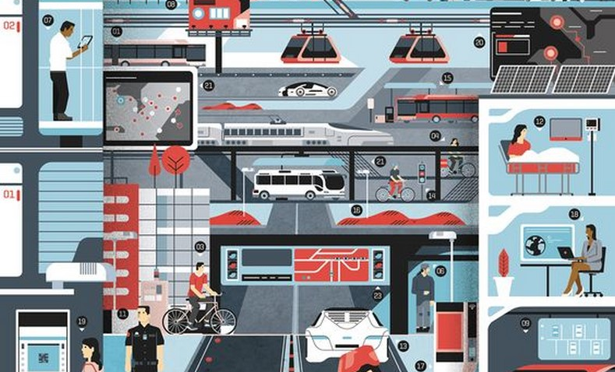
The solution to transport decarbonization is multi-faceted
Multi-modal hubs/ TOD

Slide 51
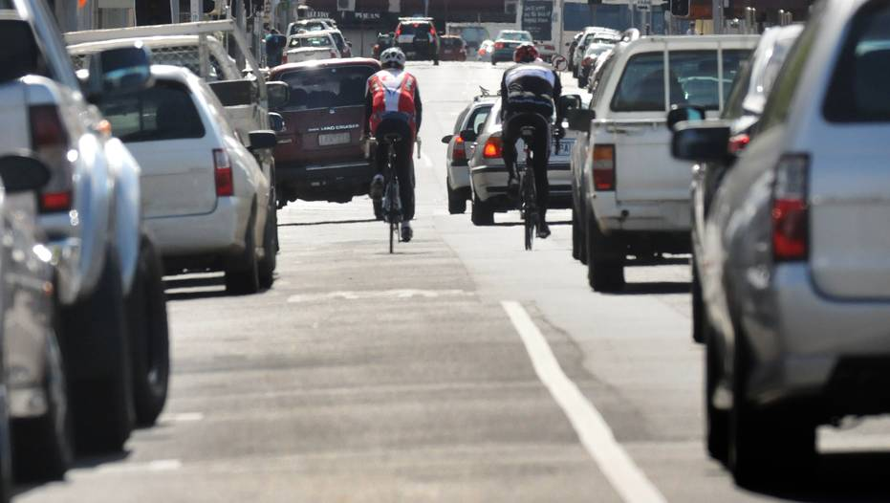
The solution to transport decarbonization is multi-faceted
Reclaim road space

Slide 52
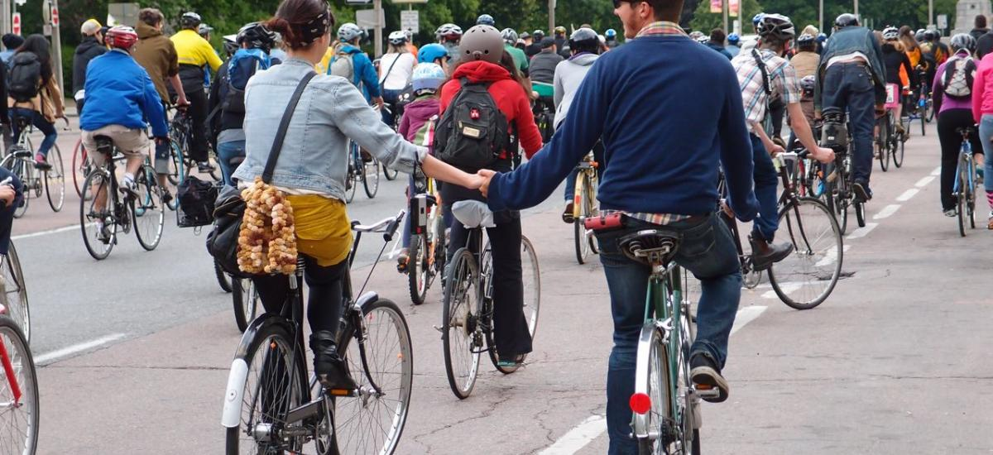
The solution to transport decarbonization is multi-faceted

Slide 53
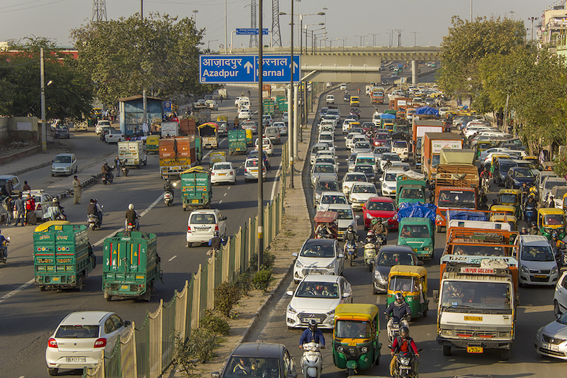
The solution to transport decarbonization is multi-faceted
Solutions should be relevant to different contexts

Slide 54

The solution to transport decarbonization is multi-faceted

Slide 55
The solution to transport decarbonization is highly complex

Slide 56

Think slow, act fast… and the perils of action bias

Slide 57










Thank you

