Slide 1
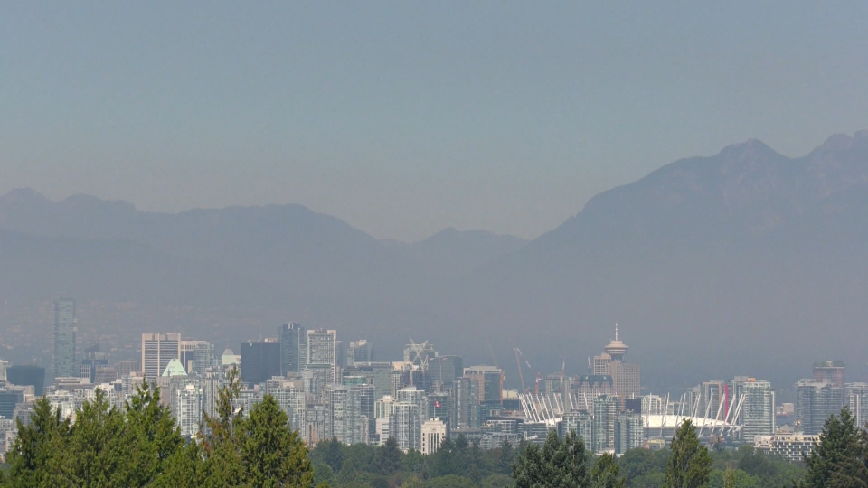


How Low Can You Go?
Mortality and Air Pollution at Low Exposures
Michael Brauer on behalf of the MAPLE Team
School of Population and Public Health
BCLF Workshop: March 30, 2023
Notes:
Let it be? Mortality and Air Pollution at Low Exposures….Here, there and everywhere: Mortality and air pollution at low exposures
-> include some info on NO2 (WHO AQ Guidelines) - role of Canadian research; NO2 slides (Crouse et al)
Are there “thresholds” or “safe levels” of air pollution below which health effects do not occur? Does it depend on the pollutant?
What is the basis for the updated WHO Air Quality Guidelines? Do they protect public health?
Do reductions in air pollution provide health benefits even if pollution levels are already low?
Will it be possible to eliminate air pollution exposure completely?

Slide 2
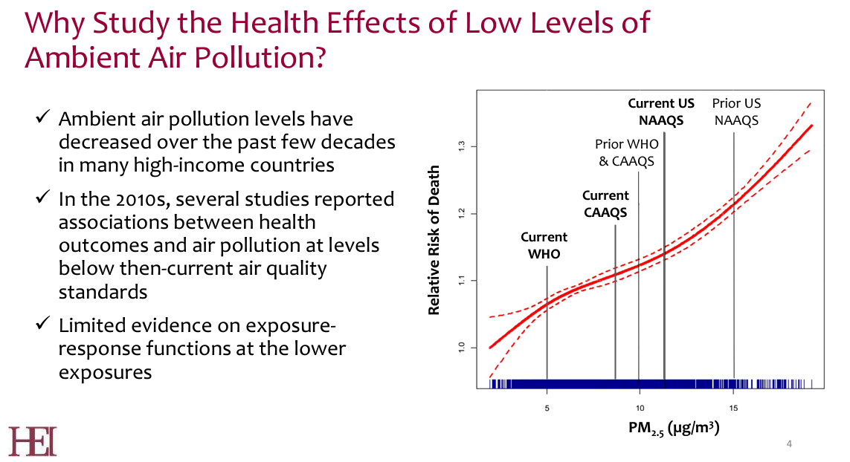

Slide 3
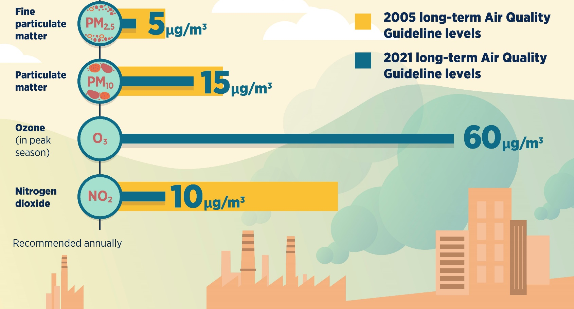
Long-term AQG levels

Slide 4
Low-level PM2.5 studies
PM2.5 REFERENCE | MEAN | SD | M-1.645*SD | P5 | HR | LCL | UCL
Pinault | 5.9 |  |  | 3 | 1.26 | 1.19 | 1.34
Cakmak | 6.5 | 2 | 3.2 | 3.2 | 1.16 | 1.08 | 1.25
Pinault | 7.1 |  |  | 3.5 | 1.18 | 1.15 | 1.21
Weichenthal | 9.5 | 1.7 | 6.7 | 6.7 | 0.95 | 0.76 | 1.19
Villeneuve | 9.5 | 3.5 | 3.7 | 4.8 | 1.12 | 1.05 | 1.2
Di | 11.5 | 2.9 | 6.7 | 7.1 | 1.08 | 1.08 | 1.09
Hart | 12.0 | 2.8 |  | 7.8 | 1.13 | 1.05 | 1.22

Slide 5
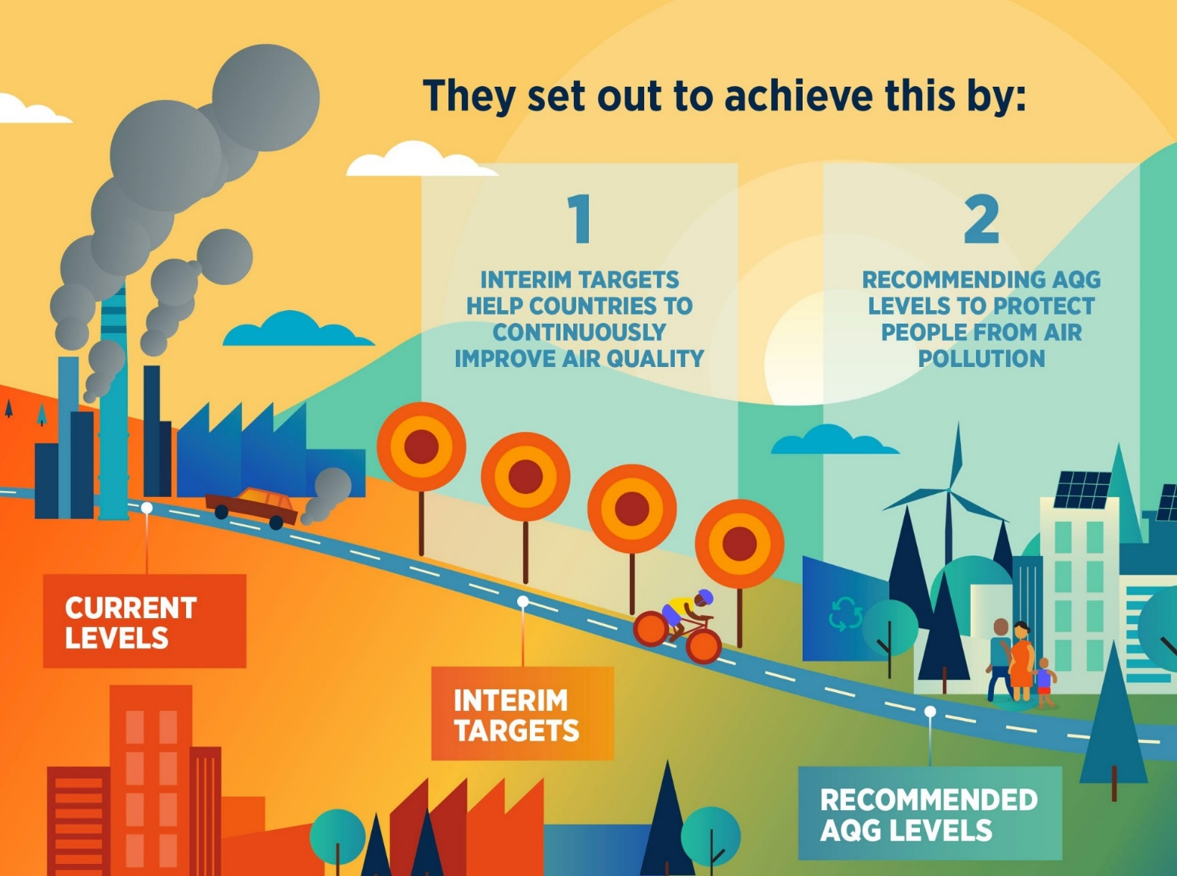
Continuous improvement of air quality

Slide 6
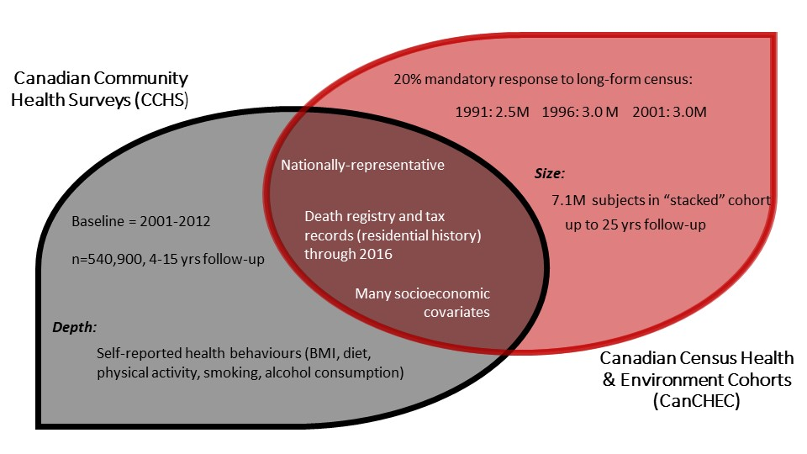

Slide 7
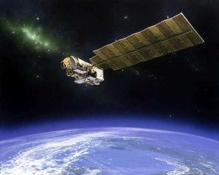
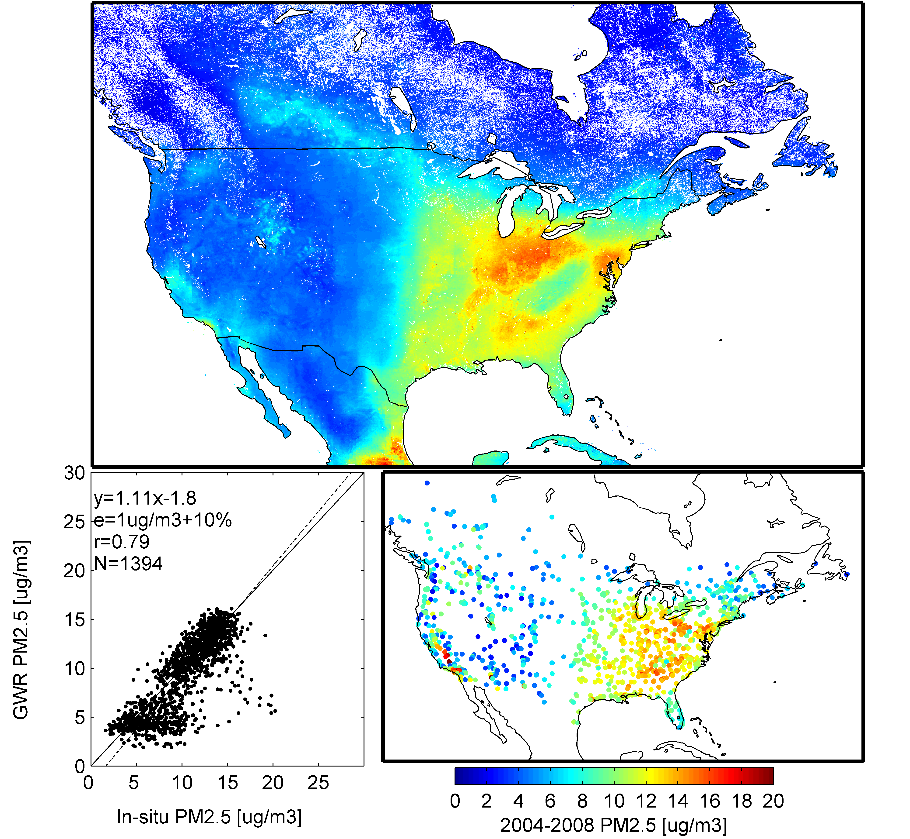

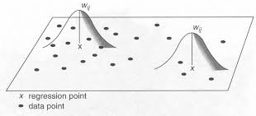
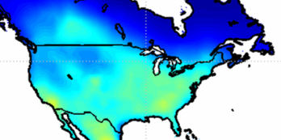
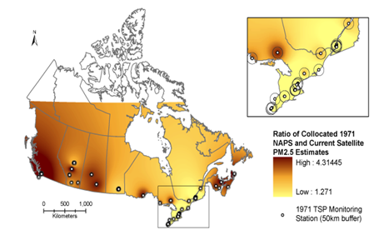
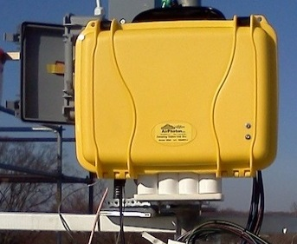
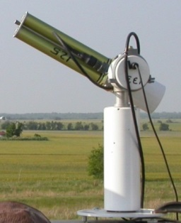
Exposure estimation
Refined PM_{2.5} 1981-1997
Initial PM_{2.5}
Refined PM_{2.5} 1998-2016
Satellite AOD
GWR
GEOS-Chem η (PM_{2.5}/AOD)
Evaluation & Refinement
Backcast with GEOS-Chem and historical PM_{2.5}, PM₁₀, & TSP
PM_{2.5}
AOD
Measurements of η (PM_{2.5}/AOD)
PM_{2.5}monitoring network

Slide 8
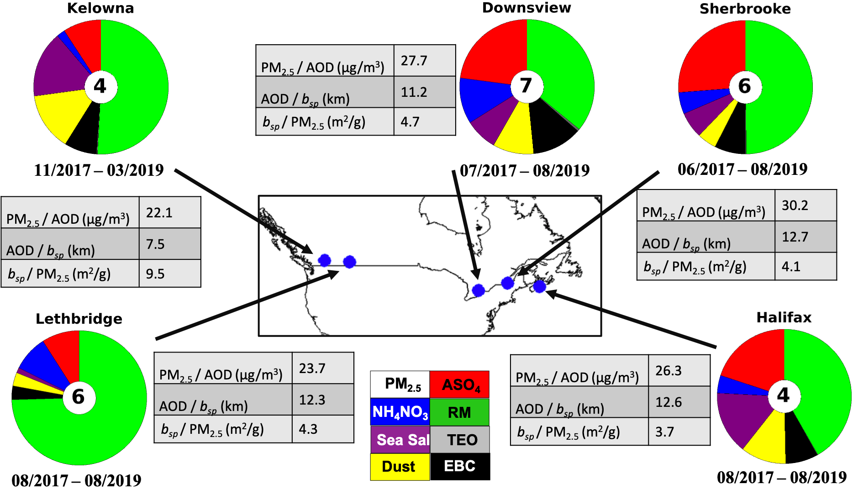

Slide 9
Phase 1
Phase 2
Notes:
Figure 5. Comparison of mean PM2.5 mass concentrations for 2000–2012 observed by in-situ ground-based monitors with (A) Phase 1 V4.NA.01 and (B) Phase 2 V4.NA.02-MAPLE satellite-derived PM2.5 estimates for all North American monitor locations. Annotations include the root mean square difference (RMSD), line of best fit (y), coefficient of determination (R2) and the number of points (N). See Figure 6 for Canadian locations only.

Slide 10
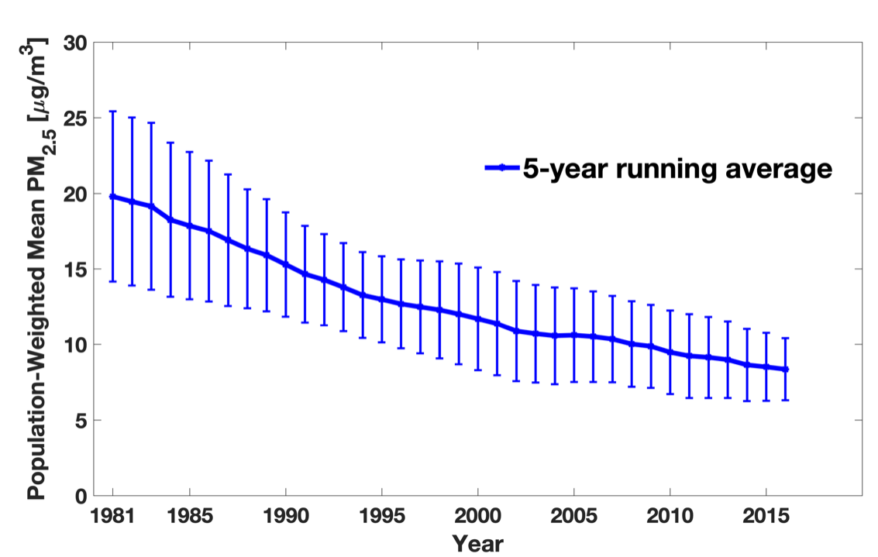
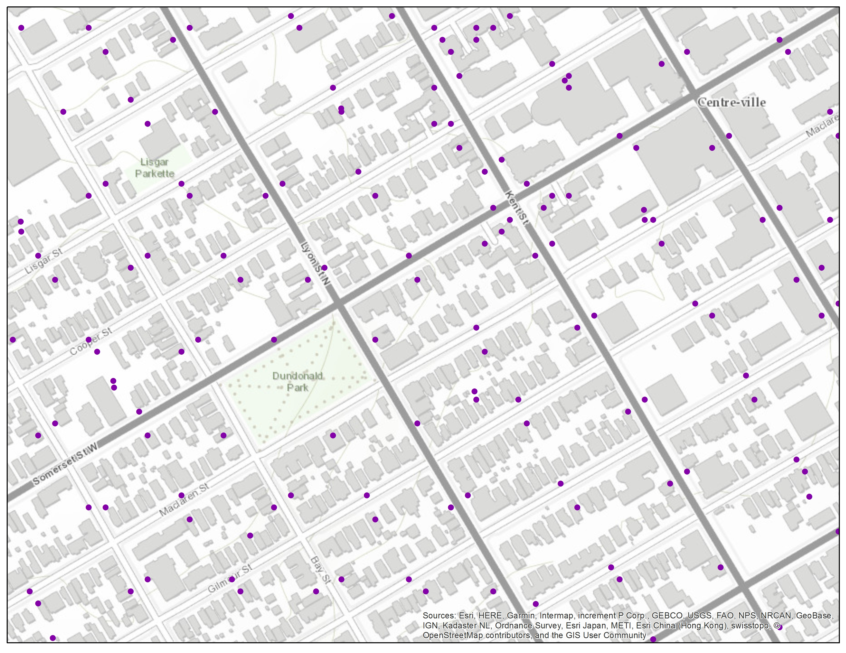
Exposure backcasting (1981 – 1997)
Backcasting with historical ground-based measurements of PM_{2.5}, PM₁₀, and TSP, remote sensing, chemical transport model, and elevation data
Captures temporal & spatial changes in concentrations over time
Estimates from nearest grid cell assigned to residential postal codes
~250m
Meng et al., ES&T 2019

Slide 12
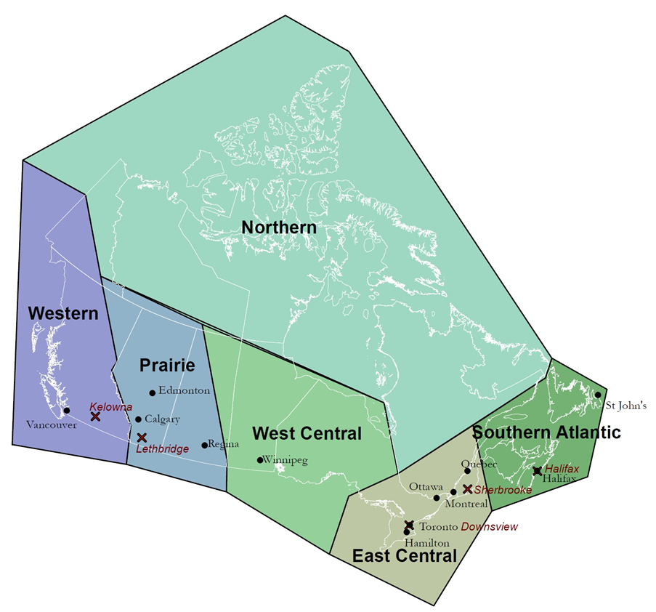
Geographic Identifiers & Contextual Covariates
Regional airsheds
Neighbourhood-level marginalization:
material deprivation
residential instability
dependency
ethnic concentration
Airsheds

Slide 13
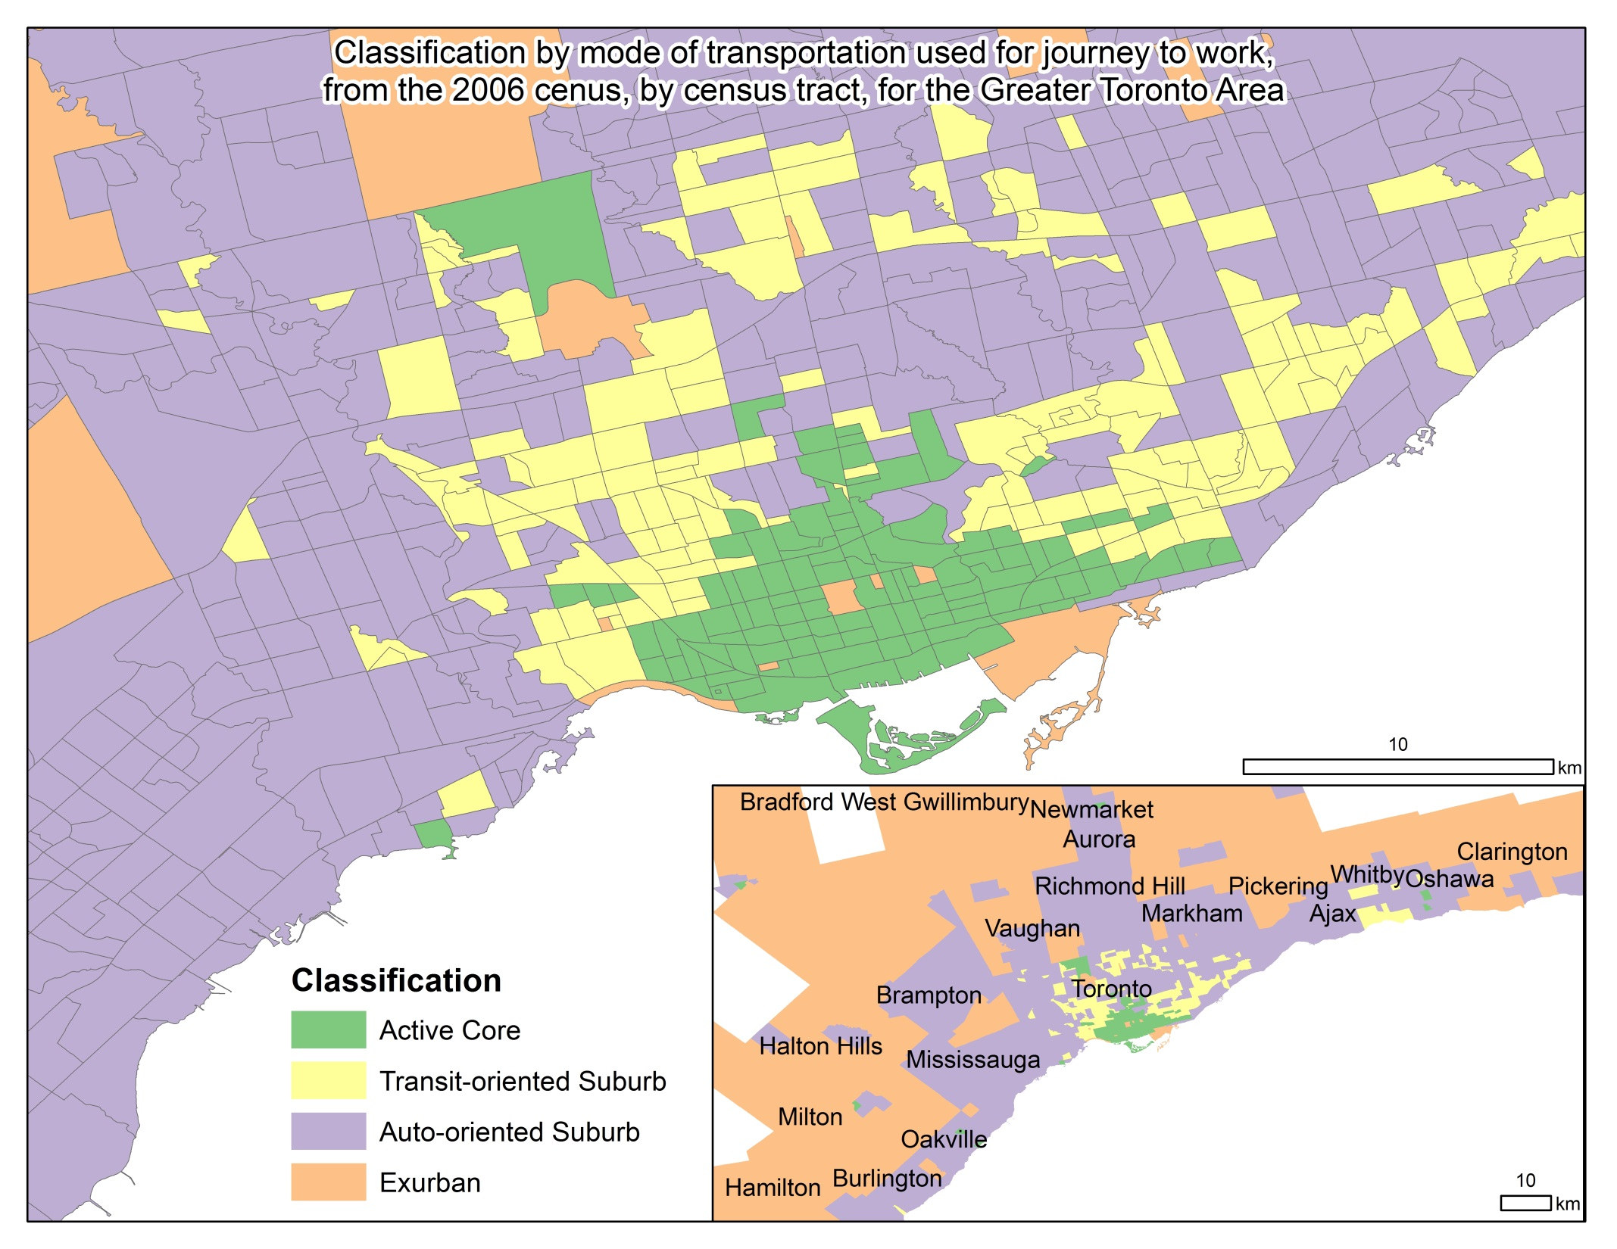
Geographic Identifiers & Contextual Covariates
Community size
(6 levels. small town → large city)
Urbanization
(4 levels. transit reliant suburb → urban core,)
Airsheds

Slide 14
Results: CCHS
One of largest analyses of PM_{2.5} and mortality including individual-level behavioural risk factors (4.4 million person-years)
Over 50k deaths from non-accidental causes; up to 15 years follow-up
Annual average PM_{2.5} concentration: 6.8 µg/m³ (s.d. 2.5)
HR per 10 μg/m³ PM_{2.5}
Full (CanCHEC) model: [individual-level SES and contextual (e.g. city size, marginalization) covariates | 1.12 (1.06-1.19)
+ behavioural covariates (fruit and vegetable consumption, leisure exercise frequency, alcohol consumption, and smoking behaviours) | 1.09 (1.02-1.15)

Slide 15
Results: Stacked CanCHEC
7.1 million individuals (128 million person-years)
~1.5 million deaths; up to 25 years of follow-up
Mean (sd) PM_{2.5} 8.5 µg/m³ (3.1)
Notes:
1.225
1.195
1.255

Slide 17
Results: Stacked CanCHEC
HR per 10 μg/m³ PM_{2.5}
Non-accidental mortality (Fully adjusted model) (128M P-Y) | 1.08 (1.07 – 1. 10)
+ O₃ + Ox | 1.04 (1.03 – 1.04) 1.02 (1.01 – 1.03)
Notes:
1.225
1.195
1.255

Slide 19
Results: Stacked CanCHEC
HR per 10 μg/m³ PM_{2.5}
Non-accidental mortality (Fully adjusted model) (128M P-Y) | 1.08 (1.07 – 1. 10)
+ O₃ + Ox PM_{2.5} <12 μg/m³ (111M P-Y) PM_{2.5} <10 μg/m³ (90M P-Y) | 1.04 (1.03 – 1.04) 1.02 (1.01 – 1.03) 1.06 (1.05 – 1.08) 1.01 (0.99 – 1.02)
Notes:
1.225
1.195
1.255

Slide 20
Notes:
Healthcare access, population characteristics (age, immigrant proportion, etc.)

Slide 21
Summary and Implications
Consistent associations between PM_{2.5} concentrations and non-accidental mortality in all cohorts, including stacked cohort of 7.1 M
  Population representative cohort
  Unlikely to be confounded by behavioural risk factors (CCHS)
  Very low levels of exposure (minimum effect level of 2.5 µg/m³ 10 yr mean)
  Driven by associations with major causes of death in Canada (CVD, Stroke, Respiratory)
    Lung Cancer
Associations varied regionally, and were attenuated by ozone, Ox
  Unlikely to be due to population characteristics → pollution mixtures?
No evidence of threshold; supra-linear shape
Suggests benefits of continued reductions in exposure
Refined global concentration-response function over 2.5 – 5.0 μg/m³ (WHO AQG) concentration range

Slide 22
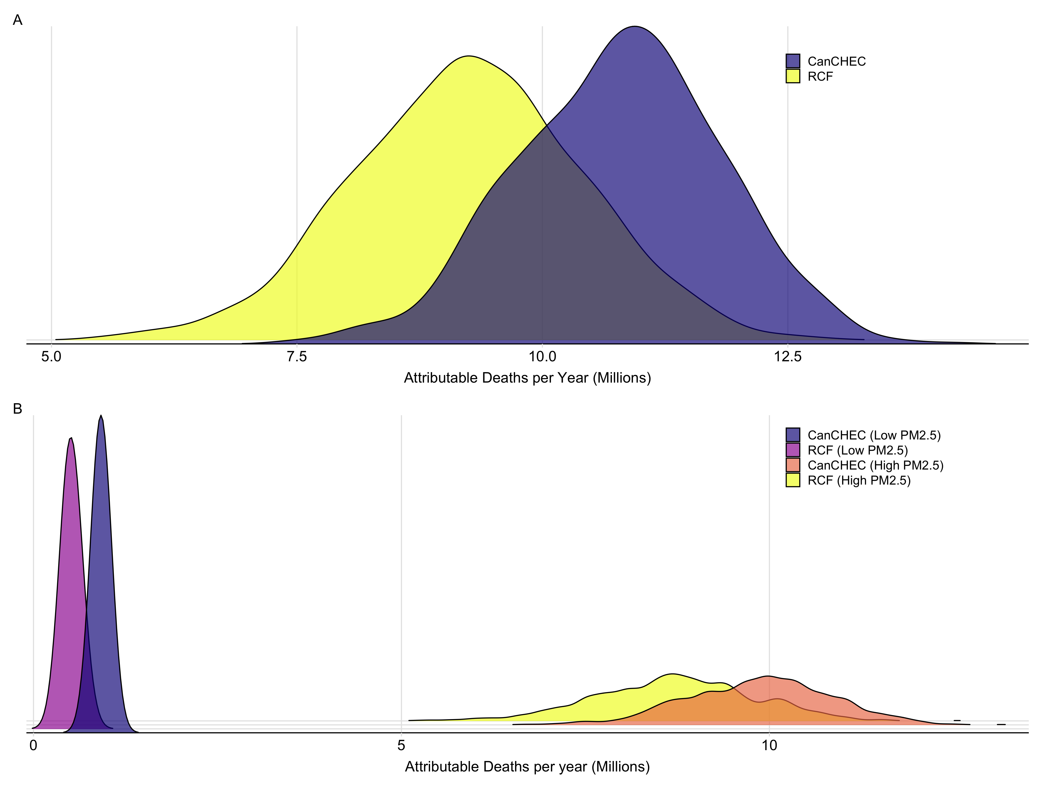
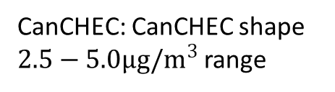
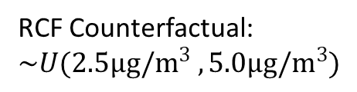
Application of CanCHEC Shape → Additional 1.55 M (17% increase ) deaths/yr globally
RCF Counterfactual: $\sim U(2.5μg/m^{3} , 5.0μg/m^{3})$
CanCHEC: CanCHEC shape $2.5−5.0μg/m^{3}$ range
Weichenthal et al. Science Advances 2022
Notes:
Density plots comparing estimated annual global mortality attributable to outdoor PM_{2.5}. (A) Distributions of attributable mortality per year predicted by the current global exposure-response function (RCF) and our new refined function incorporating the supra-linear relationship between PM_{2.5} and mortality at low concentrations (CanCHEC). (B) Distributions of attributable mortality per year predicted above (> 12 μg/m³ (High PM_{2.5})) and below (< 12 μg/m³ (Low PM_{2.5})) the current US EPA standard by the RCF model and our new CanCHEC model. Percent underestimation of attributable deaths by the RCF model is greater at lower PM_{2.5} concentrations

Slide 23
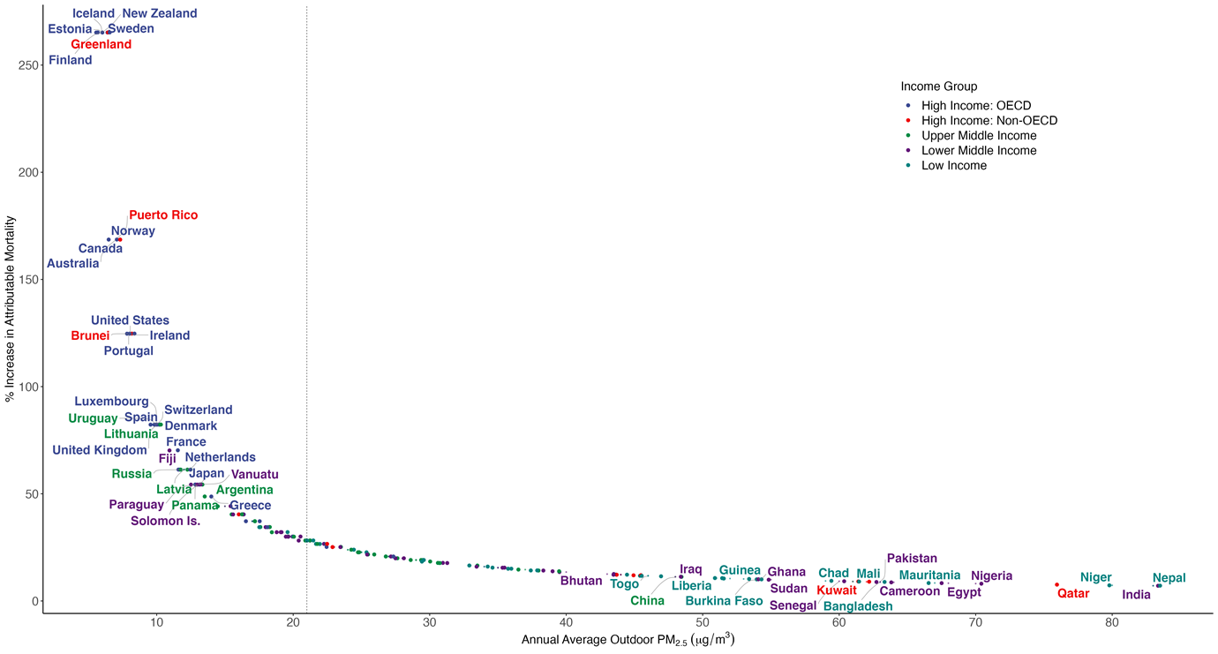
Application of CanCHEC shape → very large increases in attributable mortality estimates in mostly high income countries
Weichenthal et al. Science Advances 2022

Slide 24
THANK YOU
michael.brauer@ubc.ca

Slide 26
EXTRA SLIDES

Slide 27
Cohorts and follow-up
All linked to vital statistics (2001-2016) and tax records (from 1981) to establish residential history
Analyses over series of exposure time windows representing long-term spatial and short-term temporal associations with mortality
2001, 2003, 2005, 2007/08, 2011 CCHS participants
(n = 500,000)
2001 Canadian Census long-form respondents
(n = 3.5 million)
1996 Canadian Census long-form respondents
(n = 3.5 million)
1991 Canadian Census long-form respondents
(n = 2.5 million)
1981
Start of tax records for census cohorts
1998
Start of tax records for CCHS cohort
2016
End of follow-up
1981 – 1997: Backcasting to produce annual 1 km x 1 km estimates of PM_{2.5} exposure
1998 – 2016: Annual estimates of PM_{2.5} exposure at 1km x 1km resolution

Slide 28
Results: Stacked CanCHEC
7.1 million individuals (128 million person-years)
~1.5 million deaths; up to 25 years of follow-up
Annual average PM_{2.5} concentration: 8.5 µg/m³ (s.d. 3.1)
HR per 10 μg/m³ PM_{2.5}
Non-accidental mortality (Fully adjusted model) | 1.08 (1.07 – 1. 10)
CVD IHD Heart failure Cerebrovascular Diabetes Respiratory COPD Pneumonia Lung Cancer Kidney Failure | 1.16 (1.14 – 1.18) 1.22 (1.19 – 1.25) 1.04 (0.96 – 1.13) 1.10 (1.06 – 1.15) 1.24 (1.17 – 1.32) 1.08 (1.04 – 1.12) 1.06 (1.01 – 1.11) 1.19 (1.11 – 1.29) 0.99 (0.96 – 1.02) 0.97 (0.88 – 1.07)
Notes:
1.225
1.195
1.255

Slide 29
“full” model
Pappin et al., 2019; Christidis et al., 2019

Slide 30
Figure 2. Hazard Ratio estimates and 95% confidence intervals for the association between PM_{2.5} and non-accidental mortality for Full and DAG-informed models across cohorts.

Slide 32
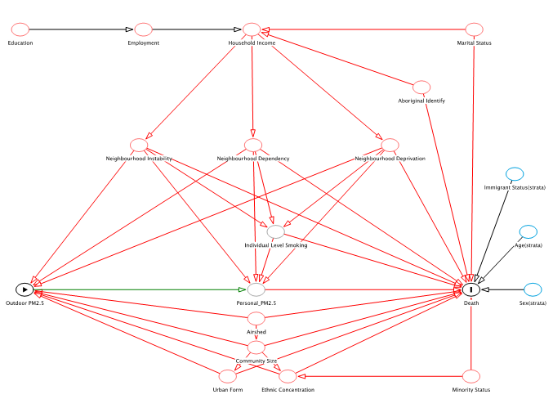
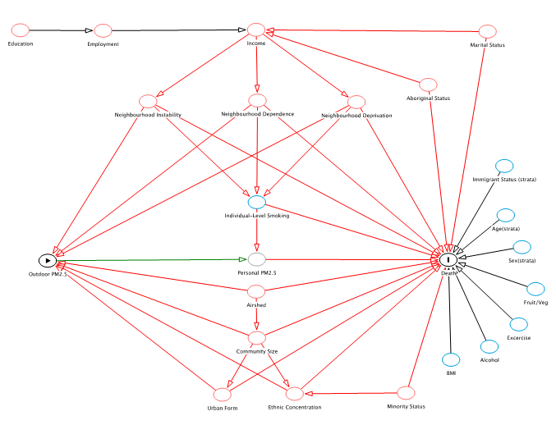
Covariates
CanCHEC
CCHS
DAG Model: Airshed, Community Size, Urban Form, (Ethnic Concentration, Dependency, Deprivation, Instability) + strata for age, sex, immigrant status (cohort)
Full model (+ available individual-level covariates)
CanCHEC: income, education, marital status, indigenous identity, employment status, occupational class, visible minority status, and years since immigrating to Canada
CCHS: + fruit and vegetable consumption, leisure exercise frequency, alcohol consumption, smoking, BMI

Slide 33
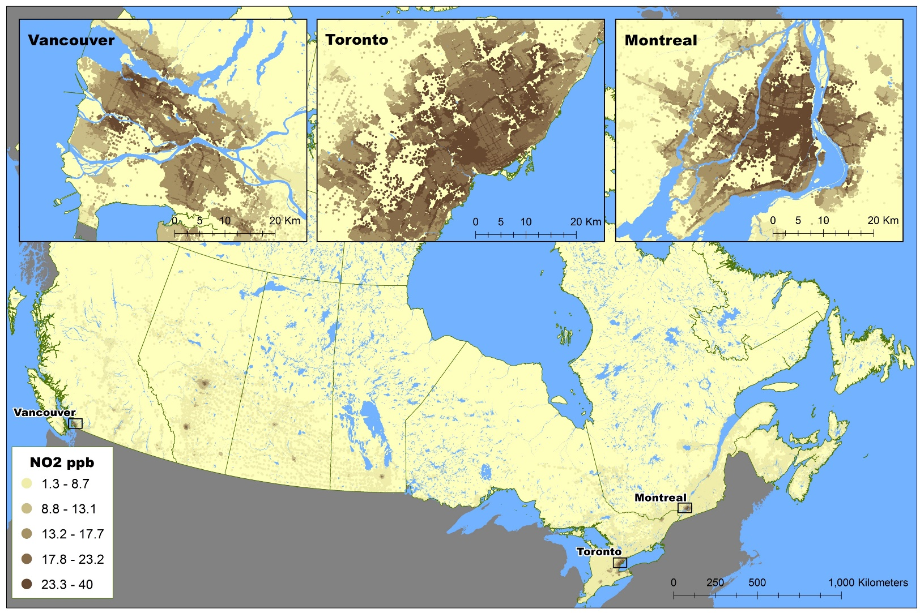
NO₂ Estimation
LUR model (satellite estimates, road length (10 km), area of industrial land use (2 km), mean summer rainfall
2006 annual mean concentrations (~10 m)
Year-adjusted using ground-based time-series measurements from 24 Census Divisions (1981 – 2012)
Hystad P et al. 2011. Creating national air pollution models for population exposure assessment in Canada. Environ Health Perspect 119(8):1123-9.

Slide 34
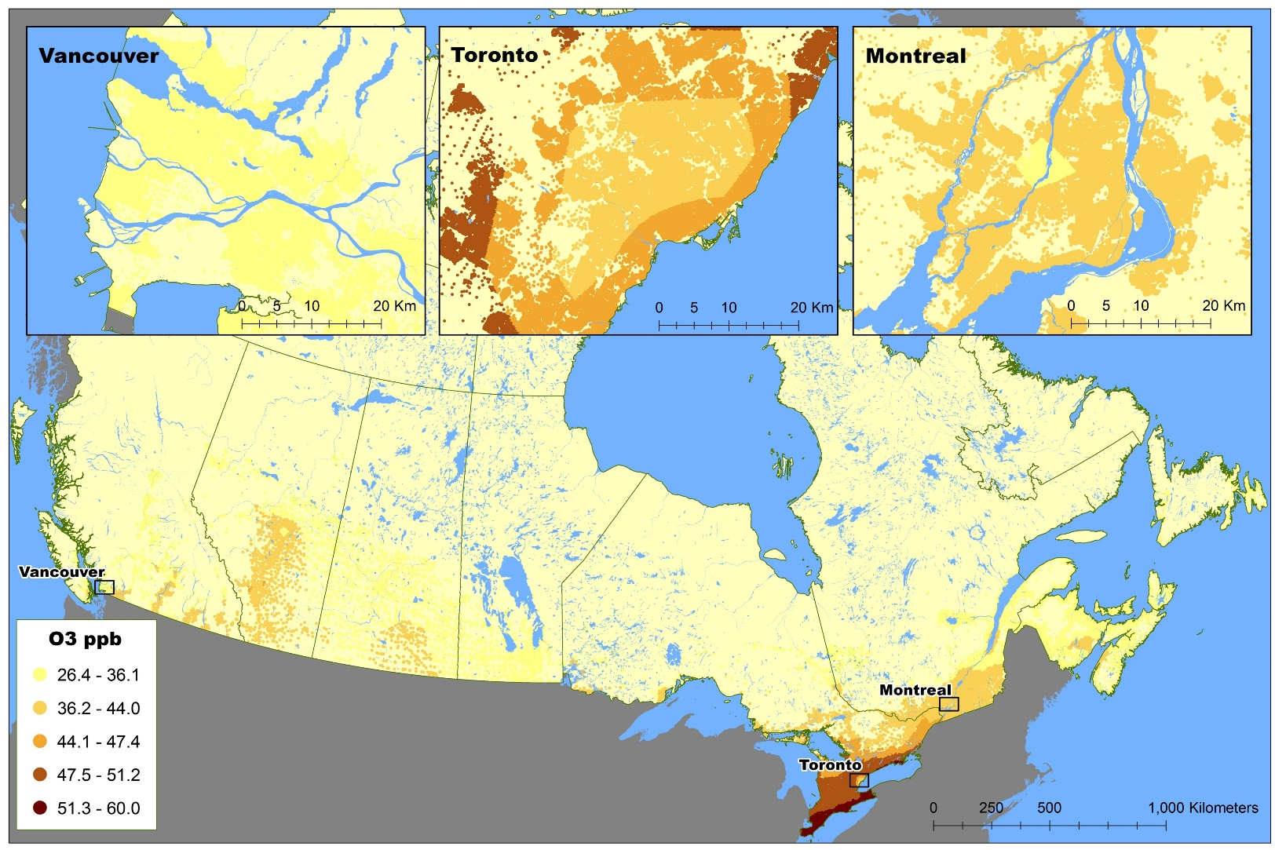
O₃ Estimation
Linear combination of hourly modelled (CTM forecast) ozone surface and ground-based observations
Mean daily 8-hour max. warm season (1 May–31 October) concentration, 2002-09 (21 km)
Year-adjusted using ground-based time-series measurements from 24 Census Divisions (1981 -2012)
Robichaud A, Ménard R. 2014. Multi-year objective analyses of warm season ground-level ozone and PM2.5 over North America using real-time observations and the Canadian operational air quality models. Atmospheric Chemistry and Physics 14(4):1769-1800.

Slide 35
Phase 1
Core Analyses
Non-accidental mortality by cohort and pooling across cohorts (Cox Prop. Haz. Models)
  Pooled CanCHEC 1.05 (1.04 to 1.06)
DAG-driven modeling framework: minimal adjustment – fully adjusted
Sensitivity to exposure window, spatial resolution, NO₂, O₃, Ox, indirect adjustment
  Attenuation by O₃, Ox, but not NO₂
  Increased estimates with longer averaging times and more finely resolved exposures
  Little impact of indirect adjustment for missing behavioural covariates
Immigrants
  Similar effects on immigrants vs non-immigrants
Brauer et al. HEI Report 203. Mortality–Air Pollution Associations in Low-Exposure Environments (MAPLE): Phase 1. 2019.
Notes:
including analysis of cause- specific mortality, analysis examining the sensitivity of PM2.5 associations to the inclusion of O3 or Ox in the models, and other factors such as regional variation. We present results for both the mCCHS cohort, where behavioral risk factors were measured, and for three separate CanCHEC cohorts. An important update from Phase 1 is the use of a Stacked CanCHEC cohort, where all participants from the three CanCHEC cycles were included together, and participants in repeated, subsequent cycles were excluded. The stacked cohort represented 7.1 million respondents followed over 128 million person- years, or about 20.2% of the population of Canada as of the 2016 census. We also updated our analyses using longer moving average exposures, as sensitivity analyses in Phase 1 indicated that a longer moving average (i.e., 10 years) provided stronger associations with mortality (Crouse et al. 2020). T

Slide 36
Results: CCHS
One of largest analyses of PM_{2.5} and mortality including individual-level behavioural risk factors (4.4 million person-years)
Over 50k deaths from non-accidental causes; up to 15 years follow-up
Annual average PM_{2.5} concentration: 5.9 µg/m³ (s.d. 2.0)
HR per 10 μg/m³ PM_{2.5}
Full (CanCHEC) model: [individual-level SES and contextual (e.g. city size, marginalization) covariates | 1.13 (1.06-1.21)
+ behavioural covariates (fruit and vegetable consumption, leisure exercise frequency, alcohol consumption, and smoking behaviours) | 1.11 (1.04-1.18)
Christidis et al., Environmental Health, 2019
Notes:
Perhaps add some supporting background for Ox reflecting PM

Slide 37
Results: CanCHEC
~8.5 million individuals (151 million person-years)
~1.5 million deaths; up to 25 years of follow-up
Annual average PM_{2.5} concentration: 7.4 µg/m³ (s.d. 2.9)
HR per 10 μg/m³ PM_{2.5}
DAG model: contextual (e.g. city size, marginalization) covariates Full (CanCHEC) model: [individual-level SES and contextual (e.g. city size, marginalization) covariates | 1.044 (1.031 – 1.056) 1.053 (1.041 – 1. 065)
+ NO₂ + O₃ + Ox | 1.043 (1.030 – 1.056) 0.982 (0.970 – 0.994) 0.955 (0.943 – 0.968)
Pappin et al., 2019.

Slide 38
“full” model
Pappin et al., 2019; Christidis et al., 2019

Slide 39
Phase 1
Core Analyses
Non-accidental mortality by cohort and pooling across cohorts (Cox Prop. Haz. Models)
  Pooled CanCHEC 1.05 (1.04 to 1.06)
DAG-driven modeling framework: minimal adjustment – fully adjusted
Sensitivity to exposure window, spatial resolution, NO₂, O₃, Ox, indirect adjustment
  Attenuation by O₃, Ox, but not NO₂
  Increased estimates with longer averaging times and more finely resolved exposures
  Little impact of indirect adjustment for missing behavioural covariates
Immigrants
  Similar effects on immigrants vs non-immigrants
Phase 2
Cause-specific mortality, “Stacked” cohort
Fully adjusted models
Sensitivity to co-pollutants, regional variation
Refined 10 year moving average exposure, lagged 1 year; 1 km PM_{2.5} 10 km O₃ 100m NO₂
Brauer et al. HEI Report 212. Mortality–Air Pollution Associations in Low-Exposure Environments (MAPLE): Phase 2. 2022.

Slide 40
Publications
Latimer and Martin. Interpretation of measured aerosol mass scattering efficiency over North America using a chemical transport model. Atmos. Chem. Phys. 2019
Meng et al. Estimated long-term (1981-2016) concentrations of ambient fine particulate matter across North America from chemical transport modeling, satellite remote sensing and ground-based measurements. Environ Sci Technol. 2019
Pinault et al. Associations between fine particulate matter and mortality in the 2001 Canadian Census Health and Environment Cohort. Environmental Research, 2017
Pinault et al. Diabetes status and susceptibility to the effects of PM_{2.5} exposure on cardiovascular mortality in a national Canadian cohort. Epidemiology. 2018
Erickson et al. Evaluation of a method to indirectly adjust for unmeasured covariates in the association between fine particulate matter and mortality. Environ Res. 2019
Crouse et al. Evaluating the sensitivity of PM_{2.5}-mortality associations to the spatial and temporal scale of exposure assessment at low particle mass concentrations. Epidemiology. 2019
Christidis et al. Low concentrations of fine particle air pollution and mortality in the Canadian Community Health Survey cohort. Environmental Health. 2019
Pappin et al. Nonlinear associations between low levels of fine particulate matter and mortality across three cycles of the Canadian Census Health and Environment Cohort. EHP. 2019
Erickson et al. Disease assimilation: the mortality impacts of fine particulate matter on immigrants to Canada. Health Reports. 2020
Weichenthal et al. How Low Can You Go? Air Pollution Impacts Mortality at Very Low Levels. Science Advances. 2022

Slide 41



MAPLE Team
Michael Brauer, The University of British Columbia
Jeffrey Brook, University of Toronto
Rick Burnett, Health Canada/IHME
Tanya Christidis, Statistics Canada
Yen Chu, University of British Columbia
Dan Crouse, University of New Brunswick
Anders Erickson, The University of British Columbia
Perry Hystad, Oregon State University
Chi Li, Dalhousie University
Jun Meng, Dalhousie University
Amanda Pappin, Statistics Canada
Lauren Pinault, Statistics Canada
Randall Martin, Dalhousie University
Alain Robichaud, Environment & Climate Change Canada
Michael Tjepkema, Statistics Canada
Richard Ménard, Environment & Climate Change Canada
Aaron van Donkelaar, Dalhousie University
Scott Weichenthal, McGill University
Weiran Yuchi, The University of British Columbia / Statistics Canada

