Slide 1
The effect of decreased traffic on air quality in Canada and across the globe – a silver lining of COVID 19 lockdowns?
2021 Air Quality and Health Workshop: “Air Quality and the COVID-19 pandemic”
March 3, 2021
Kristin Aunan, CICERO Center for International Climate Research
w/Zander Venter, Norwegian Institute of Nature Research

Slide 2
Content
COVID19 lockdowns and CO2 and short-lived climate forcers
Air quality improvements in 34 countries
What happened in Canada?

Slide 3
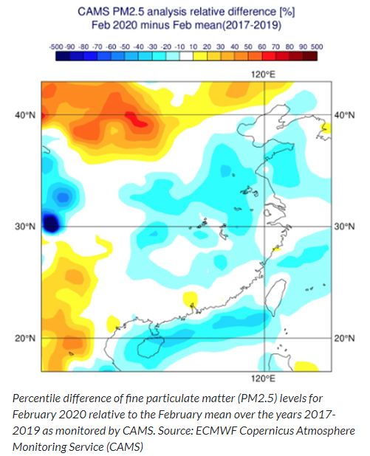
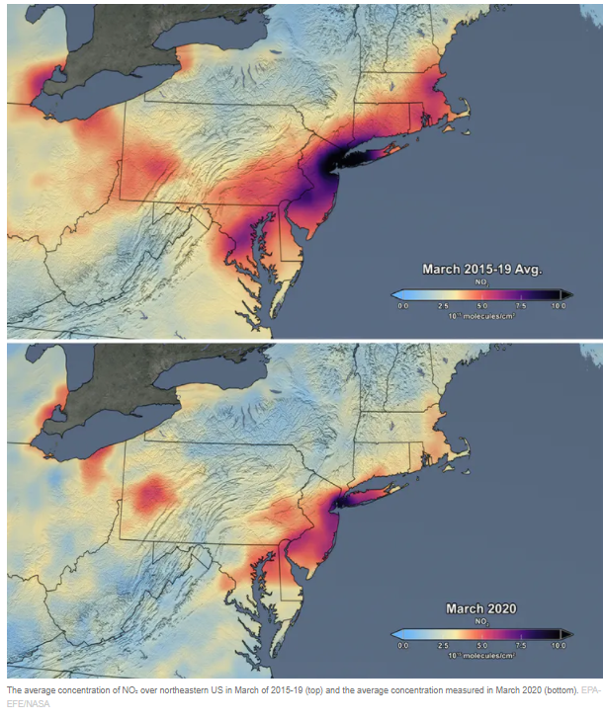
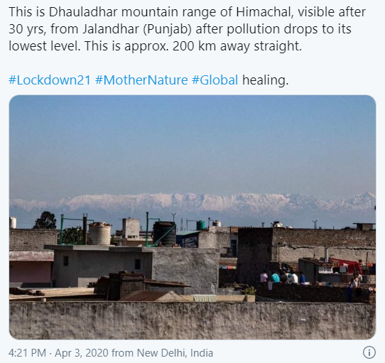
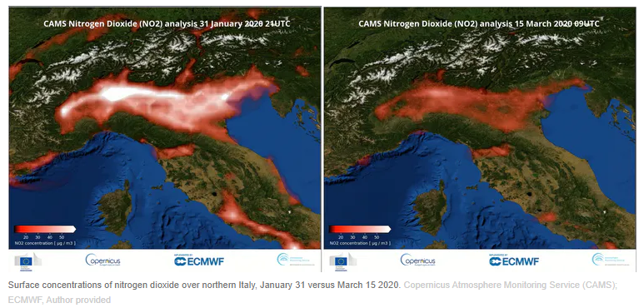
Large improvements in air quality reported
Notes:
Satellite readings showed marked reduction in air pollution levels
20-30% reduction in PM2.5 over China in February 2020 compared to 2019

Slide 4
CO₂ reduction under the Covid19 pandemic – an unprecedented decline
Global Carbon project, on fossil CO₂ emissions reductions by December 2020
Global fall of 2.4 GtCO₂
Global 7% drop from 2019
12% in the US
11% in the EU
9% in India
1.7% in China
Figure: Liu, Z., et al. (2020). Near-real-time monitoring of global CO2 emissions reveals the effects of the COVID-19 pandemic. Nat Commun, 11(1), 5172. doi:10.1038/s41467-020-18922-7
Notes:
Largest relative fall since the second world war.
The biggest emission drops in 2020 have occurred in the US and the 27 EU member states, mainly due to large reductions in the use of coal in electricity generation and of oil in transportation
After the financial crisis 2008-2009: Huge rebound in 2010
Will not slow the pace of global warming: we need sustained reductions in emissions of 1-2GtCO2 per year over the next 20-30 years to limit warming well below 2 degr C
https://www.carbonbrief.org/global-carbon-project-coronavirus-causes-record-fall-in-fossil-fuel-emissions-in-2020
It discounts other factors, such as natural variability, the temperature-induced change in heating demand and the effect of economic stimulus packages that have already begun.

Slide 5
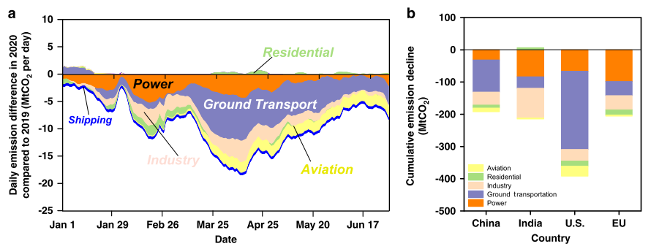
CO2 reduction under covid lockdown – transport sector had the largest reduction
Liu, Z., et al. (2020). Near-real-time monitoring of global CO2 emissions reveals the effects of the COVID-19 pandemic. Nat Commun, 11(1), 5172. doi:10.1038/s41467-020-18922-7
Notes:
Liu et al 2020: Ground transportation represents 18% of global CO2 emissions in recent years.

Slide 6
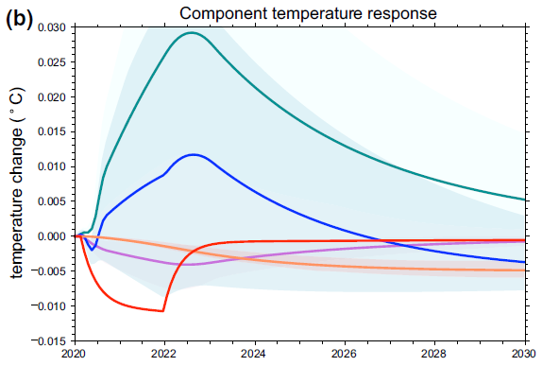
Reduction in short-lived climate pollutants may have increased global T slightly in 2020
Overall, particles (aerosols) cool the planet
Reduced levels of particles in the atmosphere may have reduced anthropogenic aerosol cooling
Small global net warming of max 0.03°C from aerosols
Modelling study by Gettelman et al. (2020) Geophysical Research Letters
Notes:
Scatter away sunlight in the clear sky and by make clouds brighter (enhanced reflection of sunlight away from the earth).
Small effect, but the aerosol changes are the largest contribution to radiative forcing and temperature changes as a result of COVID-19 affected emissions, larger than ozone, CO2 and contrail effects.
far outstripping cooling effects due to contrail, O3
In some areas warming may reach up to 0.3 degr C (Russia; SE Asia)
The peak impact on global temperature would not be felt until 2022. The global estimate is quite small, but the regional temperature perturbations estimated here may be larger by a factor of 10

Slide 7
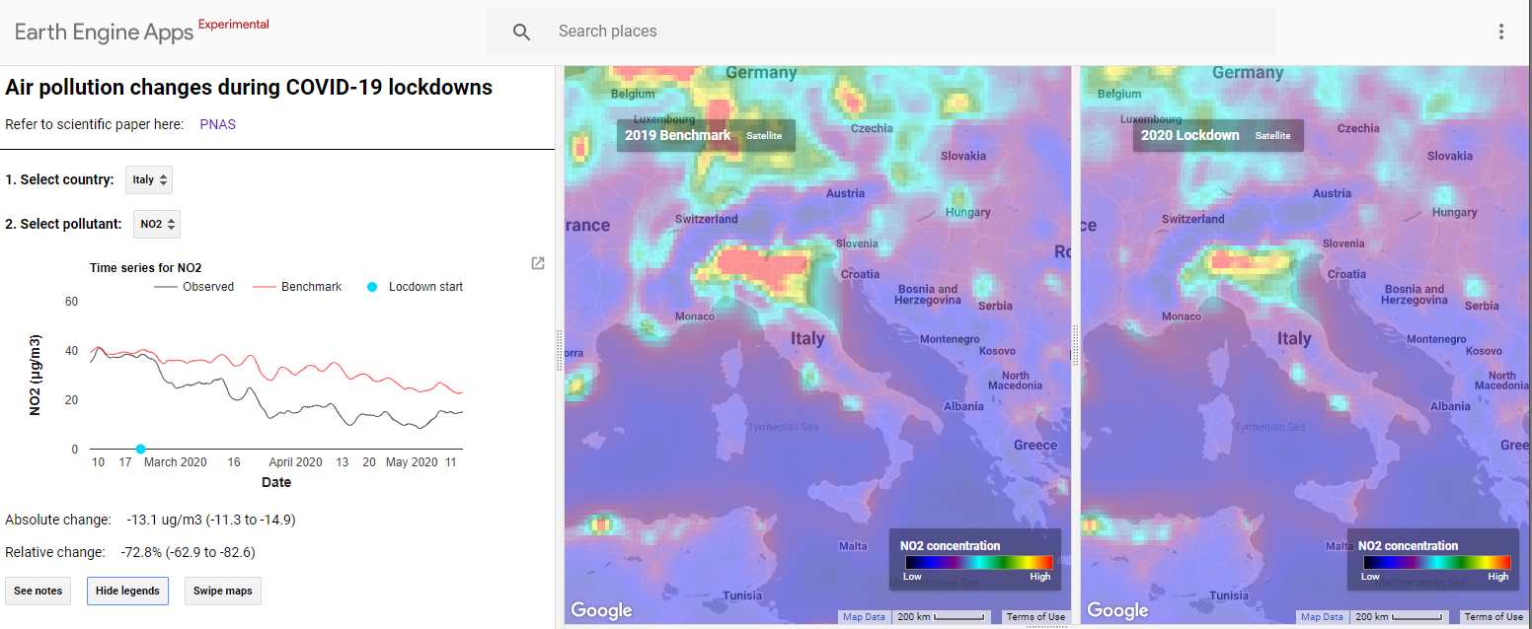
Ground-level air quality impacts
Type and timing of confinement measures affecting emissions
Meteorology
Atmospheric chemistry
Population density
Population-weighted Δ concentration of PM2.5, NO2, and ozone
A giant natural experiment for studying the effects of cutting specific air pollution sources
Notes:
We had a cut-off date of 15 May 2020
Ozone: secondary pollutant; PM2.5 partly so too
In most places, traffic is the main source of NO₂, accounting for 45–50% of emissions of the gas: Copernicus Atmosphere Monitoring Service (CAMS).
Canada: Transportation and mobile equipment was the largest contributor, accounting for 51% (0.9 Mt) of total NOx emissions. Within this source category, heavy-duty diesel vehicles, marine transportation, and off-road diesel vehicles and equipment were the largest emitters, collectively contributing 34% (602 kt) of total NO_{x} emissions. .. From 1990 to 2018, national NO_{x} emissions decreased by 25% (601 kt) (Figure 2–3). A significant driver of this trend was the decrease in emissions from light-duty gasoline trucks and vehicles, as a result of increasingly stringent vehicle regulations. Canada’s Air Pollutant Emissions Inventory Report 2020: chapter 2.3 - Canada.ca

Slide 8
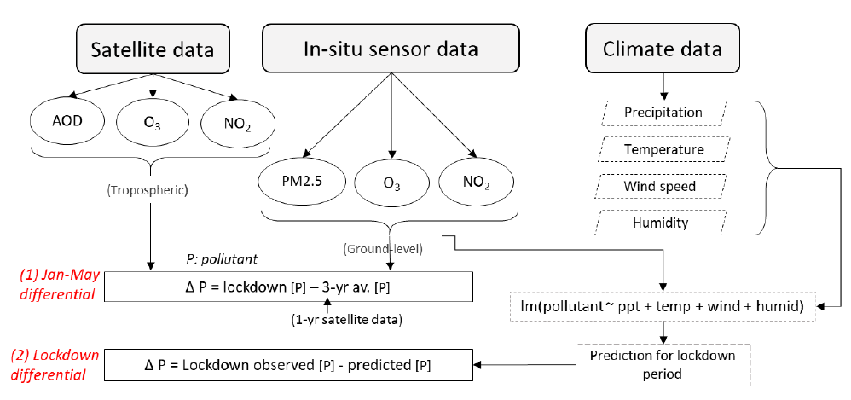
Calculation of air quality anomalies - methods
Jan-May differential: Compare Jan-May 2020 with Jan-May 2019 for satellite data and ground-level data
Lockdown differential for ground-station data: Compare data for the country-specific lock-down periods in 2020 with estimated benchmark (based on 2017-2019 air pollution and meteorological data on same dates). Take into account population to get population-weighted Δ concentration
Notes:
Two types of air pollution anomalies were estimated (will not show satellite data results
Benchmark=predicted concentration at same data given meteorology at the day in 2020. What would the levels have been in 2020 given the actual meteorology during lockdown (had it not been for covid lockdown)
Separate linear regression models for each country and pollutant, where daily pollutant concentrations were regressed on a number of explanatory variables including temperature, humidity, precipitation, wind speed, day of year, day of week, week of year, and month of year.

Slide 9
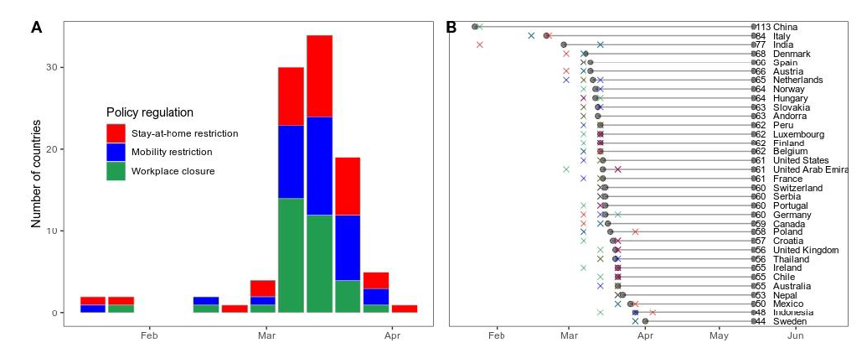
Study period: Average start date of confinement category to May 15th per country

Slide 10
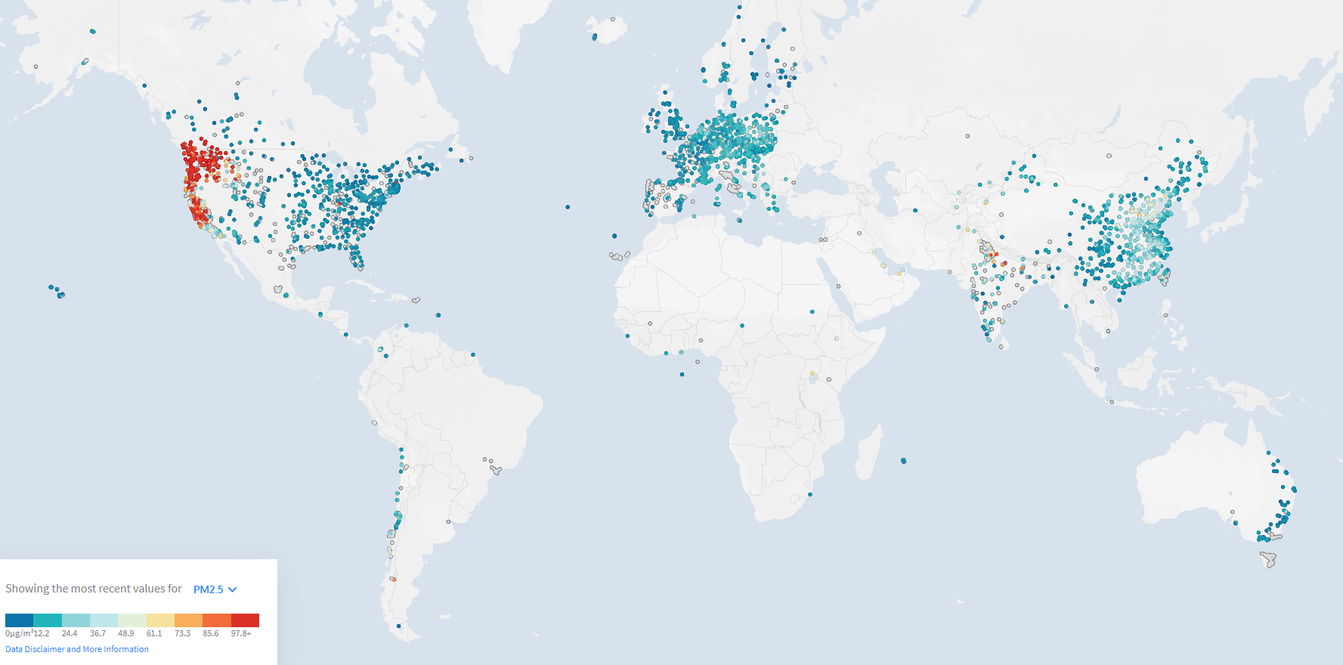
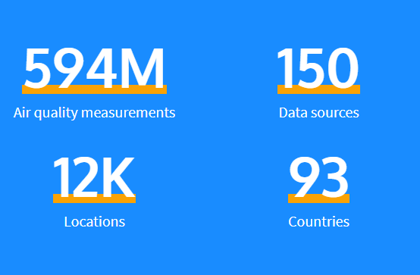
Air quality data from >10,000 ground stations in 34 countries

Slide 11
Jan−May 2020 anomalies of ground-station data (not adjusted for weather variability)
Notes:
averages subtract averages for 3-y baseline levels for the same dates
Without accounting for meteorological variability): Pop-weighted declines: NO2 36% IQR 26%, PM2.5: 31%, IQR 50%; Ozone increase: 105% IQR 77%
Satellite data: Declines in NO2 (15%; IQR: 27%) and increases in O3 (4%; IQR: 6%) relative to 2019 averages. Measures of aerosol optical depth (AOD, a proxy for PM2.5) declined by 4.7% (35% IQR).

Slide 12
Population-weighted pollutant decline/increase relative to benchmark level for 34 countries during lockdown periods (up until 15 May)
NO2: 60% (48 to 72%).
PM2.5: 31% (17 to 45%),
O3: 4% (2 to 10%)
Satellite column measurements over inhabited areas: NO2 decreased by 15% (IQR 27%); aerosol optical depth (AOD) (PM2.5 proxy) decreased by 5% (IQR 35%) and ozone increased by 4% (IQR 6%)
Notes:
Lockdown ground-level air pollution anomalies relative to weather benchmarks for NO2 (A), O3 (B), and PM2.5 (C). The daily population-weighted average (n = 34 countries) ambient pollutant concentrations observed 1 mo before and up to 15 May after lockdowns are plotted in red. Benchmark levels
which represent expected concentrations considering time of year and prevailing weather are plotted in black with 95% CIs.
Raw comparison (without accounting for meteorological variability): Pop-weighted declines: NO2 36% IQR 26%, PM2.5: 31%, IQR 50%
Ozone increase: 105% IQR 77%
tropospheric pollutant concentrations may be significantly diluted
relative to ground-level concentrations, due to mixing and transport
in mesoscale weather systems. This is particularly likely because the
satellite data have not been adjusted for confounding meteorological
effects. For instance, elevated AOD may be a product of
long-distance aerosol transport and not ground-level sources of
PM2.5 (11). The same is true for satellite-measured O3, which is
strongly influenced by its generally increasing abundance above the
boundary layer, especially during winter.
Ground-stations: Much more data for China and Europe

Slide 13
Countrywise changes (%) for 34 countries during lockdown periods (up until 15 May)
-58% (-31%, -84%)
-5% (-1%, -10%)
-27% (-12%, -42%)
Notes:
Country-specific ground-level lockdown air pollution anomalies. The difference between observed (obs.) lockdown ambient pollutant concentrations and those predicted by the weather benchmark model (trained on 2017–2019 data) are plotted for 34 countries (points) with 95% CIs (error bars).
Larger points represent regression models with greater R2 values.
Canada 58% decrease NO2; O3 5% decrease; PM2.5 27% decrease

Slide 14
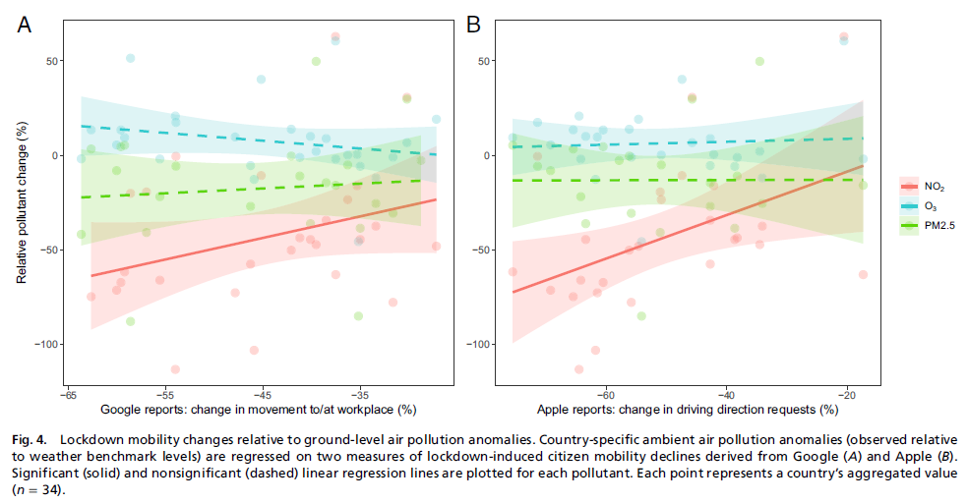
Clear link between transport sector activity and ambient NO2
Notes:
Quite clear for NO2

Slide 15
All other factors unchanged, health benefits of air pollution reductions 50.000 (11’–90’) premature deaths avoided 89.000 (65’–107’) pediatric asthma ERV avoided
~3% of pre-covid annual air pollution deaths avoided
~1% of pre-covid annual air pollution deaths avoided
(Venter, Z. S., Aunan, K., Chowdhury, S., Lelieveld, J. (2021). Air pollution declines during COVID-19 lockdowns mitigate the global health burden. Environ Res, 192).
Notes:
Increased ozone levels counteracts the avoided health burden from PM and NO2 reductions.
Net India: 33.000 avoided deaths (~3% of pre-covid annual air pollution deaths)
Net China: 15.000 avoided deaths (~1% of pre-covid annual)
Globally: 0.7% of ann deaths avoided; ca 2% of ERVs avoided.
Ozone: China: VOC-limited regime; India: NOx-limited regime
NB logaritmic scale;

Slide 16
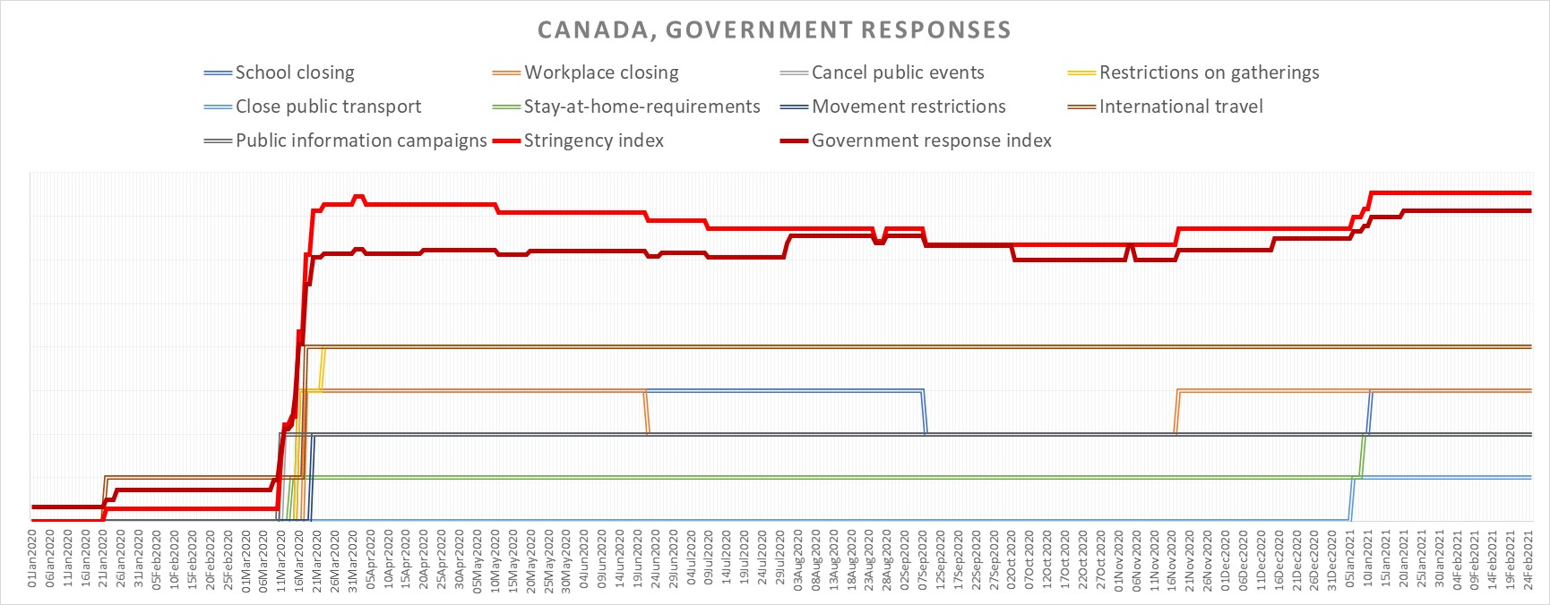
Canada: Government responses
Oxford Covid-19 Government Response Tracker https://github.com/OxCGRT/covid-policy-tracker
Notes:
Oxford Covid-19 Government Response Tracker (OxCGRT) GitHub - OxCGRT/covid-policy-tracker: Systematic dataset of Covid-19 policy, from Oxford University
https://github.com/OxCGRT/covid-policy-tracker

Slide 17
2.8% reduction in surface transport CO2 emissions
11.2 % reduction in surface transport CO2 emissions at peak reduction (April 2020)
Global Carbon Project: Coronavirus causes ‘record fall’ in fossil-fuel emissions in 2020 | Carbon Brief
Notes:
https://www.carbonbrief.org/global-carbon-project-coronavirus-causes-record-fall-in-fossil-fuel-emissions-in-2020
It discounts other factors, such as natural variability, the temperature-induced change in heating demand and the effect of economic stimulus packages that have already begun.

Slide 18
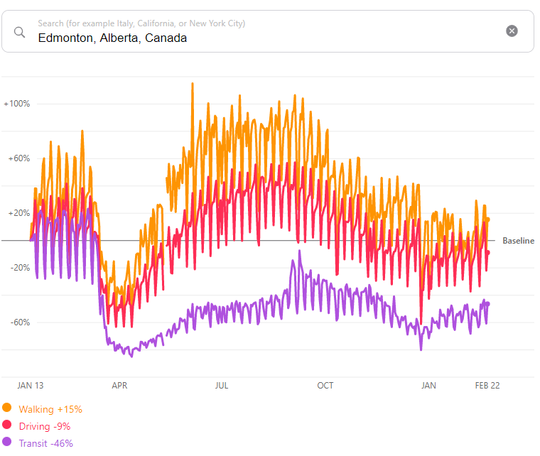
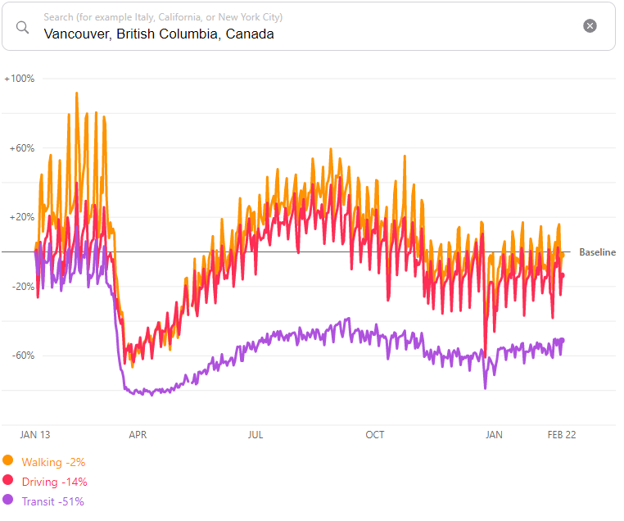
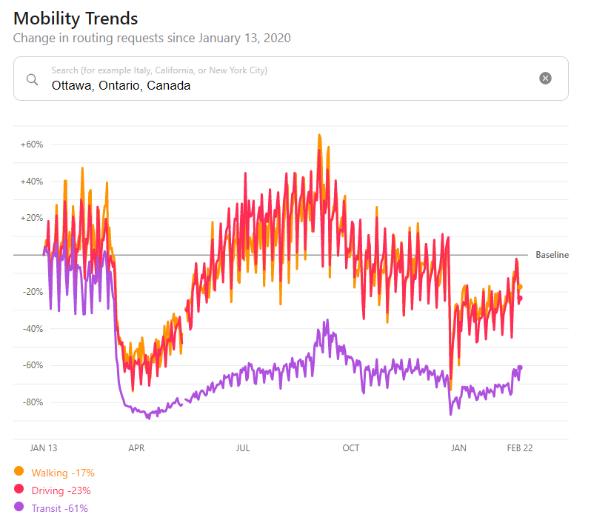
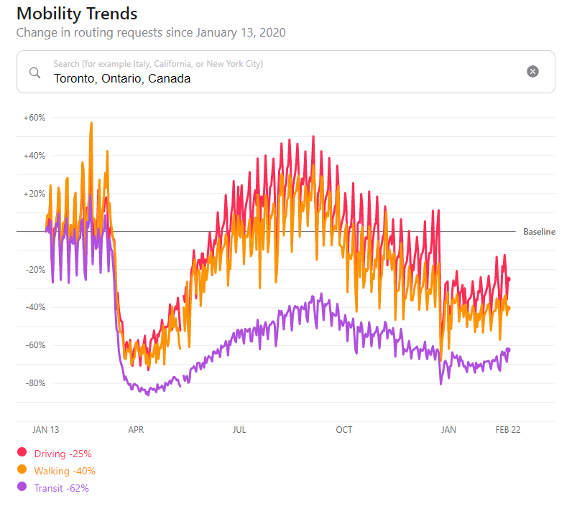
Mobility trends in 3 Canadian cities 2020 (Change in routing requests since Jan 2020)

Slide 19
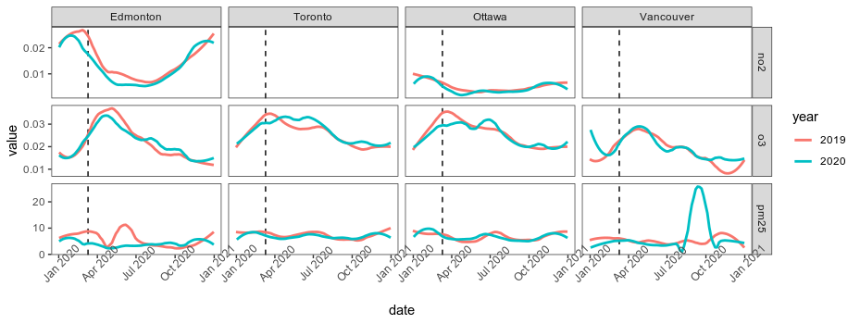
Comparison 2019 vs 2020 (NB no meteorological benchmarking!)
Notes:
Ppm for NO2 and O3; microgr/m3 for PM2.5

Slide 20
Conclusion
We found overall substantial reductions in ambient levels of NO2 and PM2.5; slight increases in surface ozone
Our study provides justification for local and national initiatives to get rid of polluting transportation systems
Long-term exposure levels need to go down to obtain large and lasting health benefits – short-term dips only bring small benefits and lockdowns obviously not sustainable
Will any of the behavioral changes that have reduced air pollution emissions be maintained or will things get back to how it was, or even worse in terms of emissions?
Notes:
Venter, Z. S., Aunan, K., Chowdhury, S., & Lelieveld, J. (2020). COVID-19 lockdowns cause global air pollution declines. Proc Natl Acad Sci U S A. doi:10.1073/pnas.2006853117
Venter, Z. S., Aunan, K., Chowdhury, S., & Lelieveld, J. (2021). Air pollution declines during COVID-19 lockdowns mitigate the global health burden. Environ Res, 192, 110403. doi:https://doi.org/10.1016/j.envres.2020.110403

Slide 21
Thank you !
Kristin.aunan@cicero.oslo.no
Explore data interactively:lockdown-pollution (earthengine.app https://nina.earthengine.app/view/lockdown-pollution

